Slide 1
Antenatal care module
*obesity and pregnancy
* ANC nice guidline
nutrition during pregnancy
Amniocentesis and cvs
Tocolytic ttt in pregnancy*
Antenatal magnesiumsulphate action
PPROM
Antenatal corticosteroid
ANTI-D IMMUNOGLOBULINE

Slide 2
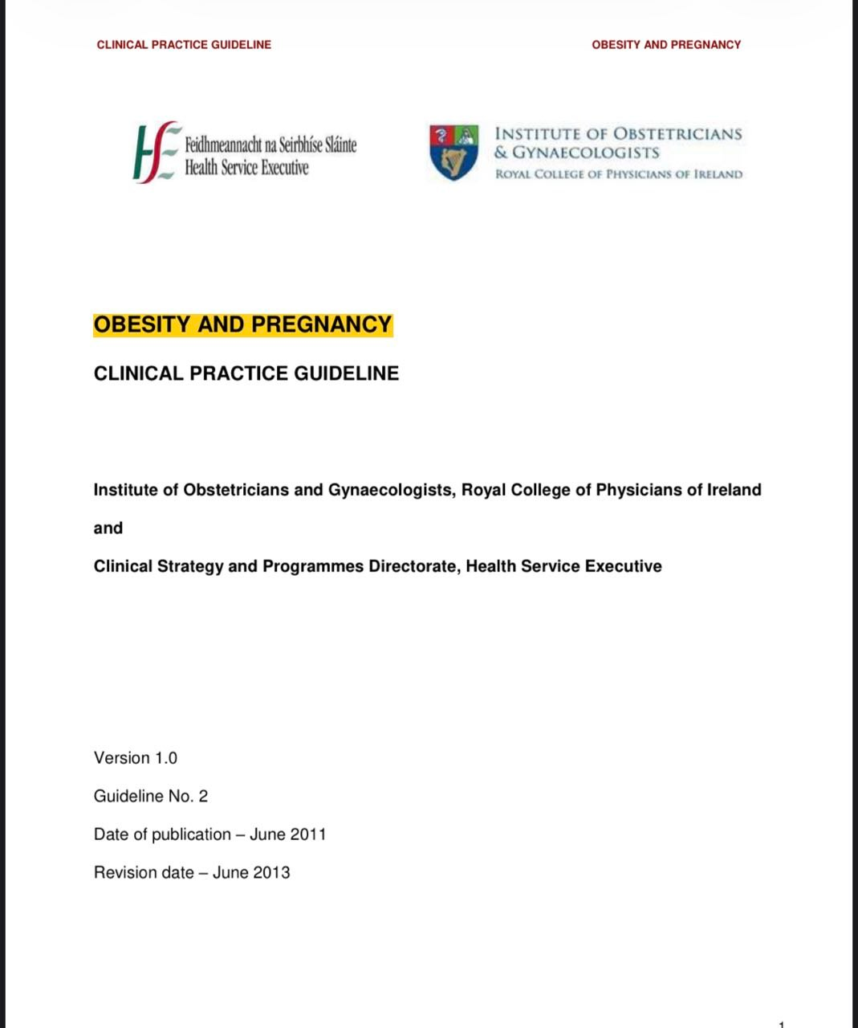
OBESITY AND PREGNANCY

Slide 3
KEY RECOMMENDATIONS
1. The label of obesity may be upsetting for many pregnant women. Care and communications need to be conducted in a sensitive and respectful manner.
2. Women who are obese should be advised to lose weight before becoming pregnant.
3. Obese women should take high dose folic acid supplementation periconceptionally to reduce the risk of congenital malformations such as Neural Tube Defects (NTDs).
4. All pregnant women should have their weight and height measured accurately at their first antenatal visit. Their Body Mass Index (BMI) should be calculated and entered in the obstetric records.
5. Obese women should have their mid-arm circumference (MAC) measured at their first antenatal visit. If the MAC is > 33cms, a large cuff should be used to measure their blood pressure.

Slide 4
6.Women with a BMI > 29.9 kg/m2 should have an oral Glucose Tolerance Test to screen for gestational diabetes mellitus at 24 to 28 completed weeks gestation.
7. Obese women undergoing caesarean section should be given routine antibiotic prophylaxis and thromboprophylaxis. All obese women who are immobilised antepartum or postpartum should receive thromboprophylaxis. Thromboprophylaxis dosage should be based on maternal weight, not BMI, at her first antenatal visit. Early mobilisation of obese women postpartum should be encouraged to prevent venous thromboembolism.

Slide 5
Contineue recommendation
8. Intravenous access, if required, should be established early in labour in women with moderate to severe obesity.
9. Obese women should receive extra support to help them initiate and continue breastfeeding.
10. Provided there are no obstetric or medical contradictions, obese women should be encouraged to keep exercising during and after pregnancy.
11. An audit should be conducted in each maternity unit to determine whether the facilities and equipment are suitable for the care of morbidly obese women

Slide 6
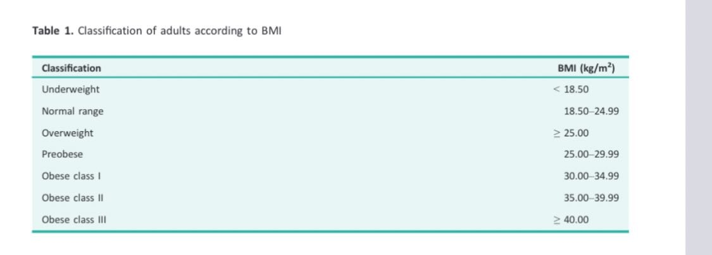

Slide 7
gtg
Obese women are at high risk of vitamin D deficiency. However, although vitamin D supplementation may ensure that women are vitamin D replete, the evidence on whether routine vitamin D should be given to improve maternal and offspring outcomes remains uncertain.
Some women with a booking BMI less than 40 kg/m2 or greater may also benefit from assessment of moving and handling requirements in the third trimester.
For women with obesity in pregnancy, consideration should be given to reweighing women during the third trimester to allow appropriate plans to be made for equipment and personnel required during labour and birth.
There is a lack of consensus on optimal gestational weight gain. Until further evidence is available, a focus on a healthy diet may be more applicable than prescribed weight gain targets.

Slide 8
gtg
Anti-obesity or weight loss drugs are not recommended for use in pregnancy
Clinicians should be aware that women with class II obesity and greater have an increased risk C of pre-eclampsia compared with those with a normal BMI
Women with more than one moderate risk factor (BMI of 35 kg/m2 or greater, first pregnancy, maternal age of more than 40 years, family history of pre-eclampsia and multiple pregnancy) may benefit from taking 150 mg aspirin daily from 12 weeks of gestation until birth of the baby.

Slide 9
gtg
Women with BMI 30 kg/m2 or greater are at increased risk of mental health problems and should therefore be screened for these in pregnancy. D There is insufficient evidence to recommend a specific lifestyle intervention to prevent depression and anxiety in obese pregnant women .
Women with a BMI greater than 35 kg/m2 are more likely to have inaccurate SFH measurements and should be referred for serial assessment of fetal size using ultrasound .

Slide 10
gtg
Elective induction of labour at term in obese women may reduce the chance of caesarean birth without increasing the risk of adverse outcomes
A minimum waiting period of 12–18 months after bariatric surgery is recommended before attempting pregnancy to allow stabilisation of body weight and to allow the correct identification and treatment of any possible nutritional deficiencies that may not be evident during the first months.

Slide 11
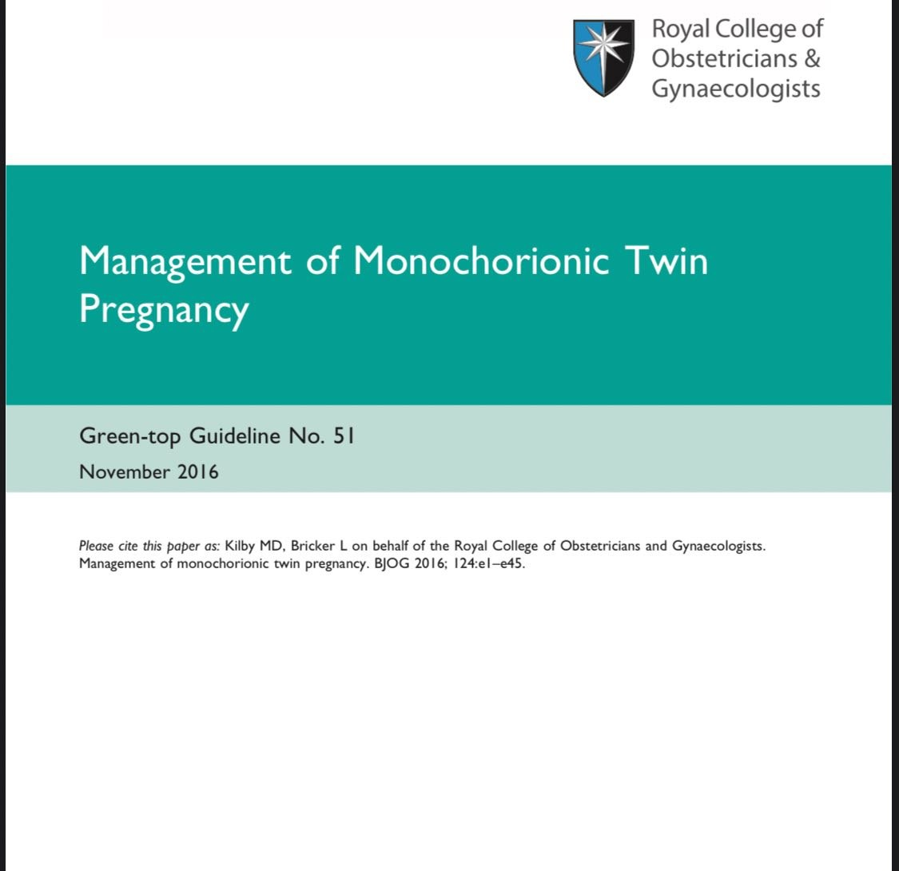

Slide 12
All women with a twin pregnancy should be offered an ultrasound examination between 11+0 weeks and 13+6 weeks of gestation (crown–rump length 45–84 mm) to assess fetal viability, gestational age and chorionicity, and to exclude major congenital malformations
Chorionicity should be determined at the time the twin pregnancy is detected by ultrasound based upon the number of placental masses, the appearance of the membrane attachment to the placenta and the membrane thickness.
If there is uncertainty about the diagnosis of chorionicity, a photographic record of the ultrasound appearance of the membrane attachment to the placenta should be retained and a second opinion should be sought.

Slide 13
If there is still doubt in the diagnosis of chorionicity, the woman should be referred to a specialist without delay.
Clinicians and women should be aware that monochorionic twin pregnancies have higher fetal loss rates than dichorionic twin pregnancies, mainly due to second trimester loss and, overall, may have a higher risk of associated neurodevelopmental morbidity. This should form part of the parental counselling.

Slide 14
Women with monochorionic twins who wish to have aneuploidy screening should be offered nuchal translucency measurements in conjunction with first trimester serum markers (combined
screening test) at 11+0 weeks to 13+6 weeks of gestation (crown–rump length 45–84 mm)
In women with monochorionic twin pregnancies who ‘miss’ or who have unsuccessful first trimester screening for aneuploidy, second trimester screening by the quadruple test should be offered.

Slide 15
All monochorionic twins should undergo a routine detailed ultrasound scan between 18 and 20+6 weeks of gestation which includes extended views of the fetal heart anatomy .
Fetal ultrasound assessment should take place every 2 weeks in uncomplicated monochorionic pregnancies from 16+0 weeks onwards until delivery .

Slide 16
At every ultrasound examination, liquor volume in each of the amniotic sacs should be assessed and a deepest vertical pocket (DVP) depth measured and recorded, as well as the umbilical artery pulsatility index (UAPI). Fetal bladders should also be visualised. Although first presentation of twin-to-twin transfusion syndrome (TTTS) is rare after 26+0 weeks of gestation, it can occur and therefore, scans should be performed at 2-weekly intervals in uncomplicated monochorionic twins until delivery .

Slide 17
Screening for TTTS by first trimester nuchal translucency measurements should not be offered.
TAPS should be screened for following fetoscopic laser ablation for TTTS and in other complicated monochorionic pregnancies requiring referral to a fetal medicine centre (such as those complicated by sGR) by serial middle cerebral artery peak systolic velocity (MCA PSV)

Slide 18
Screening for sGR
At each scan from 20 weeks of gestation (at 2-weekly intervals) onwards, calculate EFW discordance using two or more biometric parameters.
An EFW discordance of more than 20% is associated with an increase in perinatal risk .
At diagnosis, TTTS should be staged using the Quintero system

Slide 19
MX OF TTTS
TTTS should be managed in conjunction with fetal medicine centres with recourse to specialist expertise and treatment in supraregional centres.
TTTS presenting before 26 weeks of gestation should be treated by fetoscopic laser ablation rather than amnioreduction or septostomy ).
Delivery
Delivery of monochorionic twin pregnancies previously complicated by TTTS and treated should be between 34+0 and 36+6 weeks of gestation

Slide 20
Type of SGR and delivery
In type I sGR, planned delivery should be considered by 34–36 weeks of gestation if there is satisfactory fetal growth velocity and normal umbilical artery Doppler waveforms.
In type II and III sGR, delivery should be planned by 32 weeks of gestation, unless fetal growth velocity is significantly abnormal or there is worsening of the fetal Doppler assessment.

Slide 21
The management of sGR
sGR in monochorionic twins requires evaluation in a fetal medicine centre with expertise in the management of such pregnancies .
In cases of early-onset sGR in association with poor fetal growth velocity and abnormal umbilical artery Doppler assessments, selective reduction may be considered an option .

Slide 22
After a single fetal death in a monochorionic pregnancy, clinicians should be aware that the risks to the surviving twin of death or neurological abnormality are of the order of 15% and 26%, respectively.
Single fetal death in a monochorionic pregnancy should be referred and assessed in a fetal medicine centre, with multidisciplinary expertise to manage these cases.
Fetal magnetic resonance imaging of the brain may be performed 4 weeks after co-twin demise to detect neurological morbidity if this information would be of value in planning management.

Slide 23
Monochorionic monoamniotic (MCMA) pregnancies
MCMA twins almost always have umbilical cord entanglement when visualised using colour flow Doppler.
MCMA twins have a high risk of fetal death and should be delivered by caesarean section between D 32+0 and 34+0 weeks

Slide 24
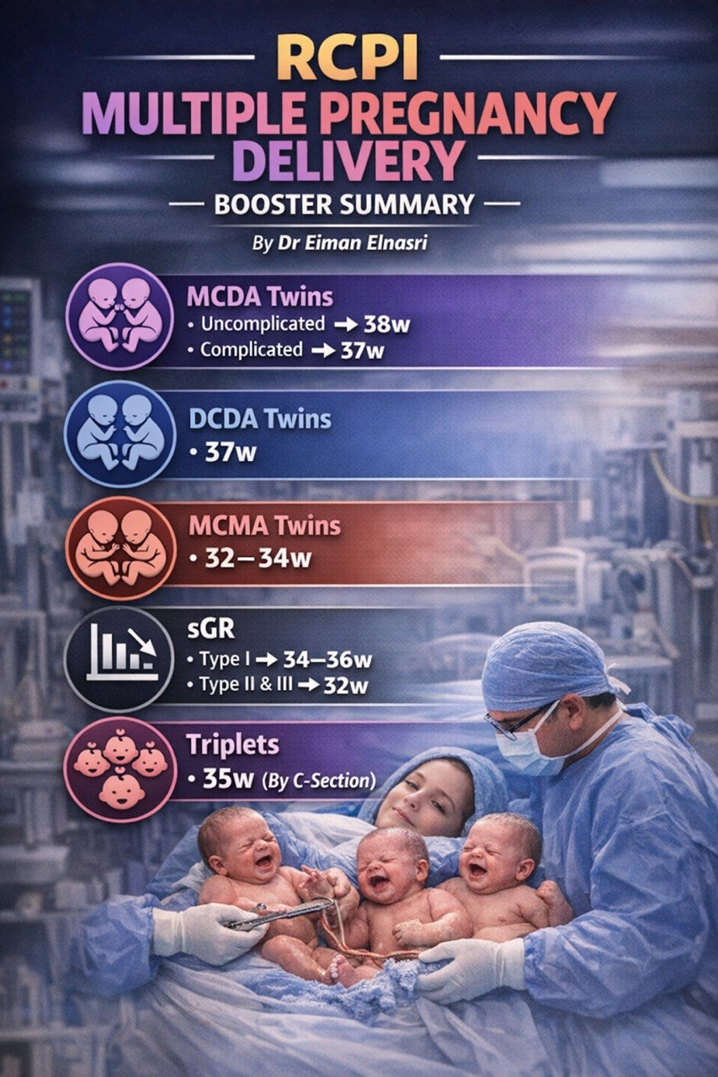

Slide 25
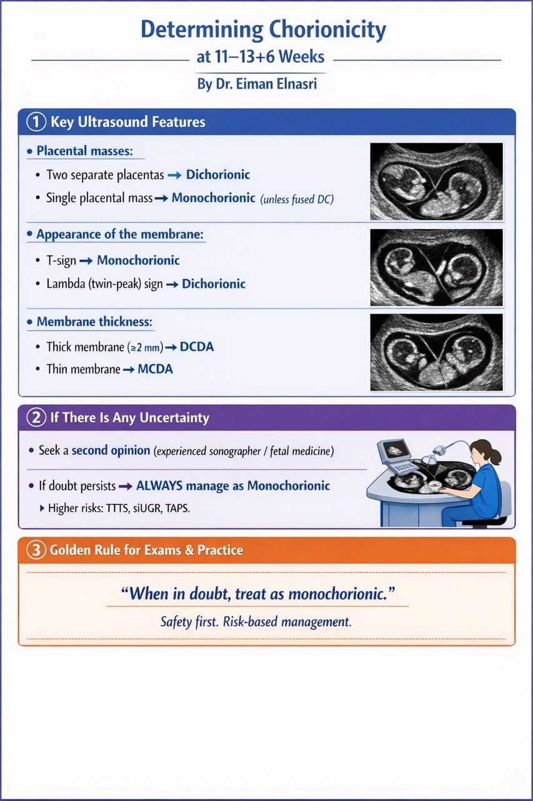

Slide 26
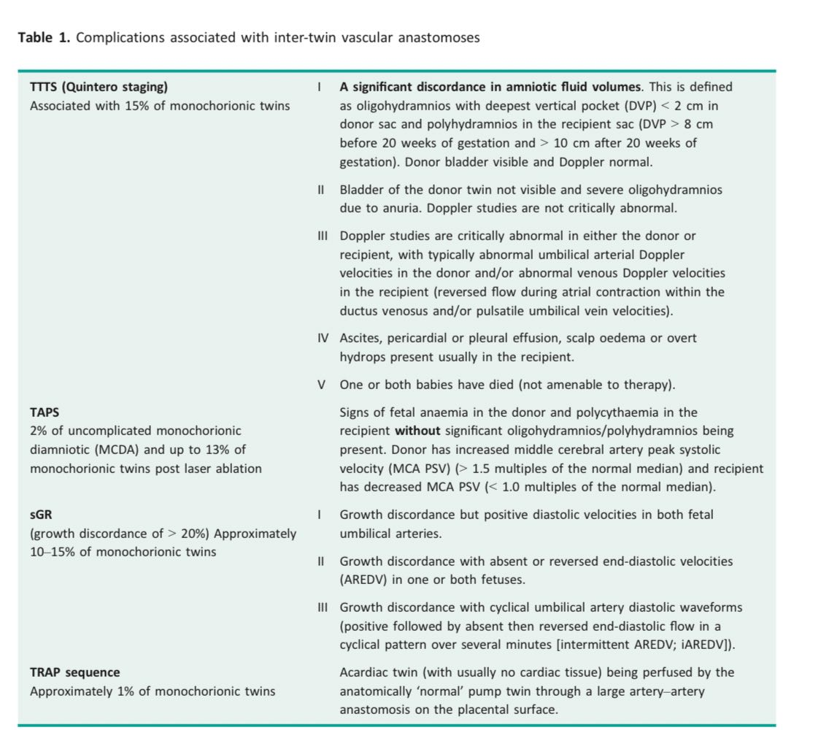

Slide 27
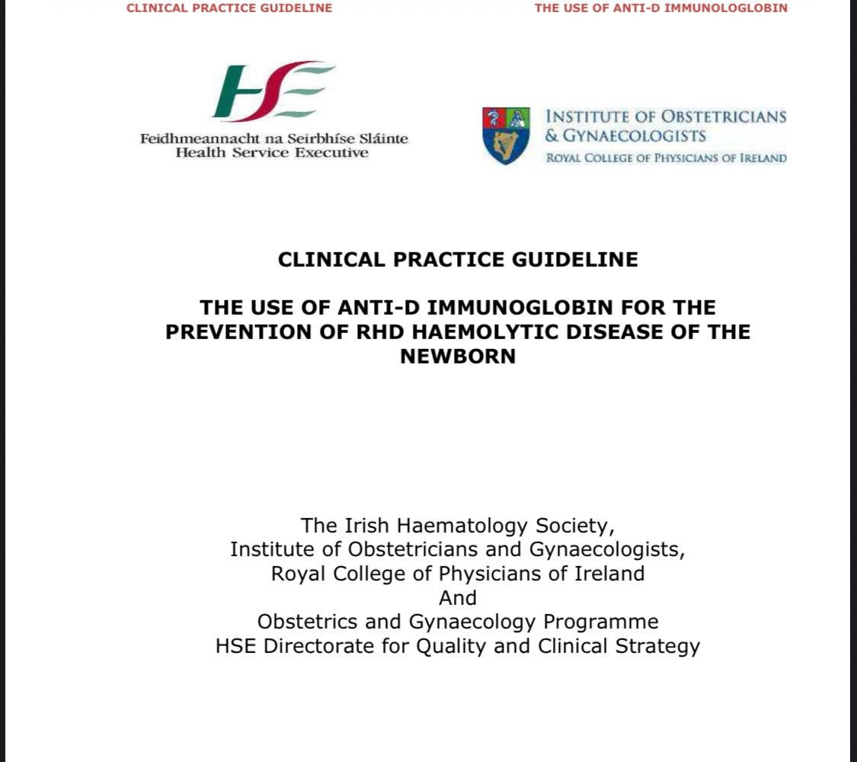

Slide 28
Key Recommendations
1. The RhD negative status of all RhD negative women presenting in pregnancy should be clearly identified in her maternity record and the requirement for Anti D Ig administration included in her pregnancy care plan.
2. Consideration should be given to the provision of hand-held cards (RhD neg cards) to the woman at booking once identified as being RhD negative.
3. Each hospital where anti-D Ig is used should have an up-to-date standard operating procedure for anti-D administration. This procedure should cover the indications and criteria for anti-D Ig, checking of laboratory results before administration, details of dose and administration, patient consent, verification checks before administration and documentation of anti-D Ig.

Slide 29
Verbal or written informed consent should be obtained prior to administration of Anti-D Ig
The details of the administration of anti-D must be recorded in the antenatal record.
The woman should remain in the hospital for approximately 20 minutes after the administration, in case of an anaphylactic reaction

Slide 30
BACKGROUND
haemolytic disease of the newborn (HDN) was a significant cause of perinatal mortality and morbidity due to the development of anti-D antibodies secondary to feto-maternal haemorrhage (FMH) occurring in RhD negative women carrying an RhD positive fetus.
The introduction of post-natal immunoprophylaxis and prophylaxis for other sensitising events with anti-D Ig (immunoglobulin) has significantly reduced the deaths due to RhD alloimmunisation and significantly reduced the incidence of seroconversion with anti-D antibodies among RhD negative women

Slide 31
Anti-D Ig Preparations available in the Republic of Ireland
Rhesonativ: is available as 625iu and 1250iu vials and is licensed for intramuscular injection only.
Rhophylac: is available as a 1500iu pre-filled syringe. It can be administered either intravenously or intramuscularly.

Slide 32
BY DR EIMAN ELNASRI
Anti-D Ig should only be given to women who are not already sensitised or have immune anti-D in their serum. It cannot reverse the immune response once sensitisation has occurred.

Slide 33
Prophylaxis following fetal loss or threatened miscarriage
before 12 weeks
after 12 weeks
Anti-D is not required if a spontaneous miscarriage occurs.
Threatened miscarriage
Anti-D Ig should be given to all non-sensitised RhD negative women who have a spontaneous complete or incomplete abortion.
Threatened miscarriage, intermittently after 12 weeks‟ gestation, anti-D Ig should be repeated at 6-weekly intervals.

Slide 34
Ectopic pregnancy
Anti-D Ig should be given to all non-sensitised RhD negative women who have a diagnosis of ectopic pregnancy.

Slide 35
RECURRENT BLEEDING AFTER 12 WKS
RECURRENT V BLEEDING AFTER 20 WEEKS +FMH TEST
RhD negative women should be given Anti-D Ig (625iu) at 6 weekly intervals if there is recurrent PV bleeding between 12 and 20 weeks.
Anti-D Ig 1000-1500iu should be given for vaginal bleeding after 20 weeks and repeated at 6 weekly intervals if bleeding is recurrent
FMH
repeated at 2 weekly intervals if recurrent bleeding

Slide 36
Recommendations for Routine Antenatal Prophylaxis
RAADP should be offered to all non-sensitized RhD negative women at 28 weeks gestation as a one-dose regimen. (1500iu).
Recommendations for Postnatal Prophylaxis
*At delivery a cord blood sample should be taken from all non-sensitised RhD negative women to determine the ABO group and RhD type of the infant
* If the infant is RhD positive (in the absence of routine FMH testing) at least 1250iu of anti-D Ig should be given to every non-sensitised RhD negative woman as soon as possible and within 72 hours of delivery.
*It may not be possible to obtain an RhD type of the fetus following an intrauterine death or in the event of delivery of a macerated fetus. In this instance Anti-D Ig should be given to the mother and a Kleihauer test should be performed to exclude a large spontaneous FMH.

Slide 37
Management of anti-D Prophylaxis following the postnatal detection of a large fetomaternal bleed
*f the Kleihauer test shows a large FMH, you must give additional Anti‑D as soon as possible, ideally within 72 hours after birth.
There are two dosing systems depending on the product:
• Intramuscular Anti‑D (RCOG/BCSH guidance):
Give 125 IU for every 1 ml of fetal red cells detected.
• Intravenous Anti‑D (Rhophylac – used in Ireland):
Give 100 IU for every 1 ml of fetal red cells.

Slide 38
WHEN TO SWITCH FROM IM TO IV
If the bleed is more than 24 ml, the total dose will be too large for intramuscular injections.
So they recommend switching to intravenous Anti‑D.
Maximum in 24 hours: 100,000 IU
• Maximum single IV dose: 4,500 IU
(If the woman needs more than 4,500 IU, give the rest in 12‑hour intervals.)

Slide 39
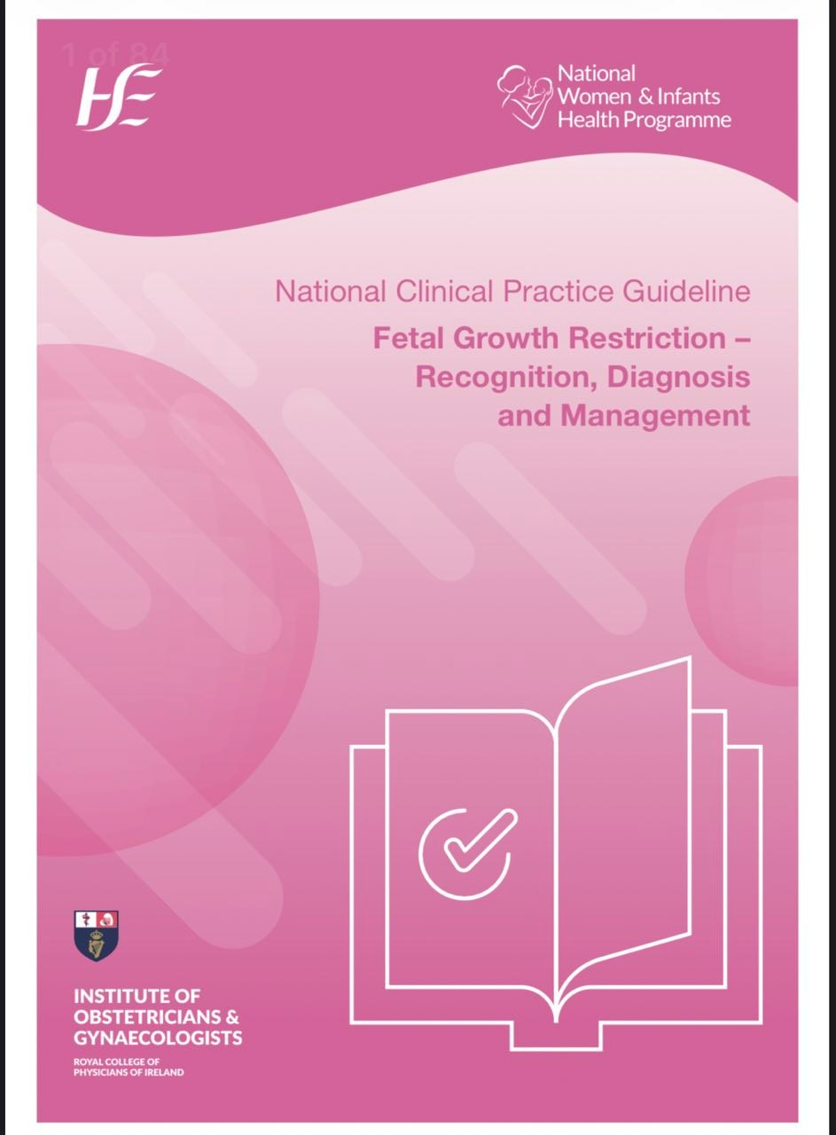

Slide 40
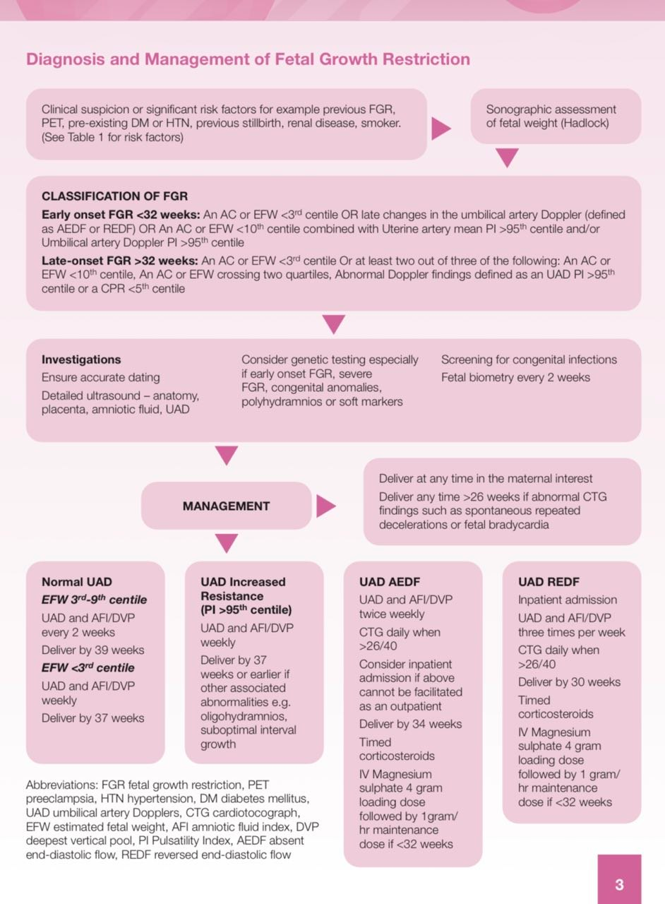

Slide 41
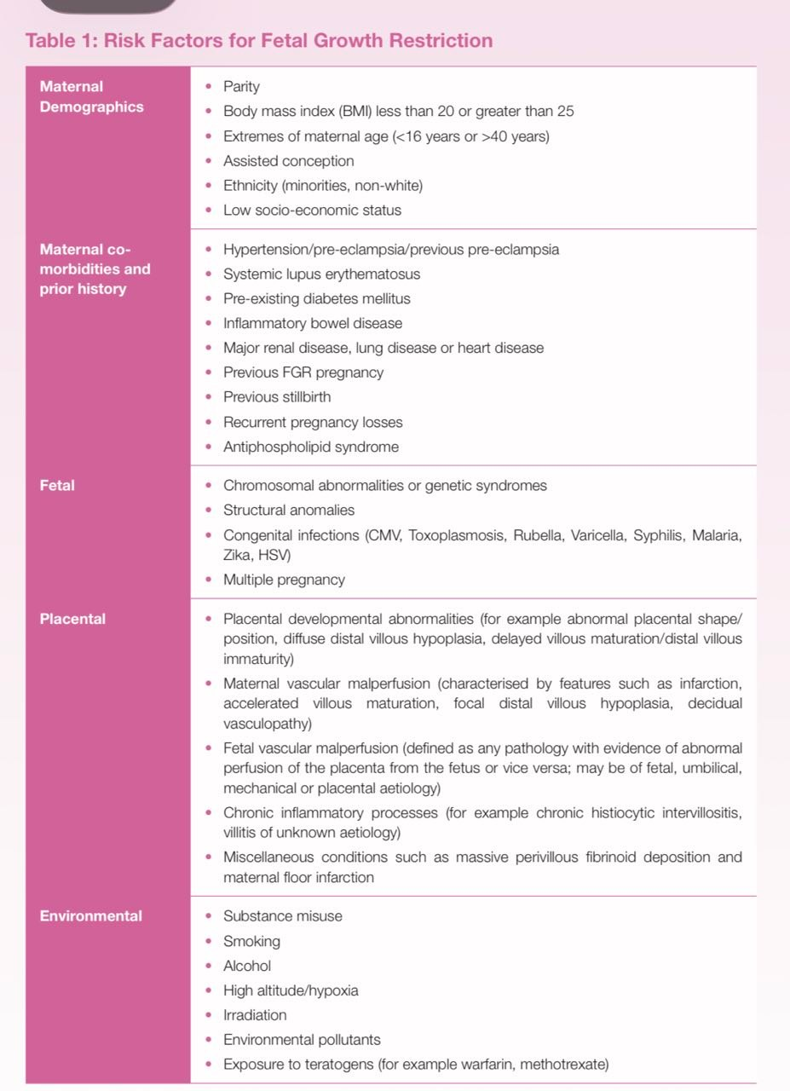

Slide 42
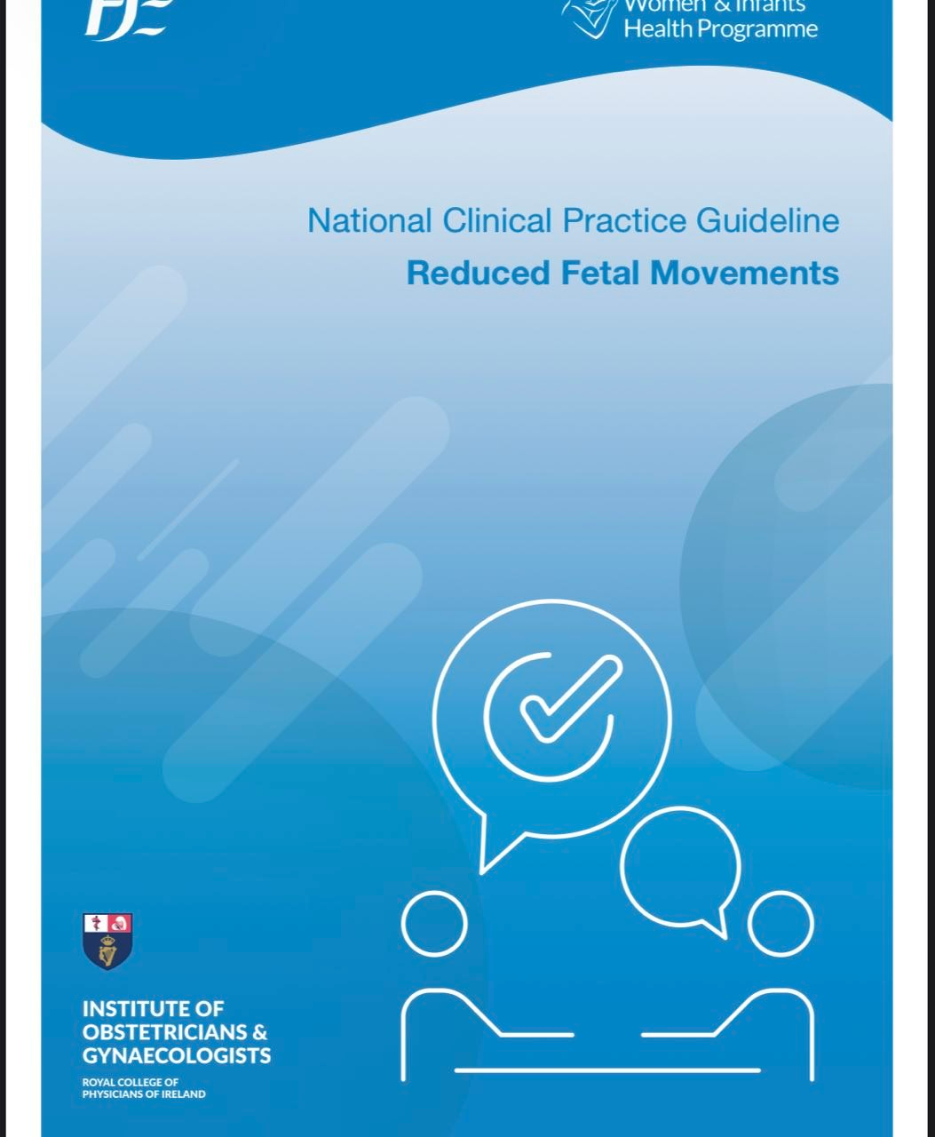

Slide 43
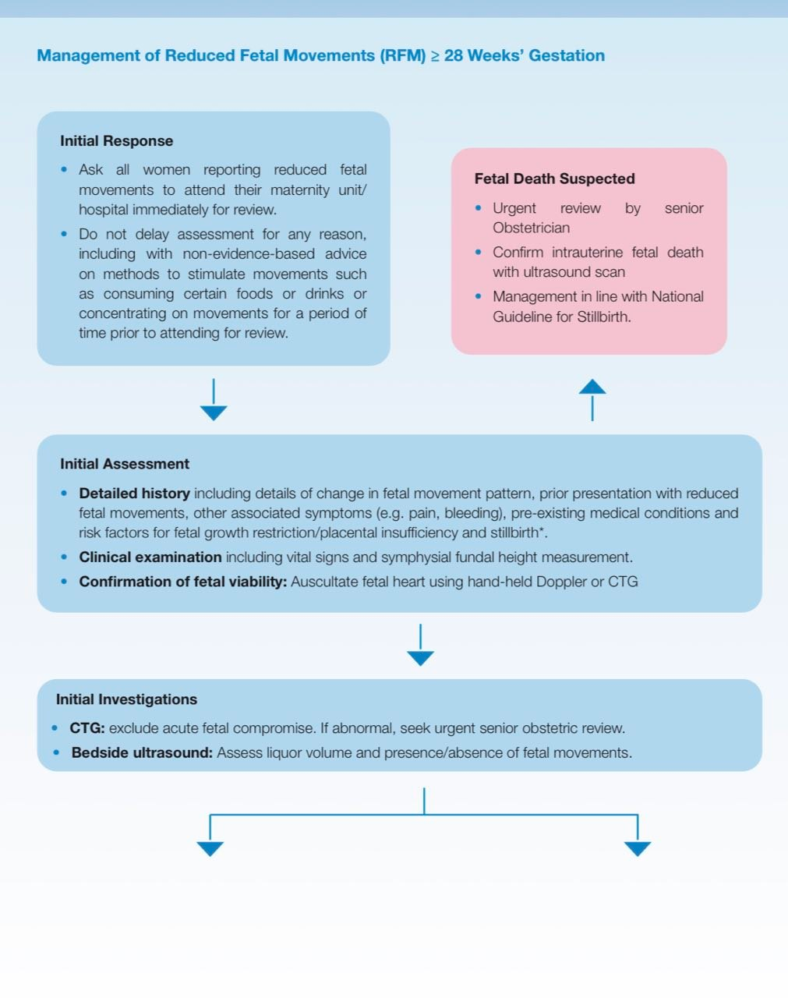

Slide 44
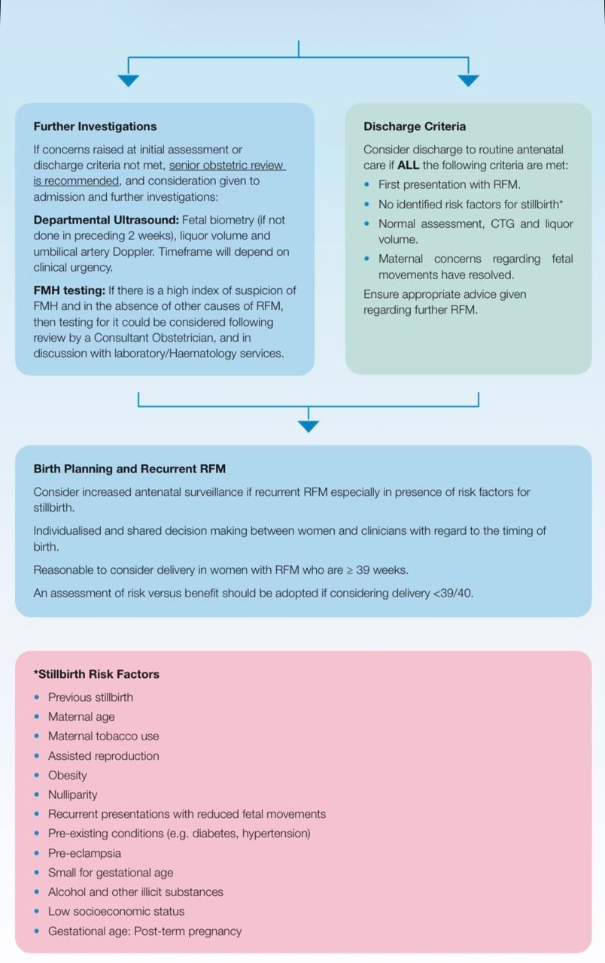

Slide 45
RED CELL ANTIBODY GTG GUIDELINE

Slide 46
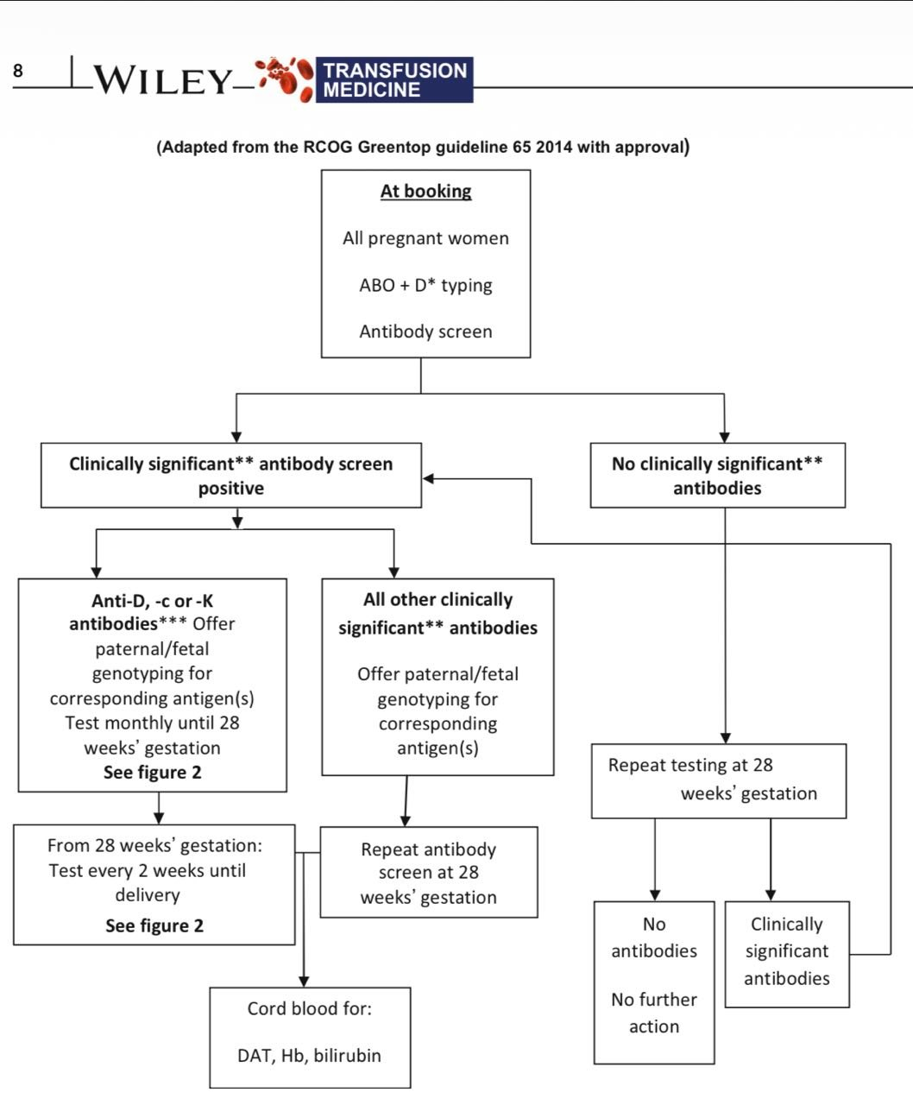
Rred cell antibodies in pregnancy

Slide 47
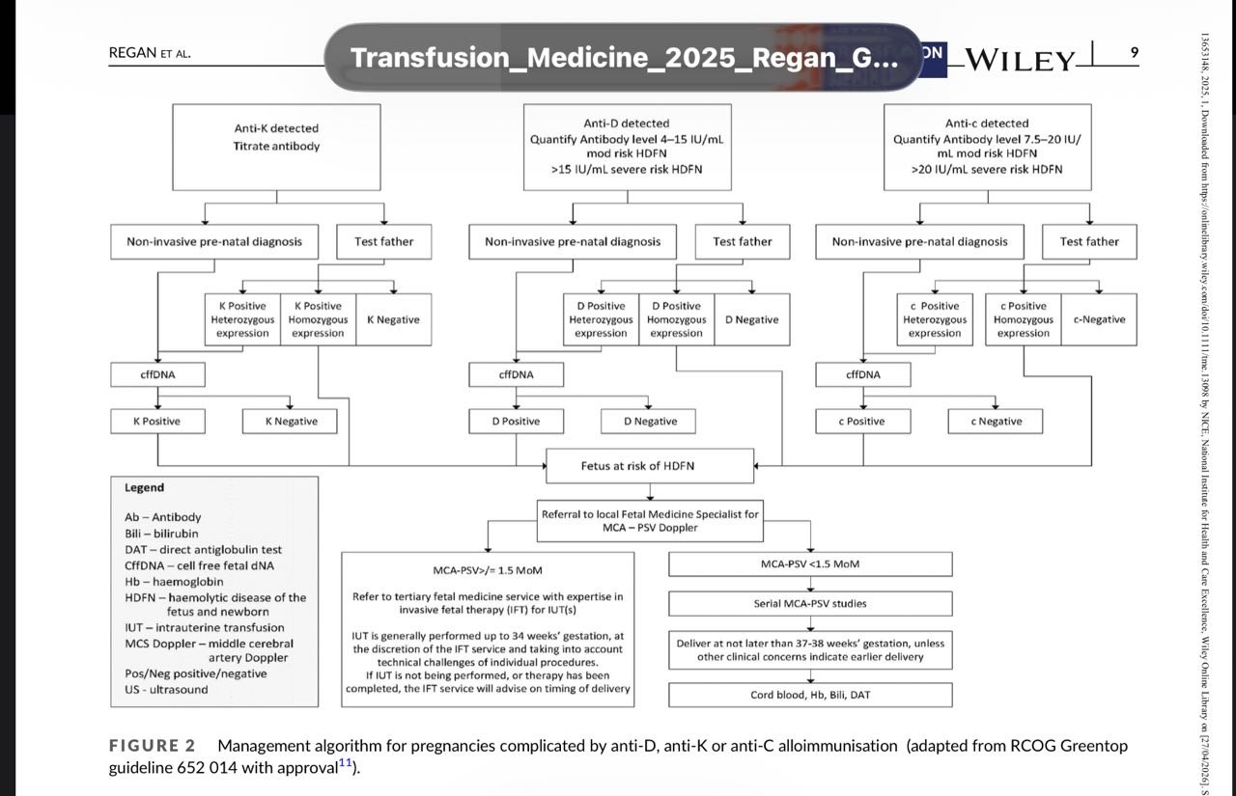

Slide 48
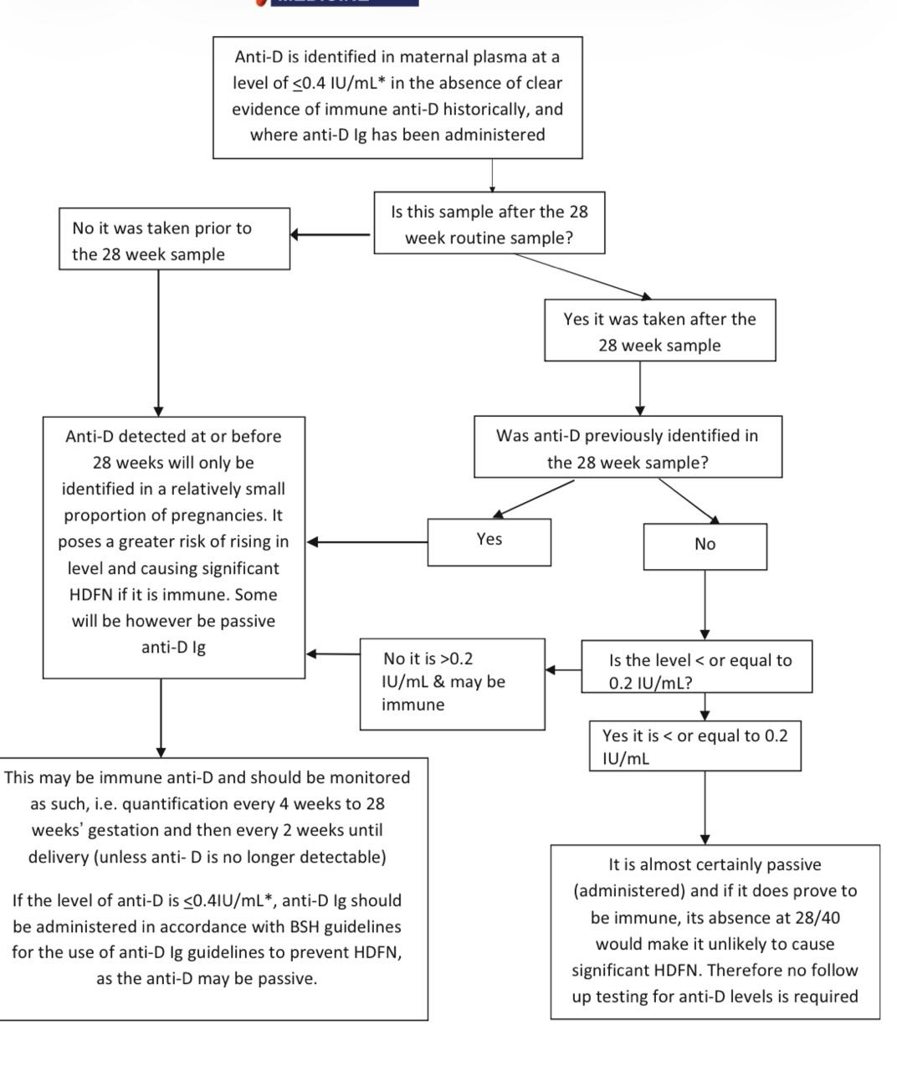

Slide 49
Purpose of the guideline
To provide evidence base informations recommend :
Blood grouping and antibody testing in pregnancy.
Prediction, prevention, and management of HDFN haemolytic disease of the fetus and newborn.

Slide 50
Key principles
All pregnant women must be ABO/D typed and antibody screened at booking and at 28 weeks.
• Clinically significant antibodies include anti‑D, anti‑c, anti‑K, and others capable of causing HDFN.
• Management depends on antibody specificity, concentration, and fetal antigen status.

Slide 51
Routine Antenatal Testing
At 10 weeks:
All pregnant women should be ABO and D typed and screened… at booking.”
28 weeks:
• Repeat ABO/D + antibody screen
• Must be before RAADP in D‑negative women
• If no clinically significant antibodies at 28 weeks → no further routine testing.

Slide 52
Clinically Significant Antibodies
Anti‑D, anti‑c and anti‑K are the antibodies most often implicated in causing severe HDFN.
Other significant antibodies:
• Anti‑E, anti‑C, anti‑Fya, anti‑Jka, anti‑S, anti‑s, et

Slide 53
Follow‑up Frequency
Anti‑D, anti‑c, anti‑K
• Test monthly until 28 weeks, then every 2 weeks until delivery.
Other clinically significant antibodies
Test at 28 we, then every 2 weeks until delivery.

Slide 54
Antibody Measurement
Quantification (IU/mL)
• Only for anti‑D and anti‑c
“Anti‑D and anti‑c are the only antibodies currently quantified.”

Slide 55
Critical Levels for Referral to Fetal Medicine
Anti‑D
• >4 IU/mL → moderate risk>>>>Refer to FMU
• >15 IU/mL → severe risk TO FMH
Anti‑c
• >7.5 IU/mL → moderate>>>>>>Refer to FMU
• >20 IU/mL → severe risk to FMH

Slide 56
CONTINEU
Anti‑K
• Any detectable level is significant•
. Because anti‑K suppresses erythropoiesis
• Immediate referral regardless of titre

Slide 57
FETAL GENOTYPING)cffDNA)
• Used for RHD, RHCE (c/E), KEL*01 (K)
• False negative rate <1%
• Do not test too early:
• RHD/c/E: ≥16 weeks
• K: ≥20 weeks
“Samples for fetal K genotyping should not be taken before 20 weeks.”

Slide 58
WHEN TO USE cFFDNA
• Clinically significant maternal antibody present
• Father antigen positive or unknown
• History of HDFN
Paternal Testing
Help determine fetal risk
But it is reasonable to omit paternal testing and proceed directly to fetal genotyping

Slide 59
Women with Previous HDFN
• Automatic referral to fetal medicine before 20 weeks, regardless of antibody level or specificity.
Cord Blood Testing
For all clinically significant antibodies:
• DAT
• Hb
• Bilirubin

Slide 60
Rred cell antibodies in pregnancy

Slide 63
[4/27/2026 6:55 PM] Eiman elnasri: 10. Cord Blood Testing
For all clinically significant antibodies:
• DAT
• Hb
• Bilirubin
[4/27/2026 7:47 PM] Eiman elnasri:

Slide 64
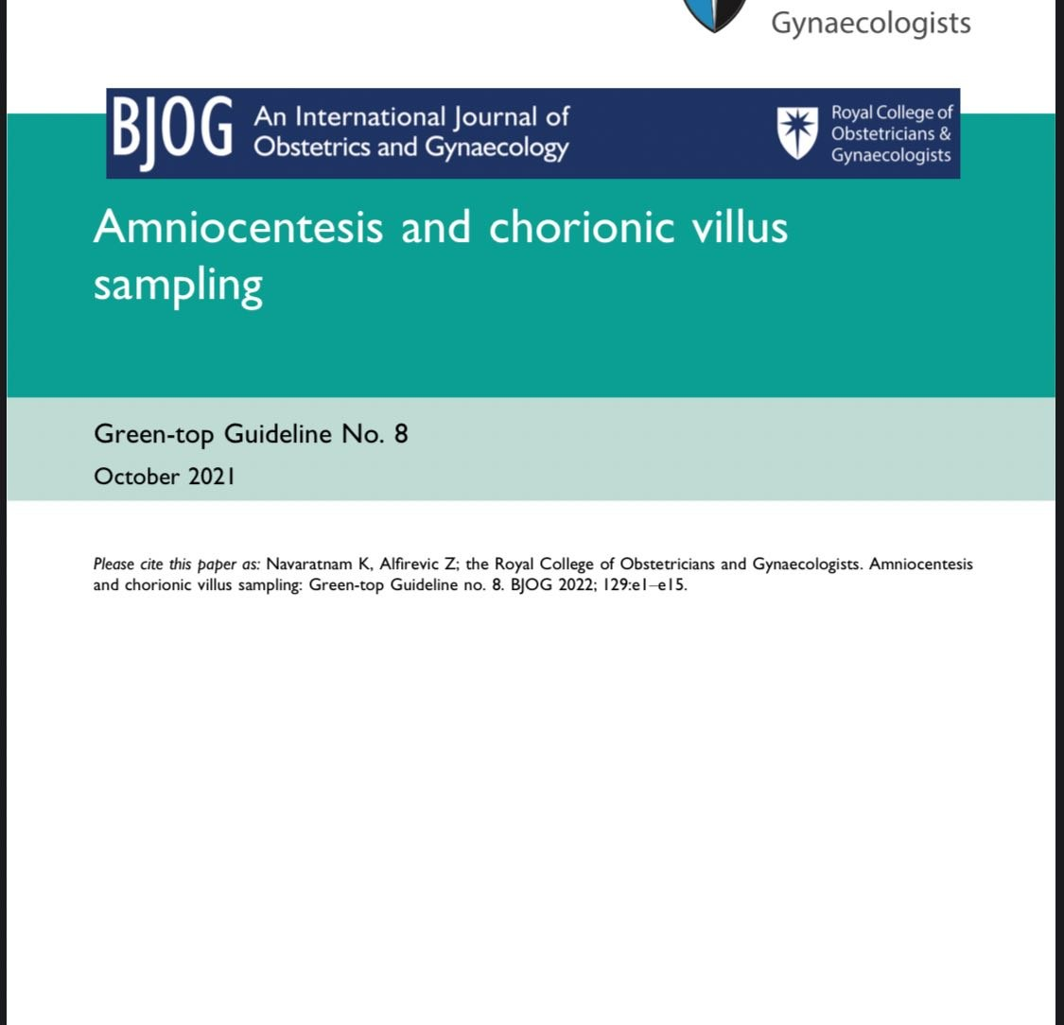

Slide 65
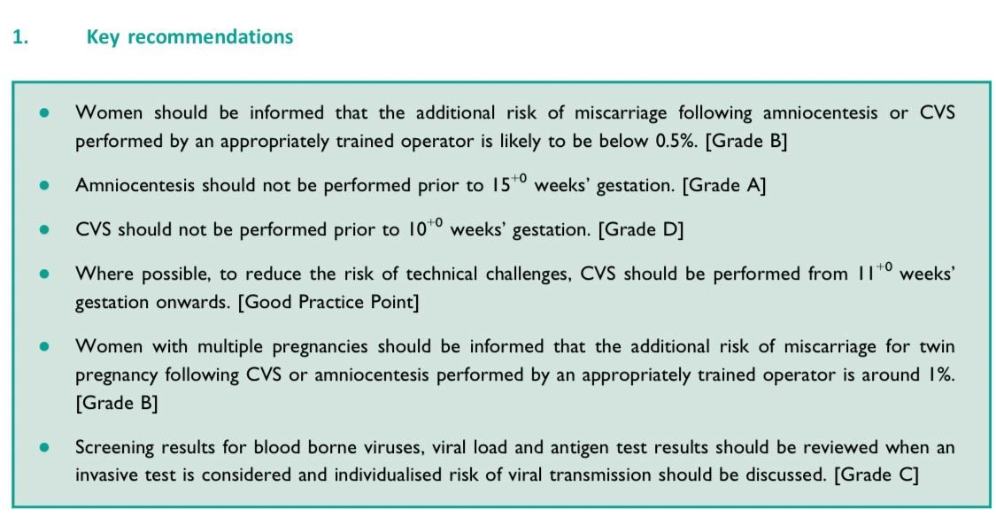

Slide 66
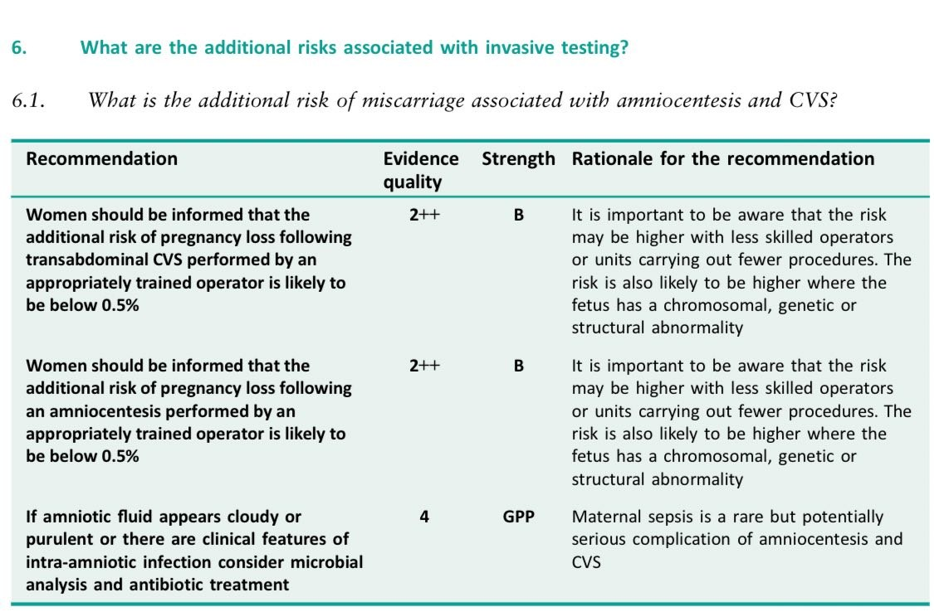

Slide 67
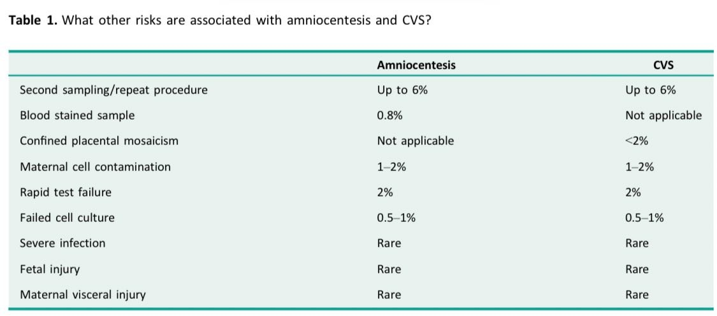

Slide 68
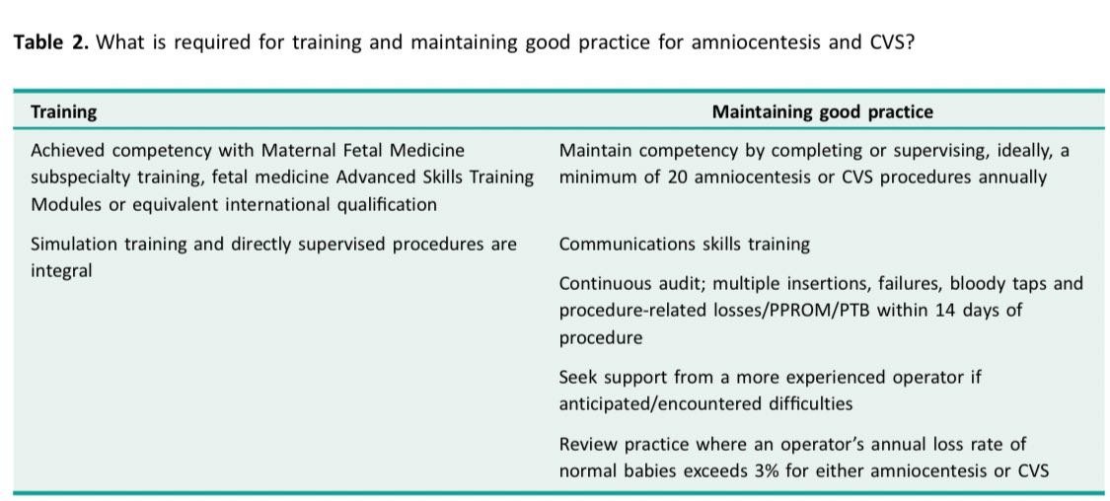

Slide 69
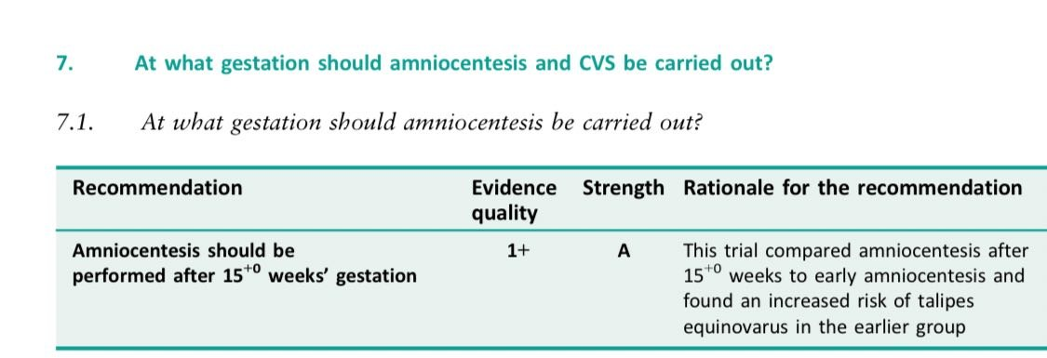

Slide 70
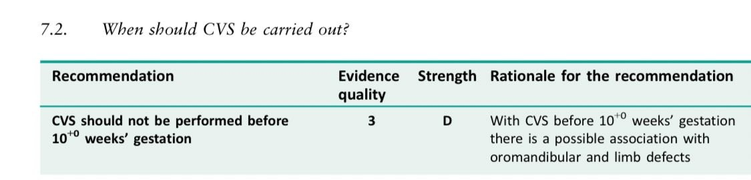

Slide 71
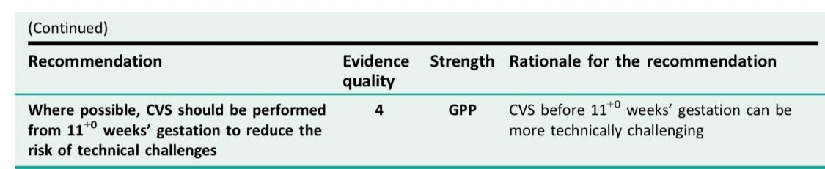

Slide 72
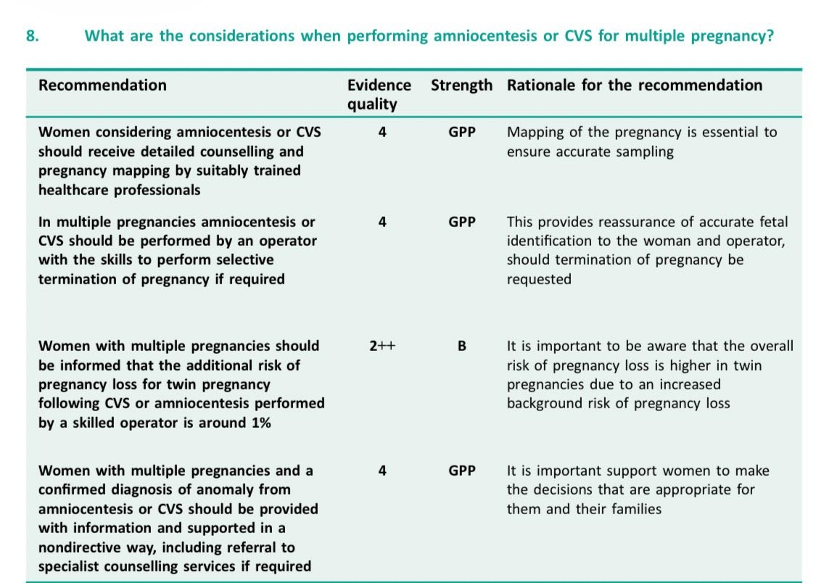

Slide 73
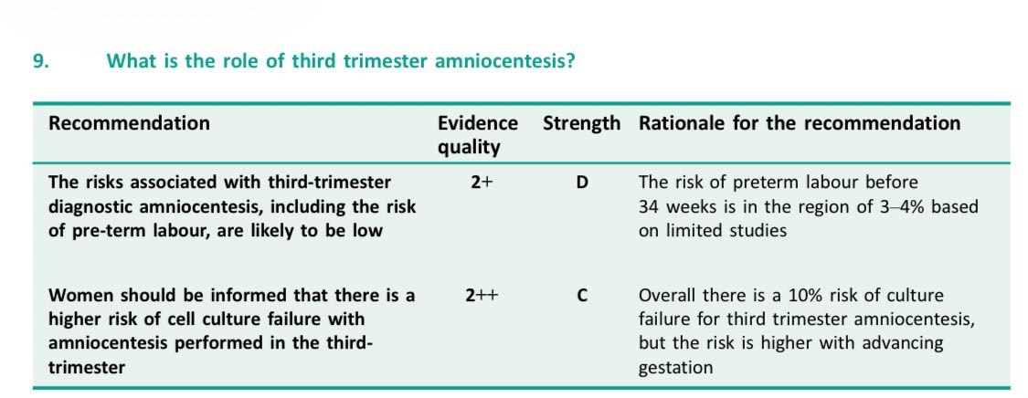

Slide 74
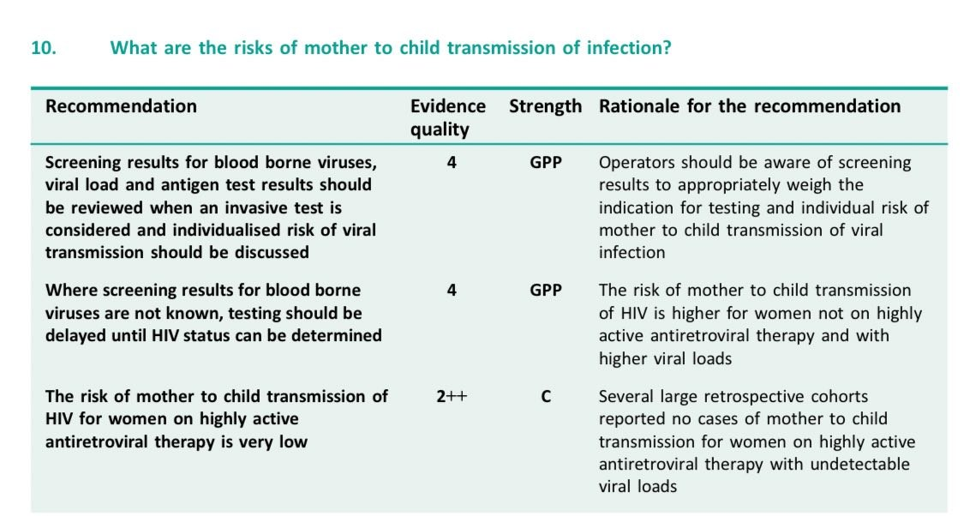

Slide 75
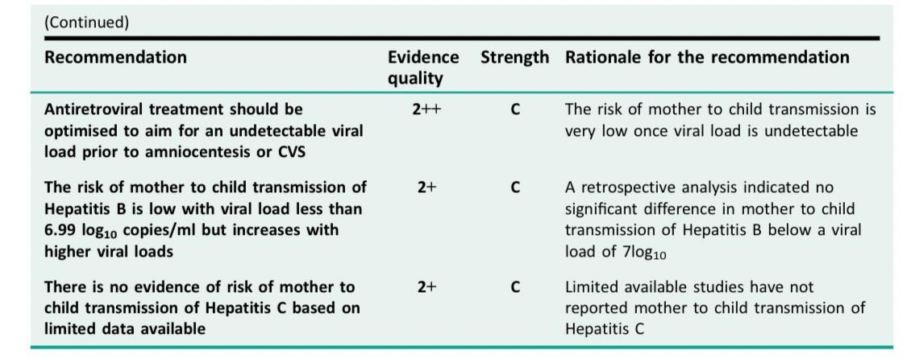

Slide 76
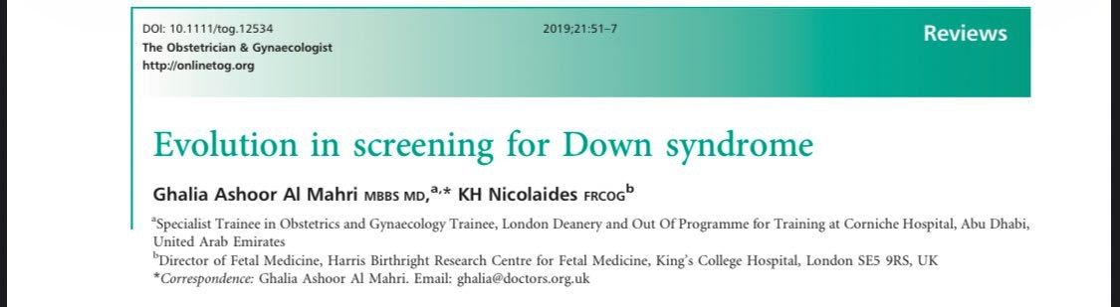

Slide 77
Down’s syndrome, Edwards’ syndrome, and Patau’s syndrome screening
The NHS offers screening to all pregnant women to assess the chance of the baby being born with:
• T21 (Trisomy 21 – Down’s syndrome)
• T18 (Trisomy 18 – Edwards’ syndrome)
• T13 (Trisomy 13 – Patau’s syndrome)
Screening is available for singleton and twin pregnancies.

Slide 78
CONTINEU
If the woman accepts screening, she attends a dating scan and has a blood sample taken.
There are two screening tests, depending on the scan results:
1. Combined test – screens for T21 and/or T18 and T13
2. Quadruple test – screens for T21 only
3.cffDNA-SCREENING TEST
Screening using ultrasound and biochemistry in the first trimester

Slide 79
1. The combined test
The combined test assesses the chance of the baby having trisomy 21 (T21), trisomy 18 (T18) or trisomy 13 (T13) by using:
• maternal age
• biochemical markers: free beta human chorionic gonadotropin (β‑hCG) and pregnancy‑associated plasma protein‑A (PAPP‑A)
• ultrasound measurements: nuchal translucency (NT) and crown–rump length (CRL)
The NT measurement must be used in combination with a maternal blood sample for calculating the chance result. It must not be used alone.

Slide 80
**The eligibility criteria for the combined test is when the CRL is between 45.0mm and 84.0mm.
**If the CRL is less than 45.0mm, the woman is recalled for a further ultrasound scan to measure the NT and remeasure the CRL.
If the CRL is greater than 84.0mm, the gestational age is calculated using the head circumference (HC).
The quadruple test is offered if the criteria is met.
If it is not possible to measure the NT, at least one more attempt is offered (‘twice on the couch’).

Slide 81
**The CRL and NT measurement must be taken on the same day.
****If it is not possible to measure the NT despite ‘twice on the couch’, further attempts do not need to be offered.
The woman must be offered the quadruple teST

Slide 82
The maternal blood sample can be: • taken at the time of the ultrasound scan
• taken before the ultrasound scan (from 10 weeks onwards)
• The laboratory is responsible for the chance calculation software and the chance result.
• Every woman who accepts a pregnancy dating scan needs to be informed that unexpected findings may be identified.
• This must include any woman who declines screening for T21 and/or T18 and T13.
• This may include an NT of greater than or equal to 3.5mm.

Slide 83
CONTINEU
combined test
it was discovered that in fetuses with trisomy 21 there is an increase in the accumulation of subcutaneous fluid behind the fetal neck (nuchal translucency) that can be assessed by ultrasonography at 11–13 weeks of gestation.
It was subsequently found that in trisomy 21 pregnancies at 11–13 weeks, the maternal serum concentration of free bhCG is about twice as high and pregnancy-associated plasma protein A (PAPP-A) is reduced to half compared with euploid pregnancies

Slide 84
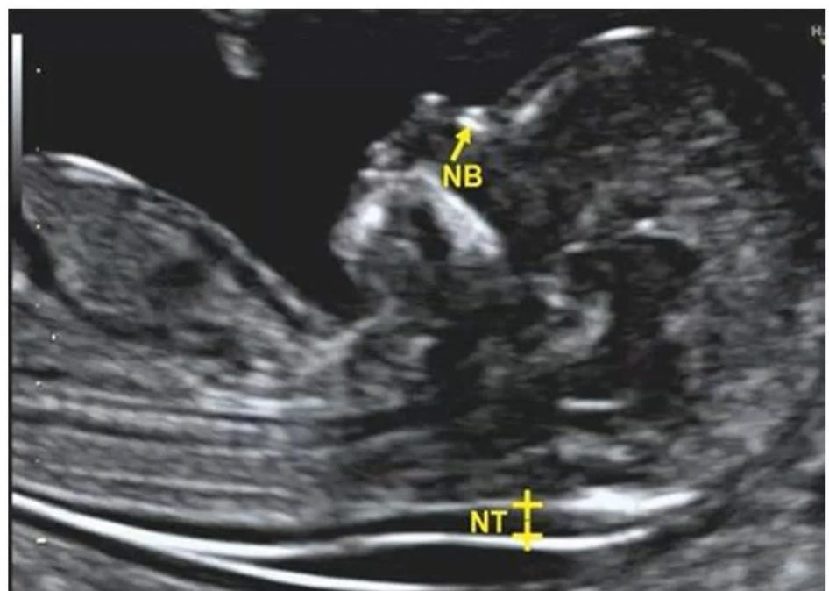

Slide 86
CONTINEU
The quadruple test
The quadruple test screens for T21 only.
The quadruple test is offered when the:
• NT measurement cannot be obtained
• CRL measurement is greater than 84.0mm and the HC measurement is between 101.0mm and 172.0mm
The quadruple test uses maternal age and the following 4 biochemical markers measured from 14+2 to 20+0 weeks:
• alpha-fetoprotein (AFP)
• human chorionic gonadotropin (hCG) or free bhCG
• inhibin-A
• unconjugated oestriol (uE3

Slide 87
classification of the final chance result into the lower or higher chance category with the chance cut‑off used, for example 1 in 150 at term.
Combined test in twin pregnancies
The test of choice for twin pregnancies is the combined test.
Every effort must be made to offer and complete this test.
The larger of the 2 CRL measurements should be used in the chance result calculation.
Quadruple test in twin pregnancies
The quadruple test is offered to a woman with a twin pregnancy to screen for T21 only when one or both of the:
• NT measurements cannot be obtained
• CRL measurements are greater than 84.0 mm
The larger of the 2 HC measurements should be used in the chance result calculation

Slide 88
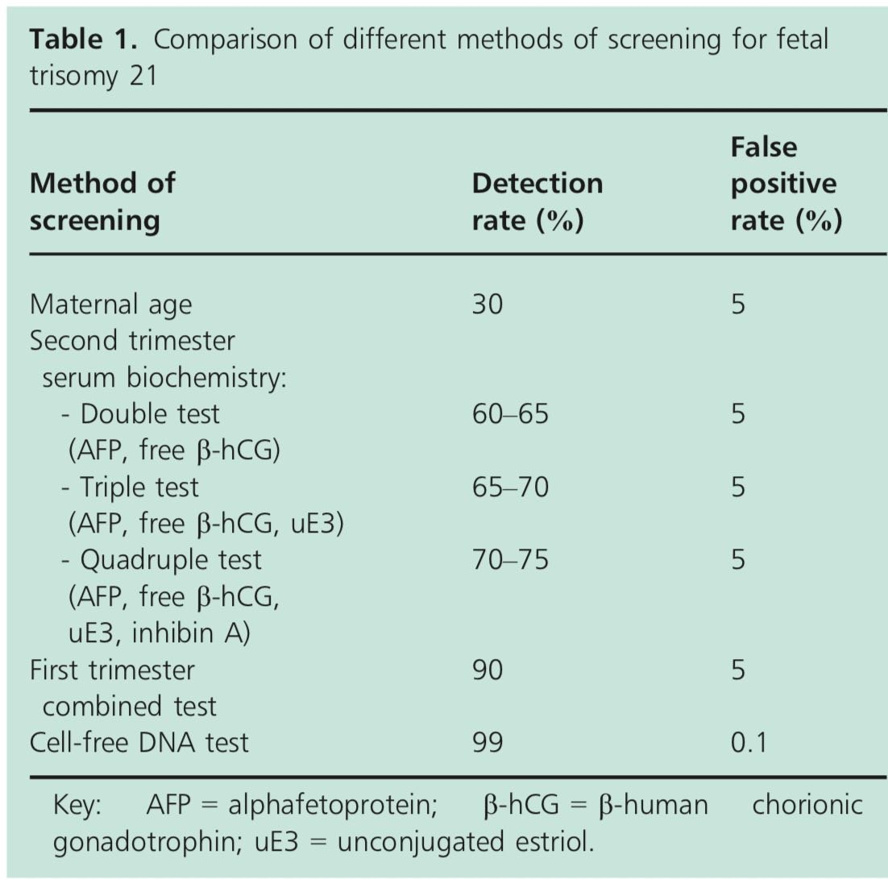

Slide 89
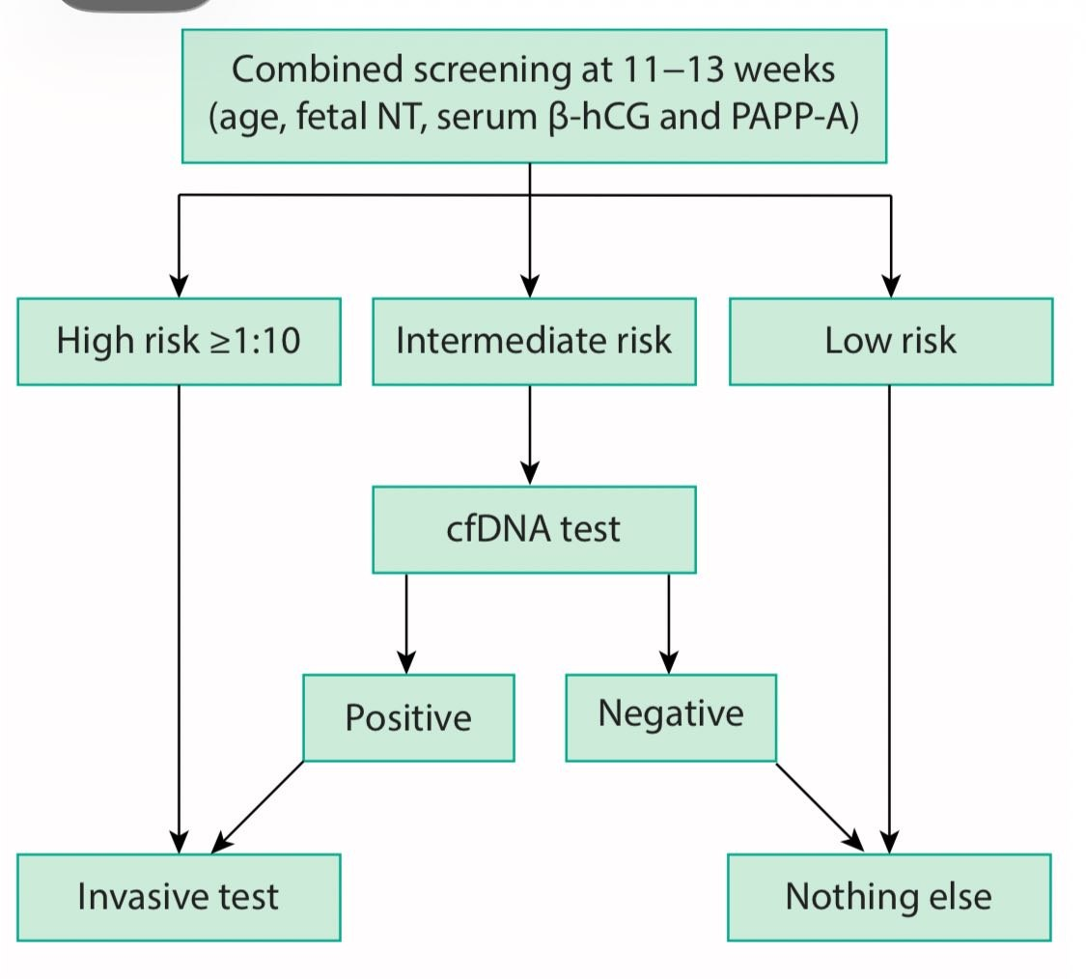

Slide 90
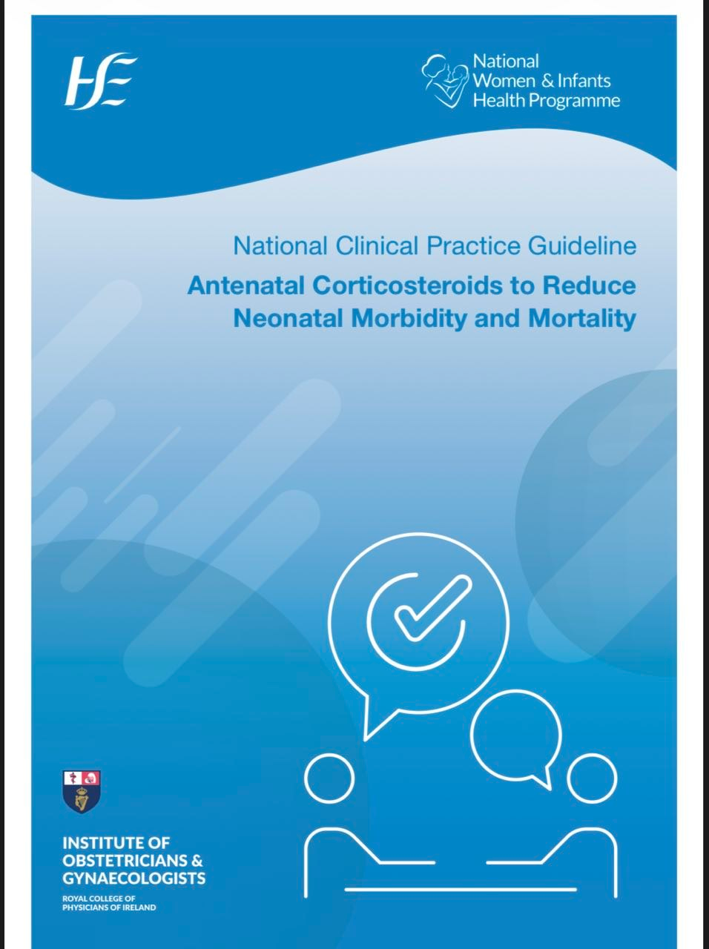

Slide 91
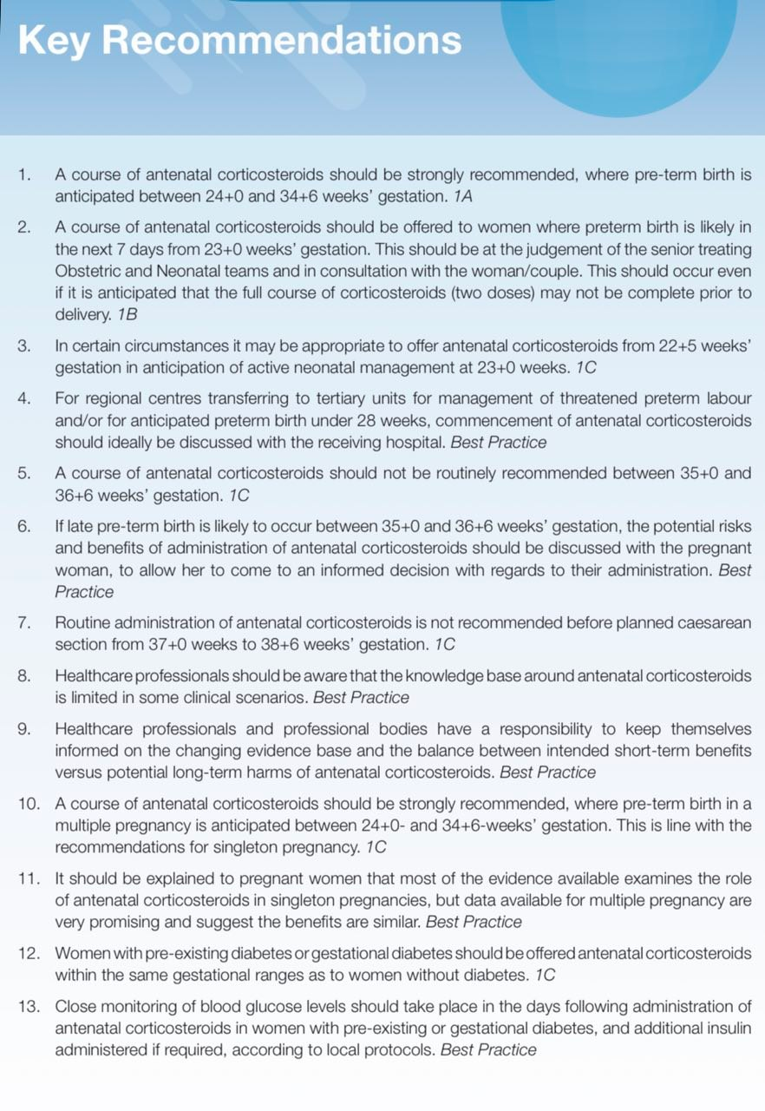

Slide 92
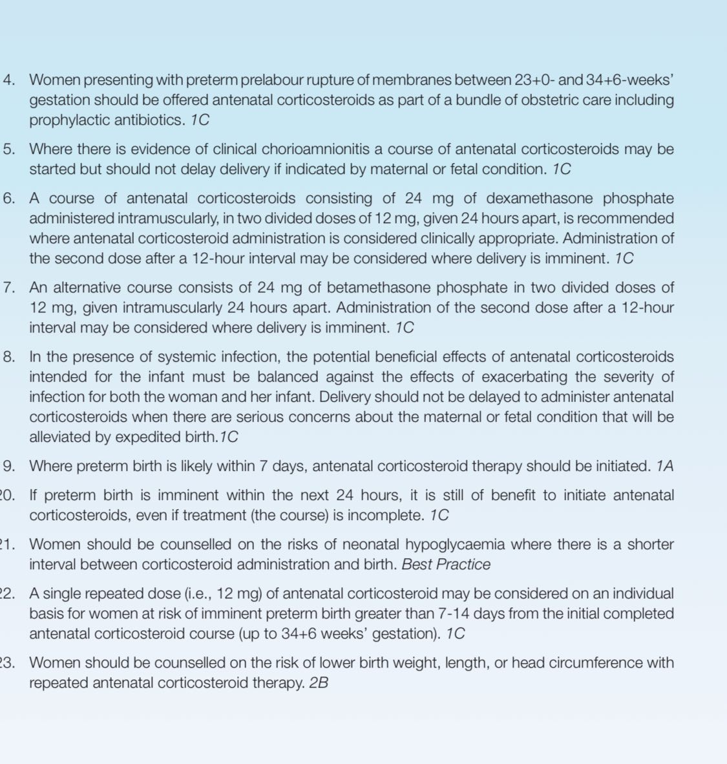

Slide 93
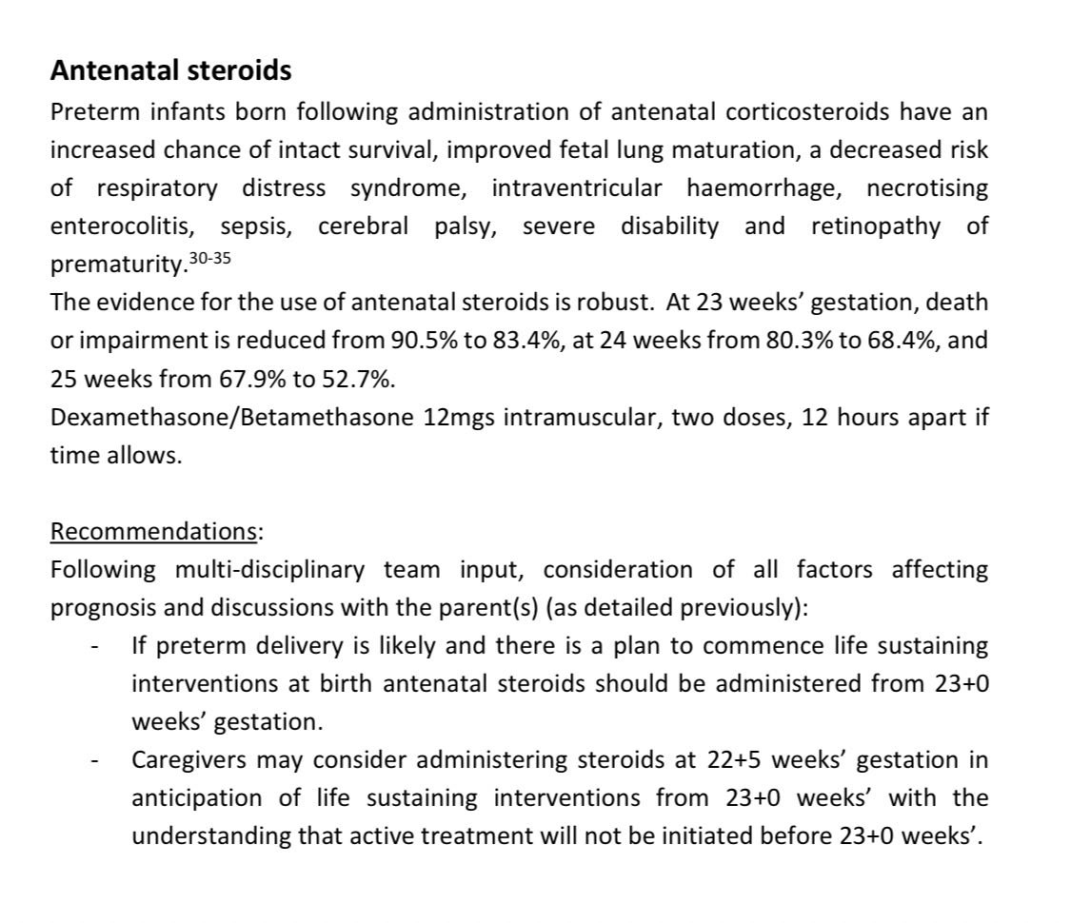

Slide 94
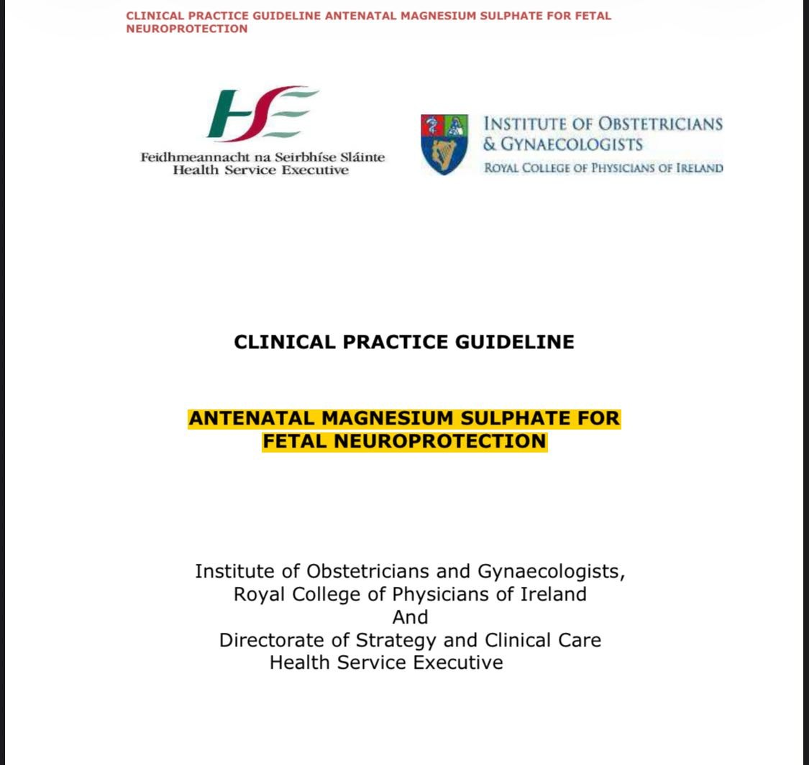

Slide 95
Key Recommendations
1. Data from several large randomized controlled trials and a Cochrane meta-analysis give evidence for a beneficial effect for magnesium sulphate in reducing the risk of cerebral palsy in infants delivered at preterm gestations. Thus administration of magnesium sulphate should be considered in all cases of planned or anticipated preterm delivery
2. Use of magnesium sulphate should be considered in all patients at risk of imminent preterm delivery before 32 weeks. However, in situations of limited resources, emphasis should be placed on ensuring that women delivering at 28 weeks or less, when the greatest benefit has been shown, receive antenatal magnesium sulphate.

Slide 96
contineu
3. Optimal benefit is seen with use of a loading dose of magnesium sulphate followed by and infusion. The recommended dosing regimen is 4g loading dose followed by an infusion of 1g/hr continued until delivery or for 24 hours, whichever occurs sooner.
4. In cases of limited resources for maternal monitoring, or limited time, it is reasonable to administer a 4g loading dose only, without a subsequent infusion.

Slide 97
contineu
5. Aim to commence magnesium sulphate approximately 4 hours prior to delivery. If it is not possible to achieve a 4 hour window prior to delivery, magnesium sulphate should still be administered, as it is likely that some benefit will be seen when administered within this time
6. No evidence available at present to guide management regarding repeated doses of magnesium sulphate in those patients that do not deliver and have magnesium sulphate discontinued. It is reasonable to consider giving a repeat dose in the event of imminent preterm delivery if 24 hours have elapsed since discontinuing the magnesium sulphate.

Slide 98
contineu
7. Given the potential for adverse maternal and fetal effects of magnesium sulphate both maternal and fetal monitoring must be employed during magnesium sulphate administration.

Slide 99
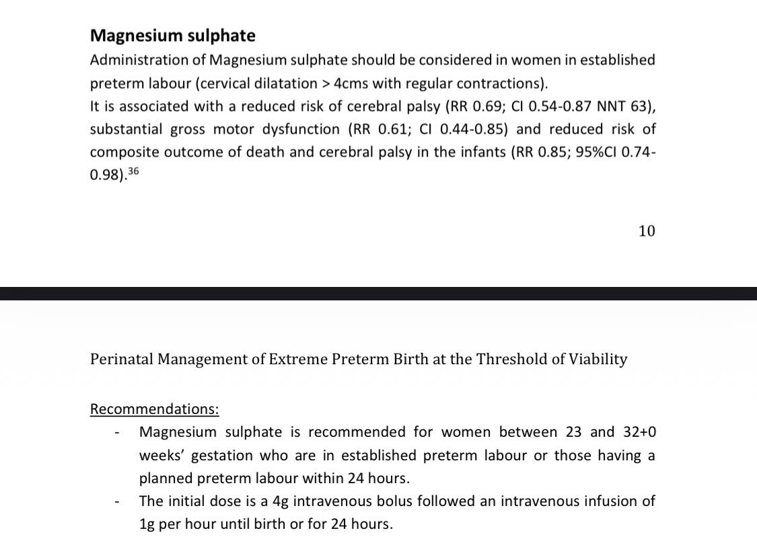

Slide 100
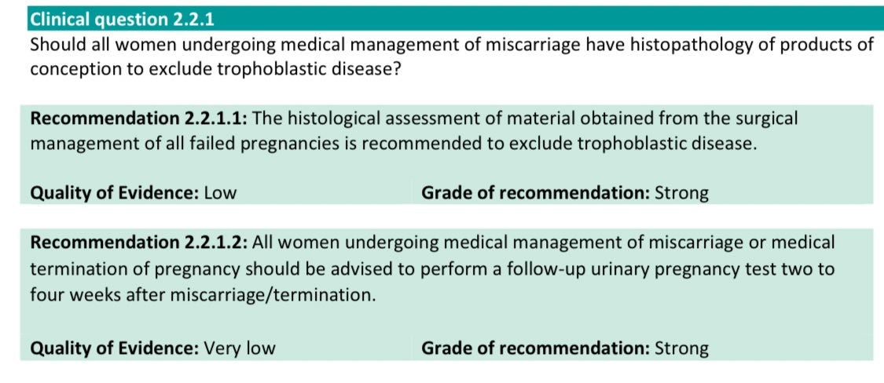
Dx ,staging and treatment of pt with GTD

Slide 101
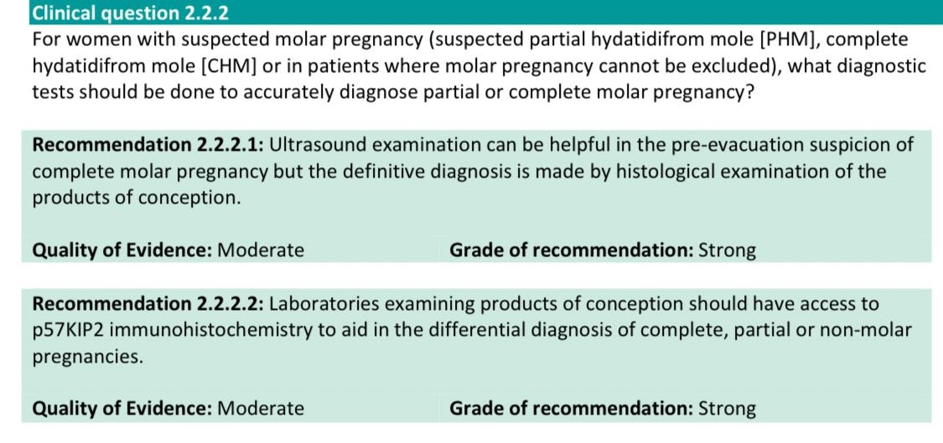
KET RECOMMENDATION

Slide 102
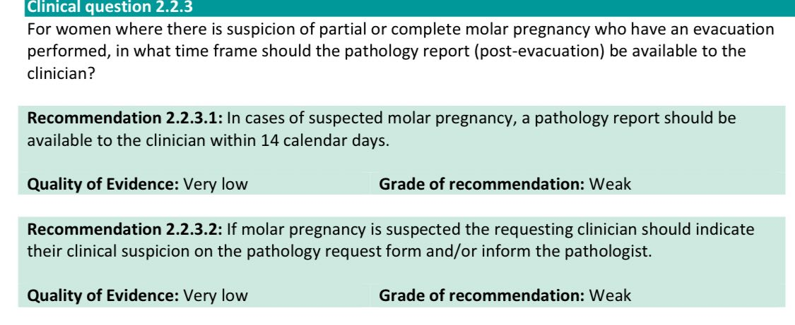
KET RECOMMENDATION

Slide 103
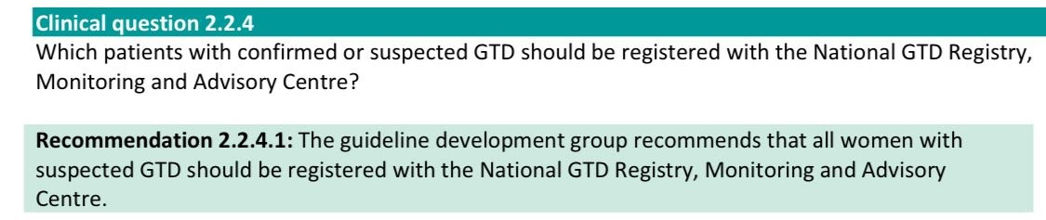
KET RECOMMENDATION

Slide 104
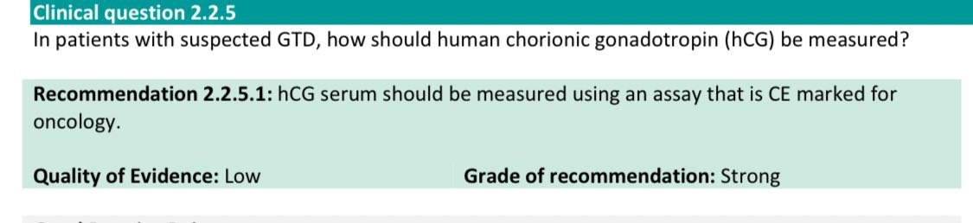
KET RECOMMENDATION

Slide 105
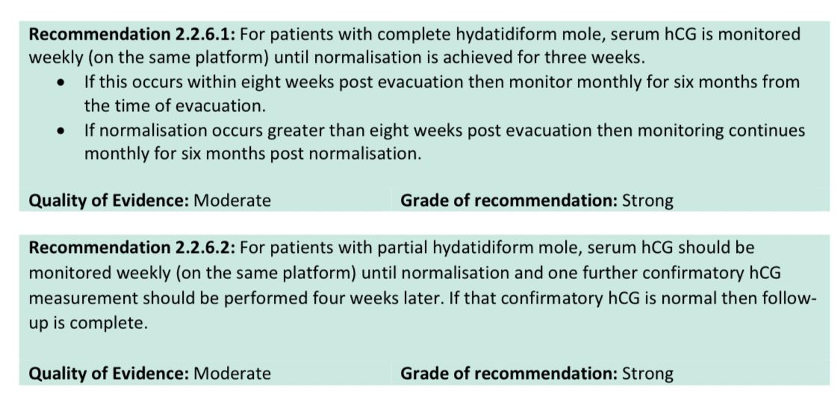
KET RECOMMENDATION

Slide 106

KET RECOMMENDATION

Slide 107
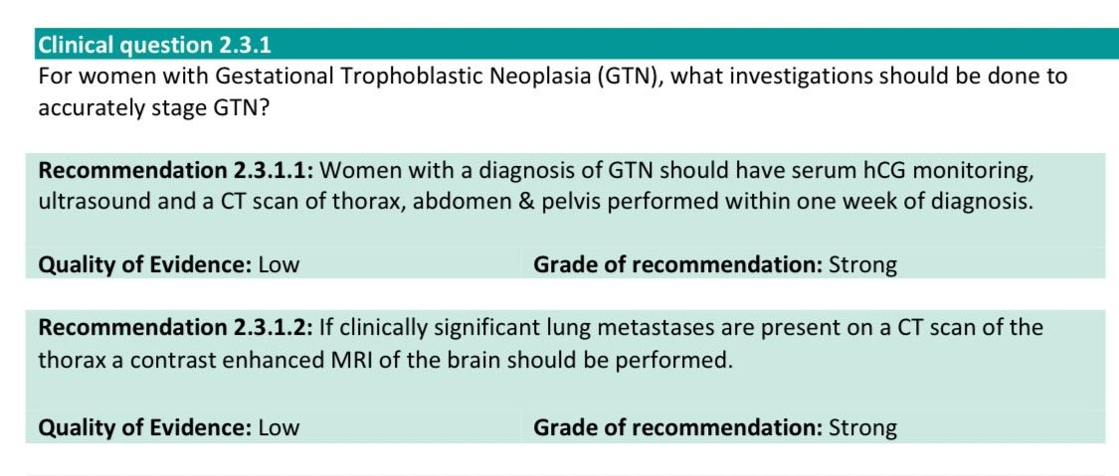
KET RECOMMENDATION

Slide 108
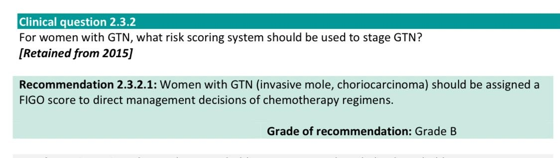
KET RECOMMENDATION

Slide 109
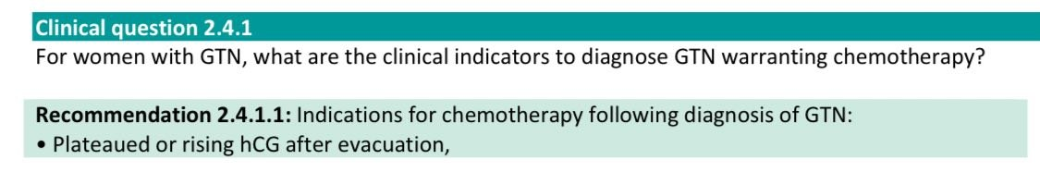
KET RECOMMENDATION

Slide 110
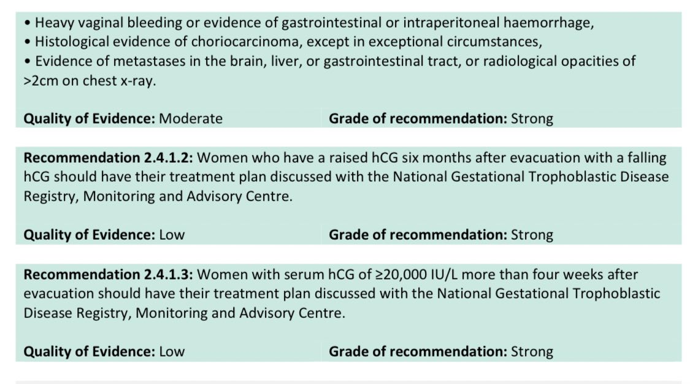
KET RECOMMENDATION

Slide 111
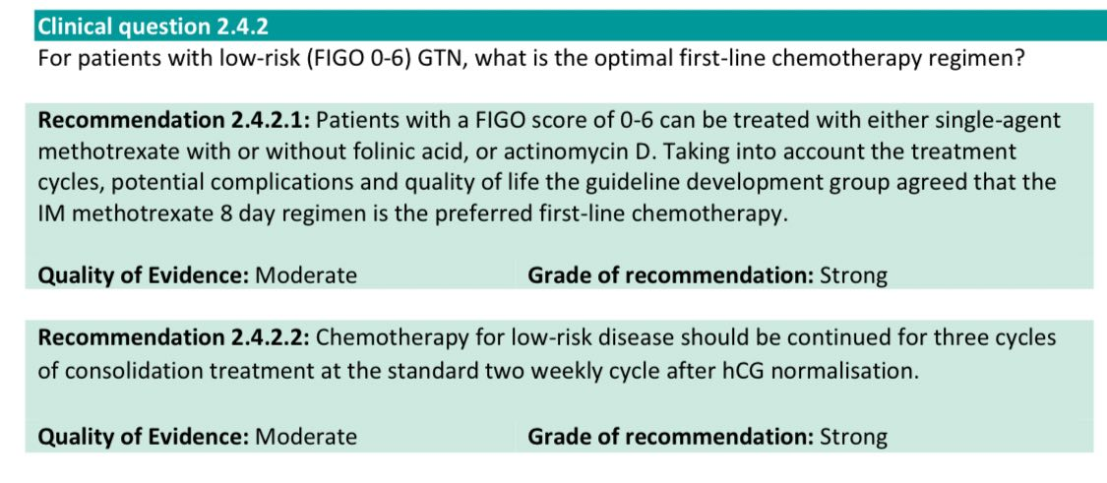
KET RECOMMENDATION

Slide 112
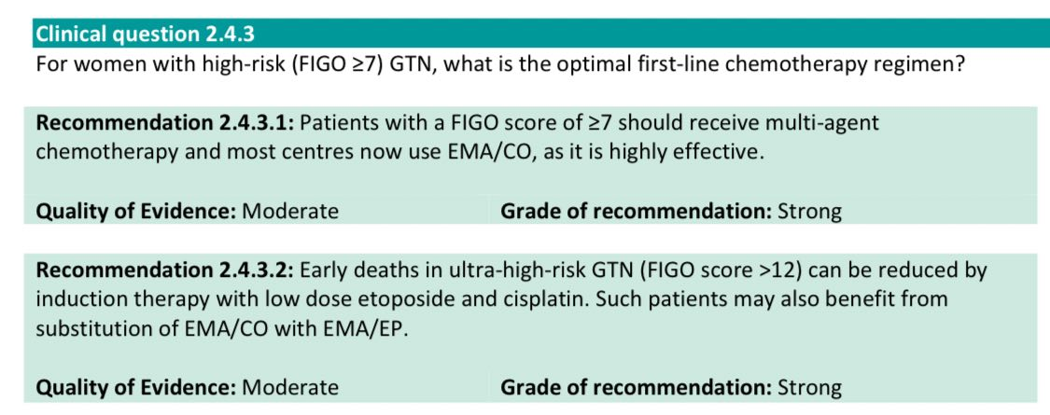
KET RECOMMENDATION

Slide 113

KET RECOMMENDATION

Slide 114

KET RECOMMENDATION

Slide 115

KEY RECOMMENDATION

Slide 116

KEY RECOMMENDATION

Slide 117

KEY RECOMMENDATION

Slide 118

KEY RECOMMENDATION

Slide 119

KEY RECOMMENDATION

Slide 120

KEY RECOMMENDATION

