Slide 1
IN THE NAME OF ALLAH
MRCPI PART 2 WRITTEN EXAM
SEPTEMBER EXAM
By dr Eiman elnasri
MBBS
Master OF clinical education
b

Slide 2
early pregnancy modules
1.investigation and mx of complication of early termination of pregnancy.
2 .termination of pregnancy under 12 weeks.
3.rm
4.ectopic pregnancy
5.fetal anatomy ultrasound .
6. Pathway for the mx of fatal fetalanomalies and life limiting conditions during pregnancy 2019.
7.mx of second trimester miscarriage.

Slide 3


INVESTIGATION AND MX OF COMPLICATION OF EARLY TERMINATION OF PREGNANCY IRISH GL 2023

Slide 4
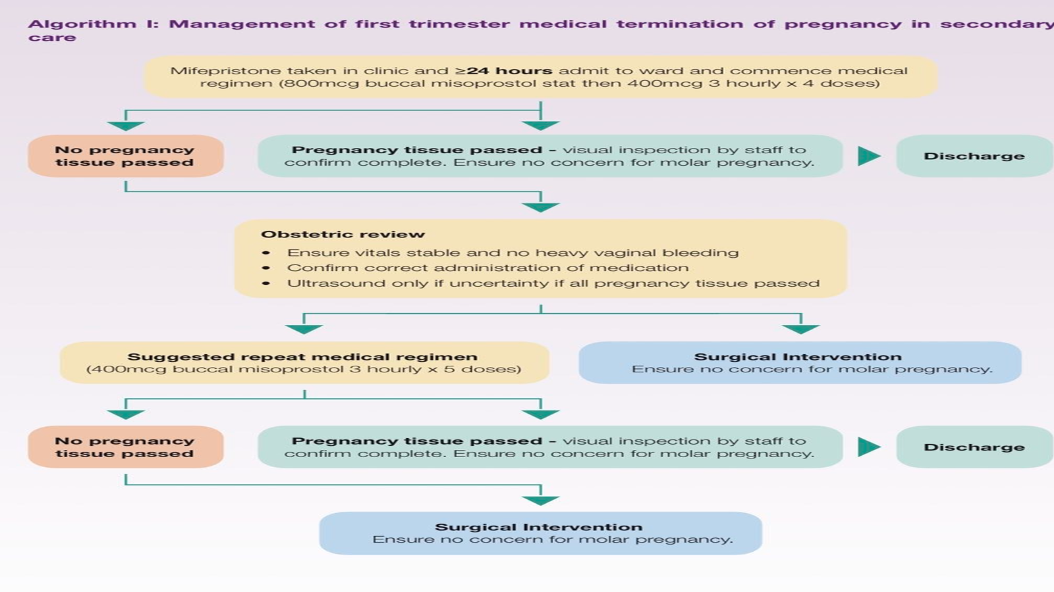

Slide 5
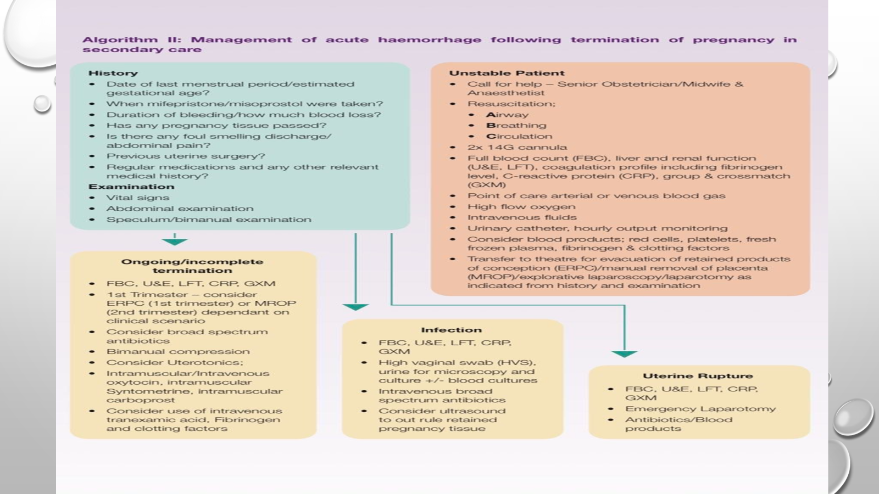
Exam q

Slide 6
background
There are several different circumstances under which TOP can be legally performed (Table 1), the most common of which is early termination of pregnancy (Section 12 of the Health (Regulation of Termination of Pregnancy) Act 2018) with 98.6% of TOPs performed in 2021 taking place under this
Section 12 allows TOP to be carried out by medical practitioners up to 12 weeks gestation i.e., 12 weeks + 0 days from first day of last menstrual period, once a minimum of three days has elapsed from the date of certification 4.

Slide 7
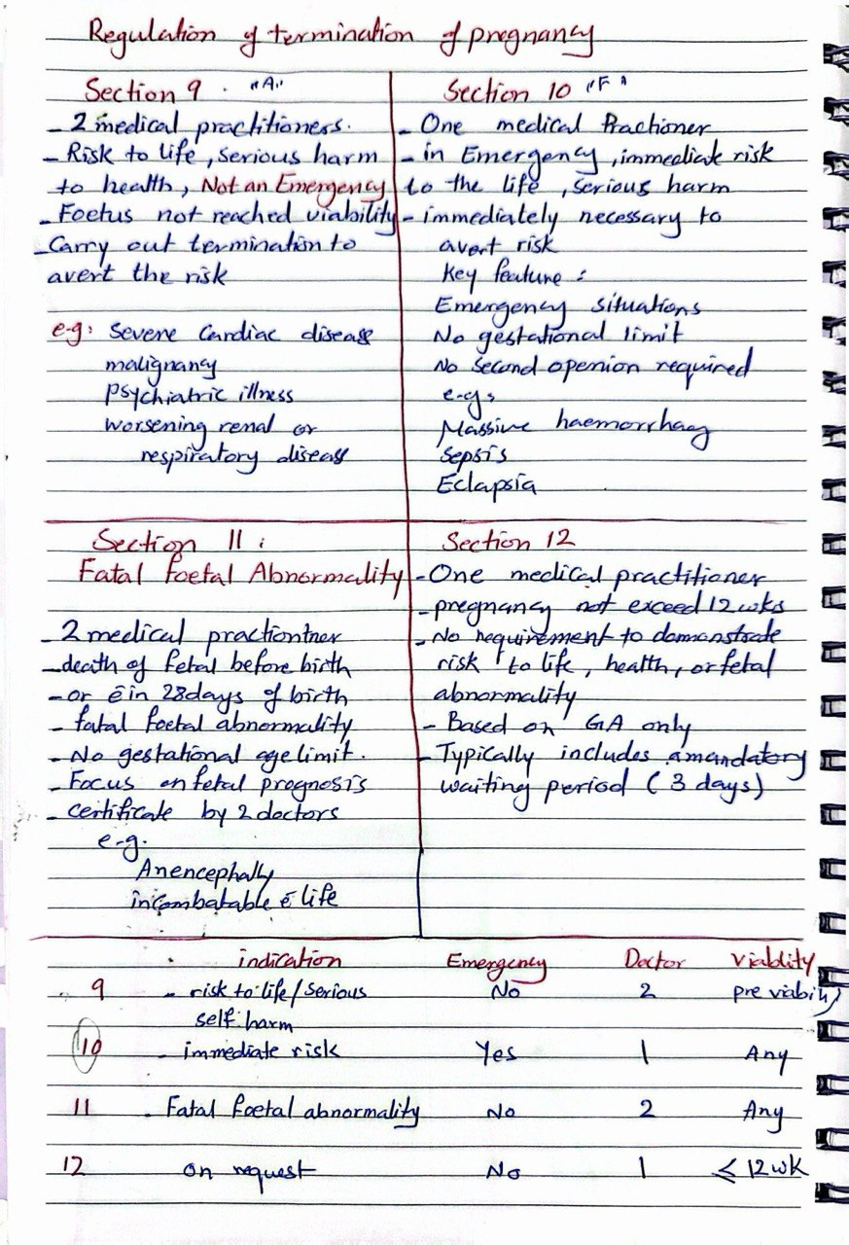

Slide 8
KEY RECOMMENDATION:
1/ALL healthcare providers including those not directly involved in providing top should be AWEAR THAT WOMEN WITH COMPLICATIONS ARISING FROM TOP MAY PRESENT TO ANY HEALTH CARE SETTING AND SHOULD BE TREATED APPROPRIATELY AND WITHOUT PREJUDICE.
2/WOMEN SHOULD BE COUNSELLED THAT MTOP CAN NOT BE REVERSED CHANCE OF ONGOING PREGNANCY IS LESS THAN 3% WHEN BOTH MIFEPRISTONE AND MISOPROSTOL HAVE BEEN TAKEN AND RISK OF MAJOR CONGENITAL MALFORMATION IS APPROXIMATELY 4.2%.

Slide 9
cotineuo
3/WE RECOMMEND ,IF THERE IS LITTLE OR NO BLEEDING FOLLOWING EARLY MTOP, REFERRAL TO SECONDARY CARE SERVICES FOR USS ASSESSMENT TO RULE OUT ONGOING OR ECTOPIC PREGNANCY IS CONSIDERED. Exam q
.4/WE RECOMMENDED ,IF ANY WOMAN IN EARLY PREGNANCY HAS SEVERE PAIN OR IS HAEMODYNAMICALLY UNSTABLE ,URGENT ASSESSMENT IN SECONDARY CARE SHOULD BE CONSIDERED TO ASSESS FOR ECTOPIC PREGNANCY ,MAJOR HAEMORRHAGE OR SEPSIS. Exam q

Slide 10
CONTINUE OF RECOMMENDATION :
5 / THERE IS NO INDICATION FOR ROUTINE US IN WOMEN UNDERGOING MTOP IN SECONDARY CARE PRIOR TO DISCHARGE IF APPROPRIATE PREGNANCY TISSUE CORRESPONDING TO US FINDING HAS BEEN VISUALISED FOLLOWING EXPULSION.
6/ If there is uncertainty regarding completion of the early medical termination procedure in secondary care and an ultrasound is performed, the purpose of the ultrasound is to confirm that a gestational sac and its contents are no longer present. Best Practice

Slide 11
Continuation of recommendations
7. We recommend that, if early MTOP in secondary care is unsuccessful, the woman should be offered further medical or surgical management until termination is complete. Best Practice
8.We recommend that, if a woman has ongoing pregnancy symptoms or a positive low sensitivity urine pregnancy test following early MTOP in primary care, they should initially be reviewed by their primary care termination provider. Grade 1A

Slide 12
Continuation of recommendations
9.We recommend that women should be referred – in a timely fashion – to secondary care termination services if ongoing pregnancy is suspected/confirmed following MTOP. Best Practice

Slide 13
CONTINUE OF RECOMMENDATION
10. We strongly recommend that health care workers providing MTOP should be familiar with potential complications such as heavy vaginal bleeding, ongoing severe pain and retained pregnancy tissue, and their respective management approaches. Best Practice
11. We suggest that ectopic pregnancy be considered in any woman attending with severe, ongoing pain in the setting of minimal vaginal bleeding following MTOP. Best Practice Exam questions

Slide 14
CONTINUE OF RECOMMENDATION
12. Women who experience severe pain, that does not improve despite analgesia, following MTOP in the community, should be advised to contact their primary termination care provider. If out of hours, they should be advised to contact MyOptions.ie which is open 24/7 for medical advice, or the local emergency department, immediately. Best Practice
13. We recommend that women should be advised to seek medical assessment if they experience heavy vaginal bleeding that soaks through two or more sanitary pads per hour for two consecutive hours post MTOP in the community. Best Practice

Slide 15
CONTINUE OF RECOMMENDATION
14. We suggest that if a woman is clinically well with symptoms suggestive of retained pregnancy tissue they be managed conservatively in the community. Grade 1B
15. We recommend referral to secondary care if there is prolonged, ongoing bleeding or a suspicion of infection. Grade 1C
16. We recommend that in a haemodynamically unstable woman who has heavy vaginal bleeding, secondary to retained pregnancy tissue, prompt uterine evacuation should be performed. Grade 1B exam q

Slide 16
CONTINUE OF RECOMMENDATION
17. We suggest that, if mild genital tract infection is suspected following examination, preliminary investigations can be performed in the primary care setting and oral broad-spectrum antibiotics should be commenced in accordance with local antimicrobial guidelines. Best Practice
18. We recommend that, if severe genital tract infection is suspected following examination, resuscitative measures such as commencing intravenous fluids, broad spectrum antibiotics and providing supplementary oxygen should be given without delay. Best Practice

Slide 17
CONTINUE OF RECOMMENDATION
19/ We strongly recommend that healthcare workers providing Surgical Termination of Pregnancy (STOP) should be familiar with potential complications such as haemorrhage, cervical lacerations and uterine perforation, and their respective management approaches. Best Practice
20/ Following TOP, all women should be offered contraceptive information and, if desired, given the contraceptive method of their choice, or referral for this service. Best Practice
21/ Long-acting reversible contraception (LARC) is the preferred method of contraception (for clinicians) and so far as possible, should be commenced immediately at the time of TOP in both primary and secondary care services. Best Practice

Slide 18
CONTONUATION OF RECOMMENDATION
22/ We suggest that women admitted to hospital with complications of TOP should be offered referral to the Medical Social Work (MSW) team and/or for counselling. Best Practice
23/ The GP TOP provider should be informed when a woman is admitted to hospital with complications of TOP, provided the woman her self consents to this communication. This communication can be via a discharge summary letter or directly by phone to the GP TOP provider. Best Practice

Slide 19
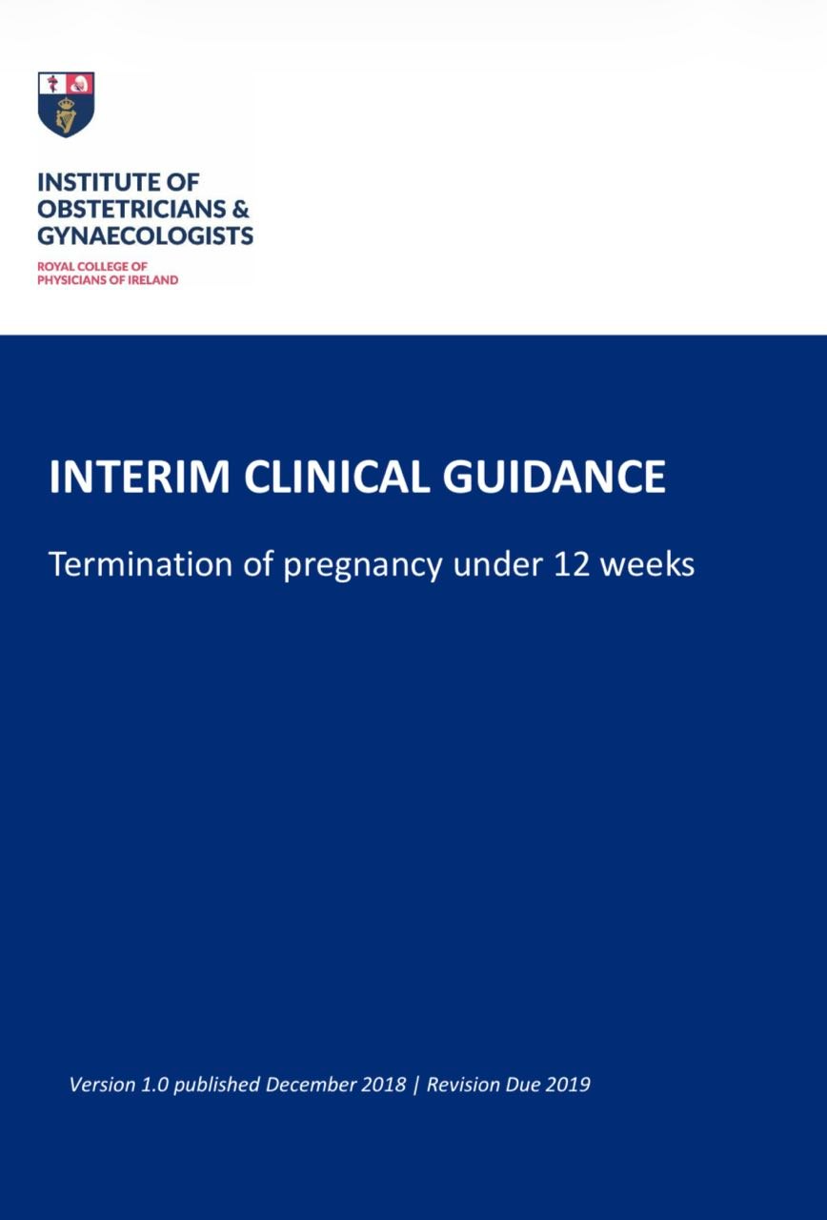

Slide 20
KEY RECOMMENDATION
Recommendation 1 Increasing the accessibility to medical termination of pregnancy services in the community leads to women having their termination at an earlier gestation. Since earlier termination is safest for women, this service should be made widely available.
Recommendation 2 A 24/7 telephone helpline, staffed by clinical staff is an important component of a comprehensive, island–wide service. The helpline should provide initial counselling, signposting to providers and symptom advice for women before, during and after termination of pregnancy.

Slide 21
Continuo recommedndation
Recommendation 3 The Act states that “12 weeks of pregnancy” shall be construed in accordance with the medical principle that pregnancy is generally dated from the first day of a woman’s last menstrual period. In clinical practice data regarding the woman’s last menstrual period is combined with an ultrasound assessment of crown rump length to determine the gestational age. A Crown Rump Length of 63mm is defined as the upper limit for termination of pregnancy at 12 weeks + 0 days gestation. Exam q

Slide 22
Continuo recommedndation
Recommendation 4 Individuals who perform obstetric scans routinely should have specialised training that is appropriate to the practice of diagnostic ultrasound for pregnant women.
Recommendation5 If a woman is sure of her dates and has no risk factors for or symptoms of ectopic pregnancy, an ultrasound is not mandatory prior to termination of pregnancy at gestations less than 9 weeks.

Slide 23
CONTONUE recomendations
Recommendation 6 Where there are clinical concerns, based on history or examination findings, an ultrasound should be arranged prior to medical termination of pregnancy at gestations of less than 9 weeks.
Recommendation 7 In order to ensure access and to aid with counselling regarding risks and benefits of different termination of pregnancy care pathways, an ultrasound scan should be arranged prior to termination of pregnancy between 9- and 12-weeks’ gestation.

Slide 24
CONTineuo recommendations
Recommendation 8 Women should be asked about their wishes to see the ultrasound screen or not.
Recommendation 9 If a patient seeking a termination of pregnancy is less than 7 weeks’ gestation THE RISK OF RH D SENSITISATION IS NEGLIGIBLE,THEREFORE BLOOD GROUP AND RH D TESTING IS NOT INDICATED.
Recommendation 10 If a patient is seeking a termination of pregnancy is 7 weeks’ gestation or greater (≥49 days post LMP), a blood group and Rhesus D testing is advised, in order to identify those who are Rhesus D negative, and take steps to prevent Rhesus D sensitisation during future pregnancies.

Slide 25
Continuo recommendations
Recommendation 11 Women should be counselled on the limitations of data estimating the risk of Rhesus D sensitisation associated with medical termination of pregnancy at 7- 9 weeks’ gestation. Following full counselling on the potential risks and the limitations of the existing data, it is ultimately each woman’s choice whether to receive Anti-D at this gestation.
Recommendation 12 For Rhesus D negative women who have a medical or surgical termination of pregnancy between 9- and 12-weeks’ gestation, a dose of at least 250IU of anti-D immunoglobulin should be administered to prevent Rhesus D sensitisation.

Slide 26
CONTinuation
****Recommendation 13 Determination of the risk of Rhesus D sensitisation following a termination of pregnancy should be deemed a high research priority and high-quality, adequately-powered studies should be resourced.
**** Recommendation 14 The decision to evacuate the uterus following incomplete termination of pregnancy should be based on clinical signs and symptoms and not on ultrasound appearance.

Slide 27
Contineuo recommendation
****Recommendation 15 Ultrasound examination should not be used routinely to screen women for incomplete abortion after medical or surgical termination of pregnancy
Recommendation 16 As part of the medical consultation prior to termination of pregnancy, an assessment of the woman’s risk of venous thromboembolism (VTE) should be considered. Women with significant risk factors for VTE may require anticoagulant treatment until the termination is performed and up to six weeks afterwards

Slide 28
Contineu recommendatio
. Recommendation 17 Routine screening for genital infections is not indicated for women prior to termination of pregnancy except where the woman has symptoms or signs of genital infection or is known to be a contact of chlamydia or gonorrhoea.
. Recommendation 18 Prior to termination of pregnancy, screening for chlamydia and gonorrhoea can be offered to women at greater risk (e.g. women younger than 25 or those with a new partner in the previous 12 months).

Slide 29
Continuo recommendation
Recommendation 19 Routine antibiotic prophylaxis is not recommended prior to first trimester medical termination of pregnancy except where the woman has symptoms or signs of genital infection or is known to be a contact of chlamydia or gonorrhoea.
Recommendation 20 Routine antibiotics are recommended prior to or at the time of surgical termination of pregnancy.

Slide 30
CONtineu recommendatios
Recommendation 21 Women presenting with infectious complications of termination of pregnancy should be managed in line with the HSE antibiotic prescribing guidelines.
Recommendation 22 Women diagnosed with a chlamydia or gonorrhoea should be offered full Sexually Transmitted Infection screening, including serology for HIV, Hepatitis B, syphilis and Hepatitis C (where indicated).
Recommendation 23 Women diagnosed with chlamydia or gonorrhoea should be managed in line with the HSE antibiotic prescribing guidelines.

Slide 31
Continuo recommendations
Recommendation 24 Many women have decided to have a termination of pregnancy before seeking care, and this decision should be respected. A woman should not be compelled to attend mandatory counselling.
Recommendation 25 It is important that women have access to a trained professional 24/7 to answer clinical queries during home medical termination of pregnancy.

Slide 32
Continuo recommendations
Recommendation 26 Counselling should be available promptly and provided by appropriately trained individuals to all pregnant women who request this service, prior to, during and post termination of pregnancy.
Recommendation 27 Medical staff should be aware of factors likely to increase the risk of poorer mental health outcomes and arrange follow up to enable early detection of those women in need of additional support.

Slide 33
CONtinuo recommendation
Recommendation 28 After surgical or medical termination of pregnancy, all women should be offered contraceptive information and, if desired, the contraceptive method of their choice or referral for this service.
Recommendation 29 It is important for health care professionals to recognise that some women prefer to discuss contraceptive options after the termination is completed.

Slide 34
Contineu recommendation
Recommendation 30 Doctors with a conscientious objection to carrying out or participating in carrying out a termination of pregnancy, are obliged to make the necessary arrangements for the transfer of care of the pregnant woman, to enable her to avail of a termination of pregnancy.

Slide 35
CONtinuo recommendation
Recommendation 31 A termination may be carried out by a medical practitioner where, having examined the pregnant woman, the medical practitioner is of the reasonable opinion formed in good faith that there is an immediate risk to the life, or of serious harm to the health, of the pregnant woman and it is immediately necessary to carry out the termination of pregnancy in order to avert that risk. In an emergency, the patients' care must be made a priority and the necessary treatment must be provided. This remains the position irrespective of any conscientious objection of the medical practitioner.

Slide 36
Section 12 of the Health (Regulation of Termination of Pregnancy) Act 2018 states that:
(1) A termination of pregnancy may be carried out in accordance with this section by a medical practitioner where, having examined the pregnant woman, he or she is of the reasonable opinion formed in good faith that the pregnancy concerned has not exceeded 12 weeks of pregnancy.
(2) A termination of pregnancy shall not be carried out under this section unless the medical practitioner referred to in subsection (1) has certified his or her opinion as to the matter referred to in that subsection.

Slide 37
CONtinuation
(3) The termination of pregnancy shall not be carried out by a medical practitioner unless a period of not less than 3 days has elapsed from— (a) the date of certification under subsection (2) by that medical practitioner, or (b) where a certification was previously made in respect of the pregnancy by another medical practitioner for the purposes of subsection (2), the date of that previous certification.
(4) A termination of pregnancy to which the certification referred to in subsection (2) relates shall be carried out as soon as may be after the period referred to in subsection (3)(a) or (b), as the case may be, has elapsed but before the pregnancy has exceeded 12 weeks of pregnancy.

Slide 38
CONtinuatione
(5) For the purposes of this section, “12 weeks of pregnancy” shall be construed in accordance with the medical principle that pregnancy is generally dated from the first day of a woman’s last menstrual period.
the Health (Regulation of Termination of Pregnancy) Act 2018, a termination of pregnancy may be carried out if a medical doctor has certified that, the pregnancy has not exceeded 12 weeks, and a period of not less than three days have elapsed from the date of certification.
@@1.2 Certification The Institute of Obstetricians and Gynaecologists requested clarity from the Department of Health regarding the 3-day certification period and received a response from the Chief Medical Officer . In practice, if certification occurs on Monday the procedure may commence on Thursday, and so forth.

Slide 39
1.4 Failed Terminations after 12 weeks Further clarification was also sough
1.4 Failed Terminations after 12 weeks Further clarification was also sought from the Department of Health on the situation where a medical termination of pregnancy is attempted but an ongoing pregnancy is subsequently discovered after 12 weeks + 0 days. The response indicated that a termination procedure that begins before 12 weeks can be lawfully completed, however a repeat course of treatment cannot be instigated. Once a pregnancy has exceeded 12 weeks and 0 days, no further intervention is legally permitted unless the maternal or fetal grounds set out in the Act are fulfilled .

Slide 40
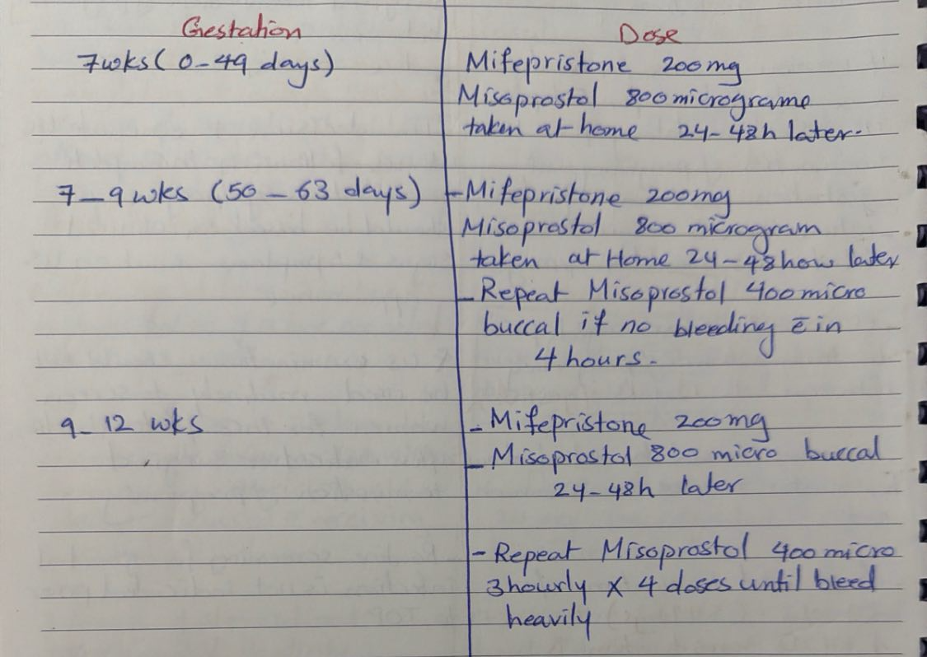

Slide 41


Slide 42
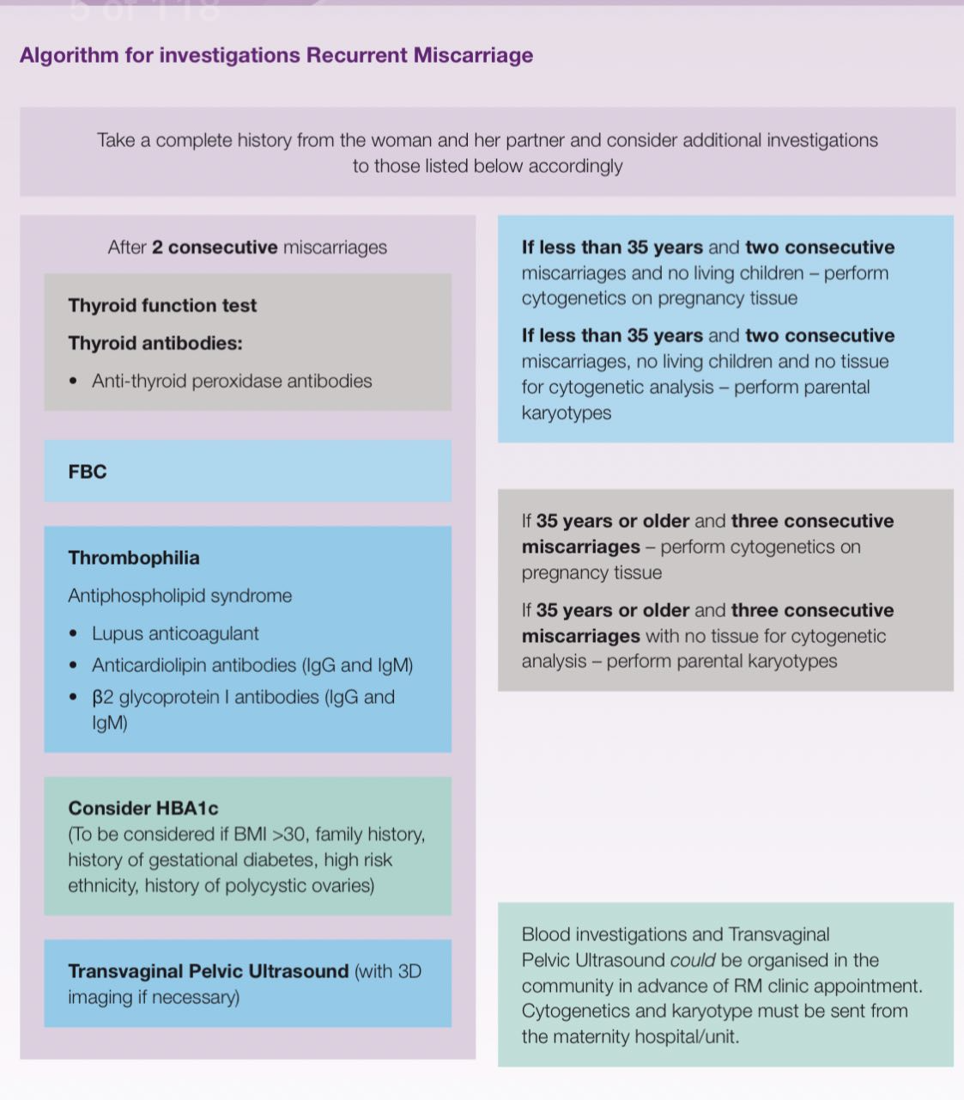

Slide 43
Purpose and background
The purpose of this Guideline is to provide a comprehensive, evidence-based guidance for the management of recurrent first-trimester miscarriage (RM) within the Republic of Ireland.
Miscarriage is generally defined as the spontaneous loss of a pregnancy before it reaches viability, that is 24 weeks of gestation, and occurs in approximately 15% of pregnancies. 9 The population prevalence of women who have had one miscarriage is 10.8%, two miscarriages is 1.9%, and three or more miscarriages is 0.7%.

Slide 44
Terminology and definitions
ESHRE defines recurrent pregnancy loss as the loss of two or more pregnancies before viability.
In the present Guideline, we adopt the term ‘recurrent miscarriage’, which we define as two or more consecutive first trimester miscarriages.

Slide 45
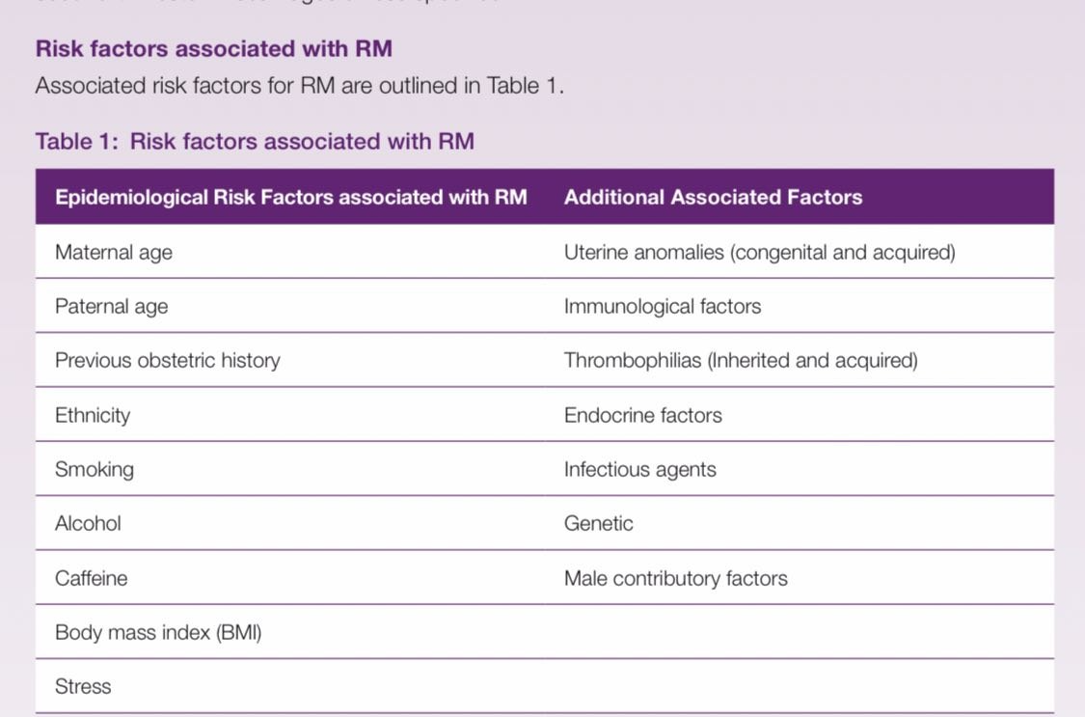
Risk factors associated with RM

Slide 46
The clinical and economic impact of RM
Increased risk of future obstetric complications
:• Preterm birth
• Small‑for‑gestational‑age (SGA)
• Fetal growth restriction (FGR/IUGR)
• Antepartum haemorrhage (APH)
• Placental abruption
• Stillbirth

Slide 47
• Predictor of long‑term maternal health conditions
:• Cardiovascular disease
• Venous thromboembolism (VTE)
• Mental health disorders
Psychological Impact
• High rates of:• Anxiety
• Depression
• Post‑traumatic stress disorder (PTSD)
• Grief response:• Normal adaptive grief
• Risk of pathological grief
• Suicidality reported in some cases
• RE:CURRENT Irish study:• 50% of women with RM scored well below population norm for mental health → suggests high likelihood of depression

Slide 48
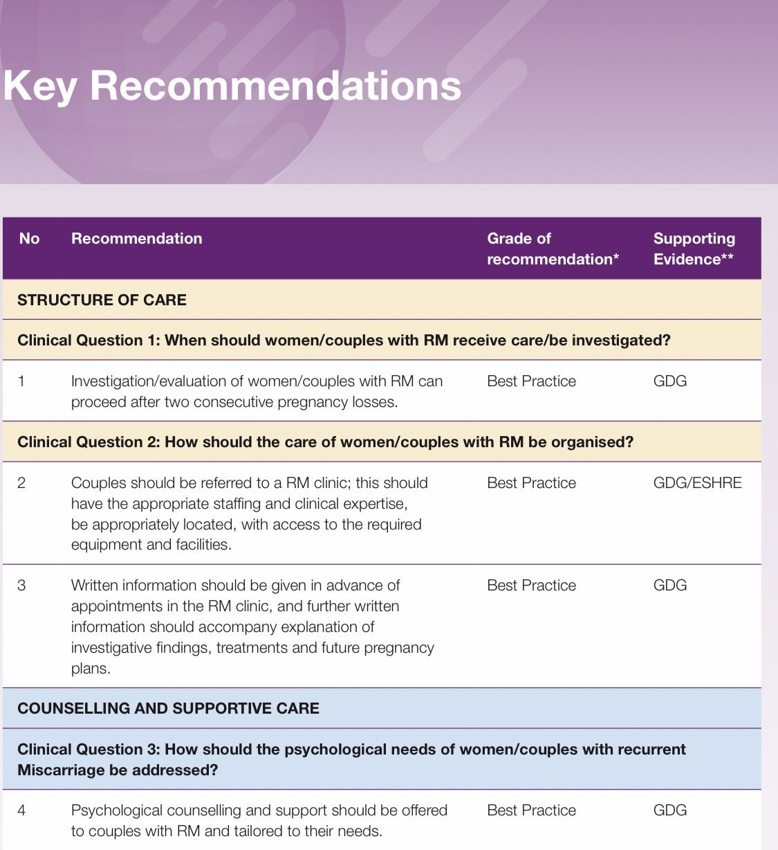
Key recommendations

Slide 49
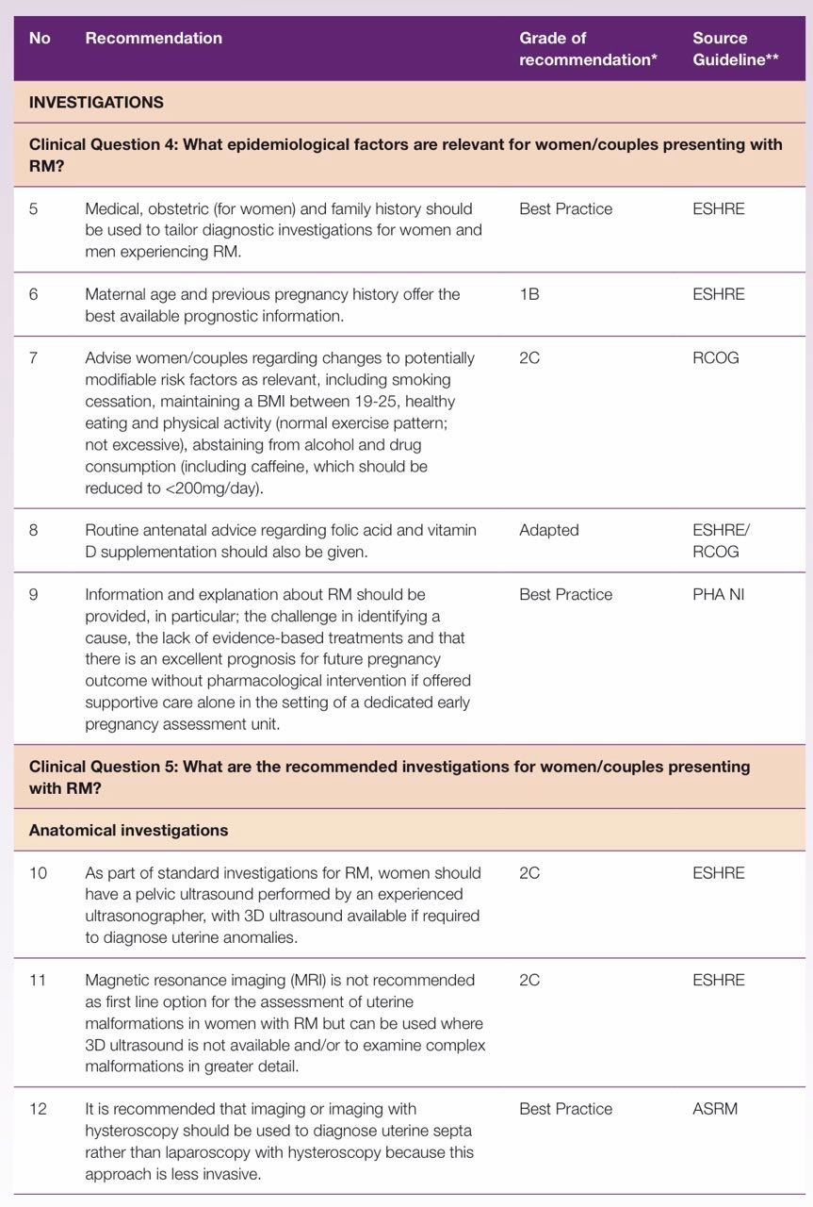

Slide 50
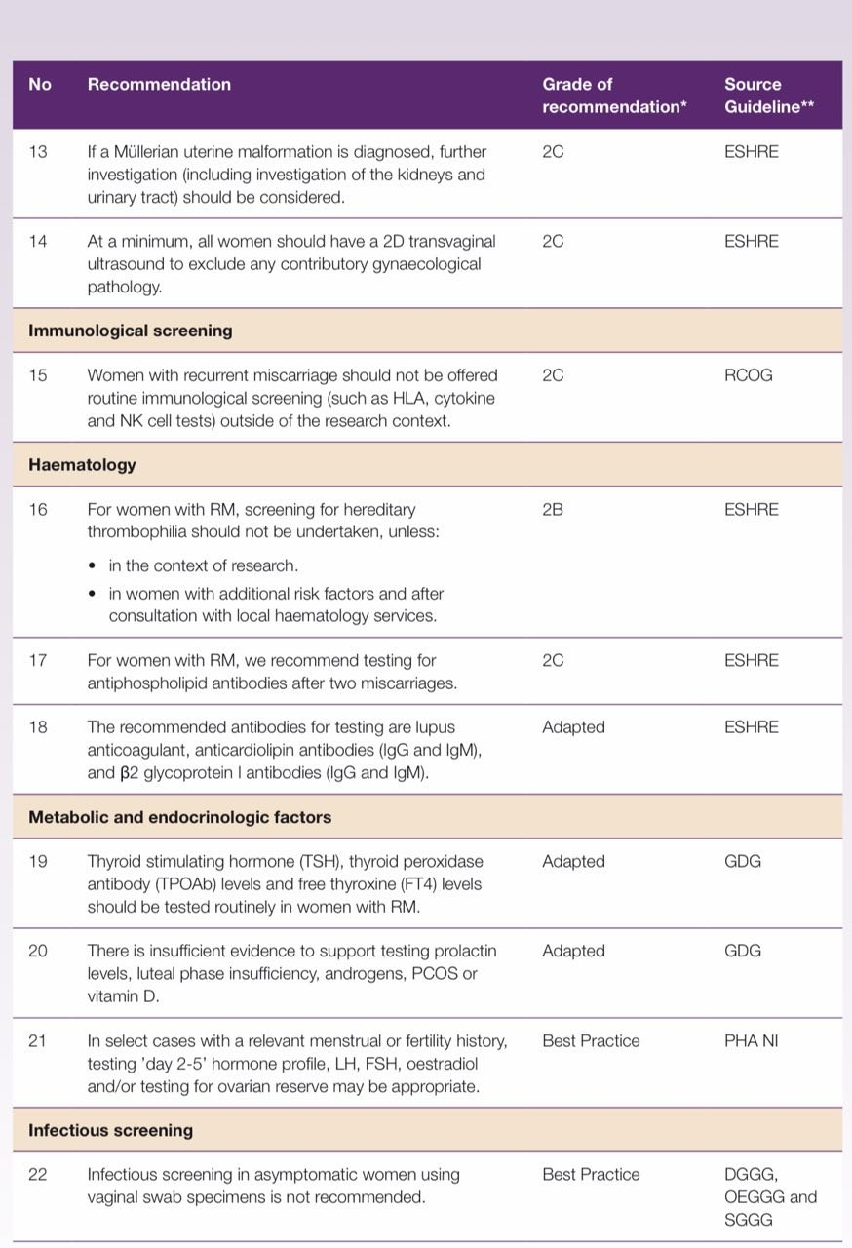

Slide 51
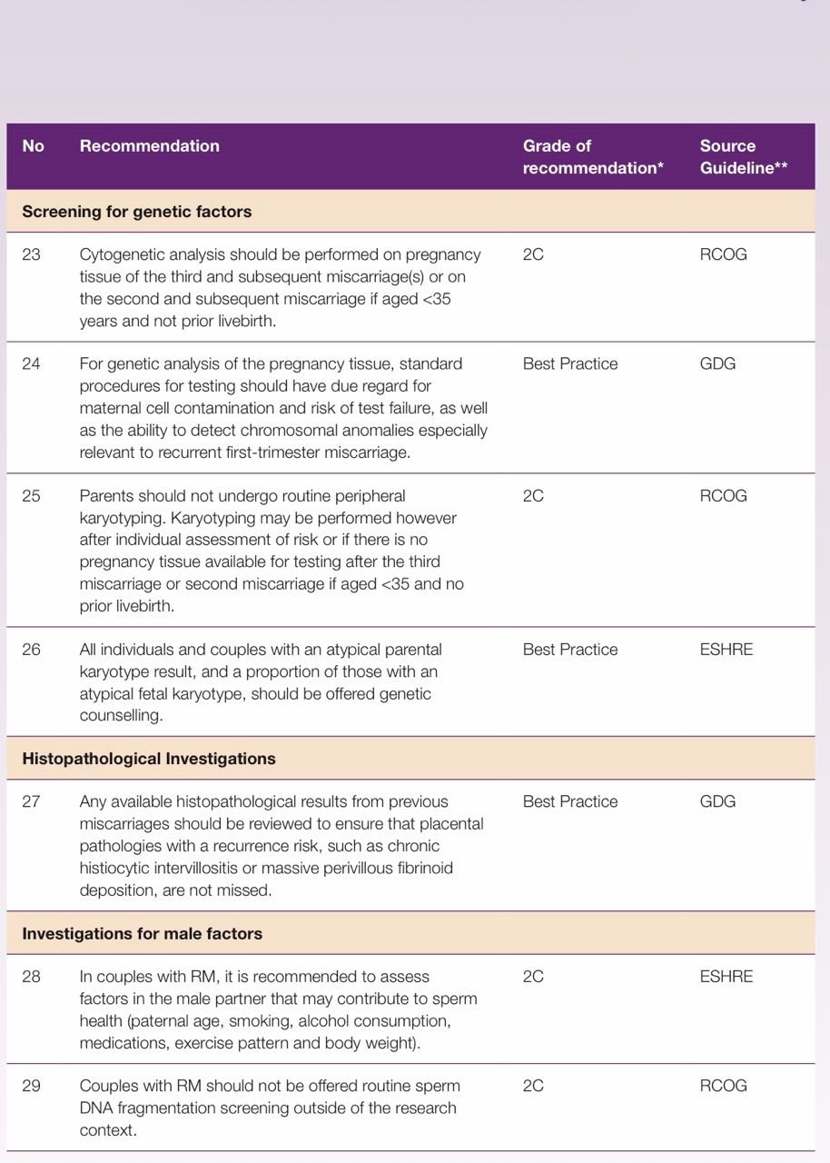

Slide 52
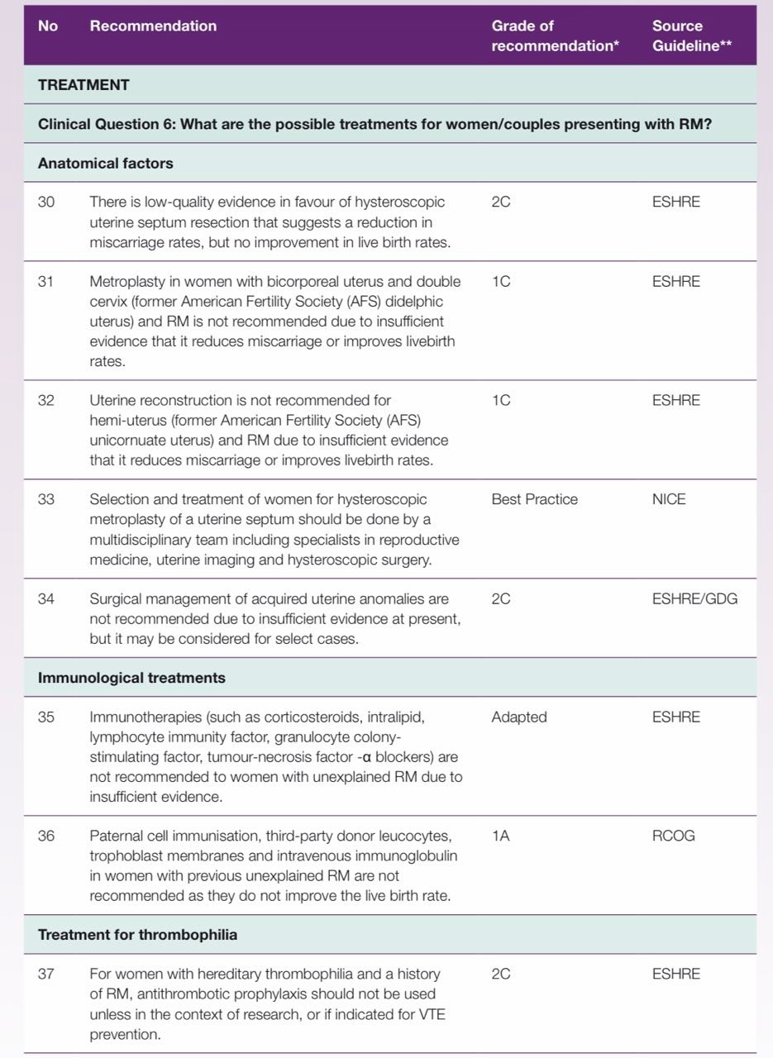

Slide 53
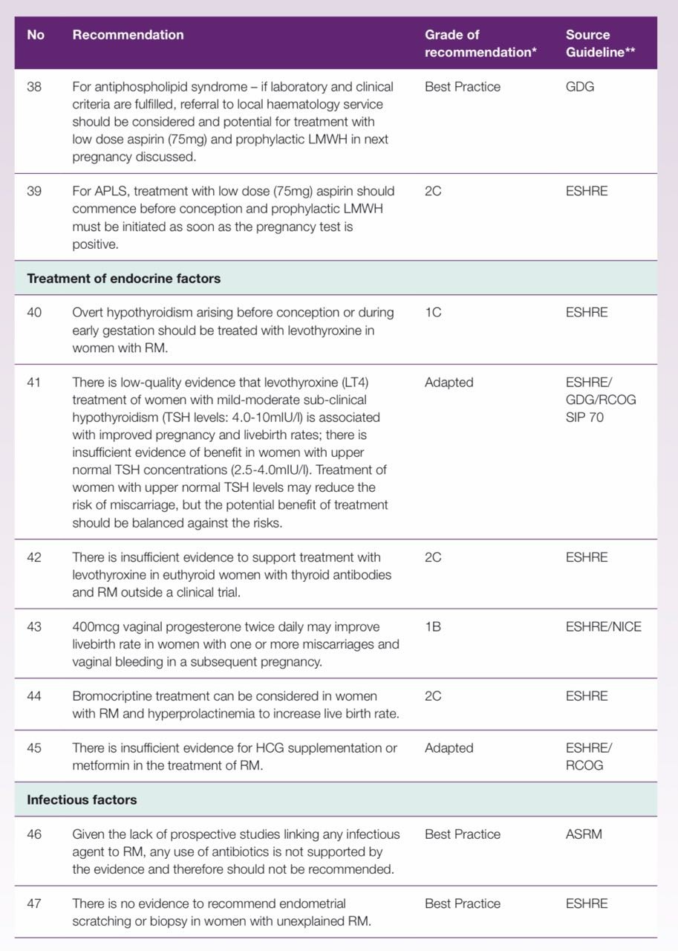

Slide 54
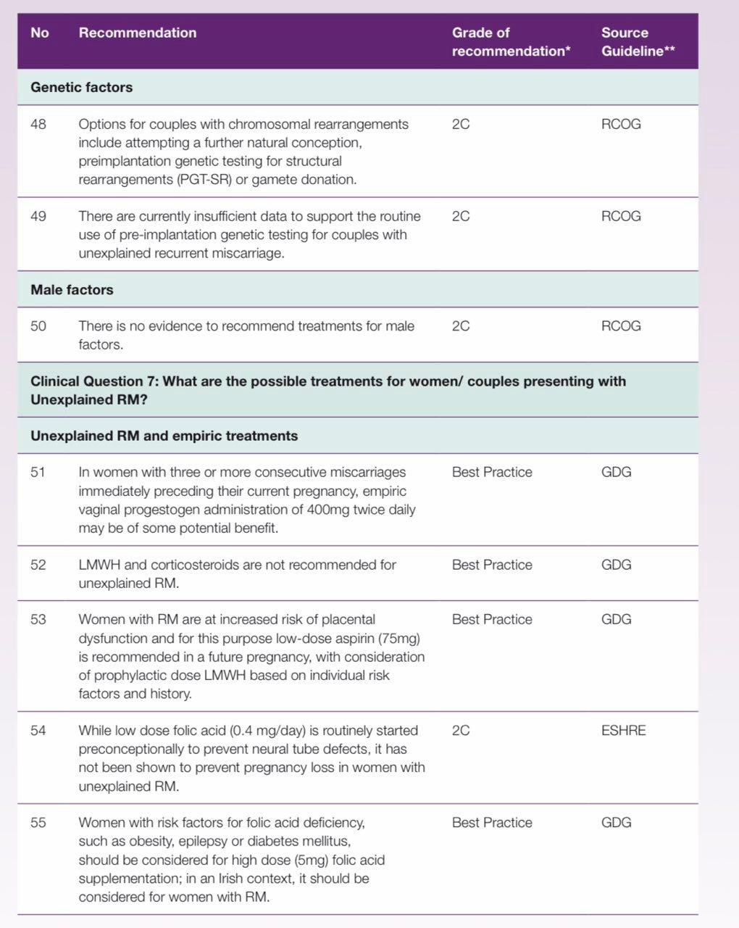

Slide 55
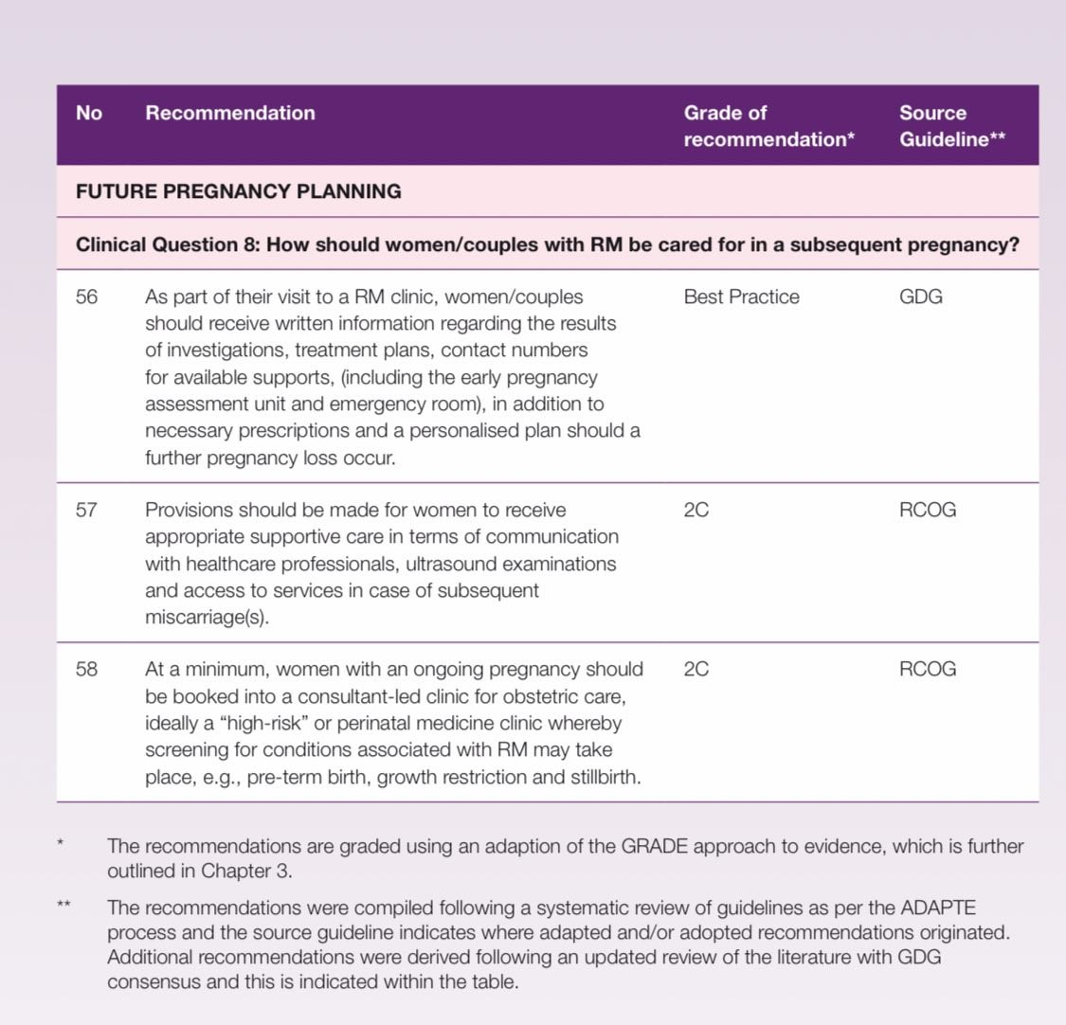

Slide 57


Slide 58
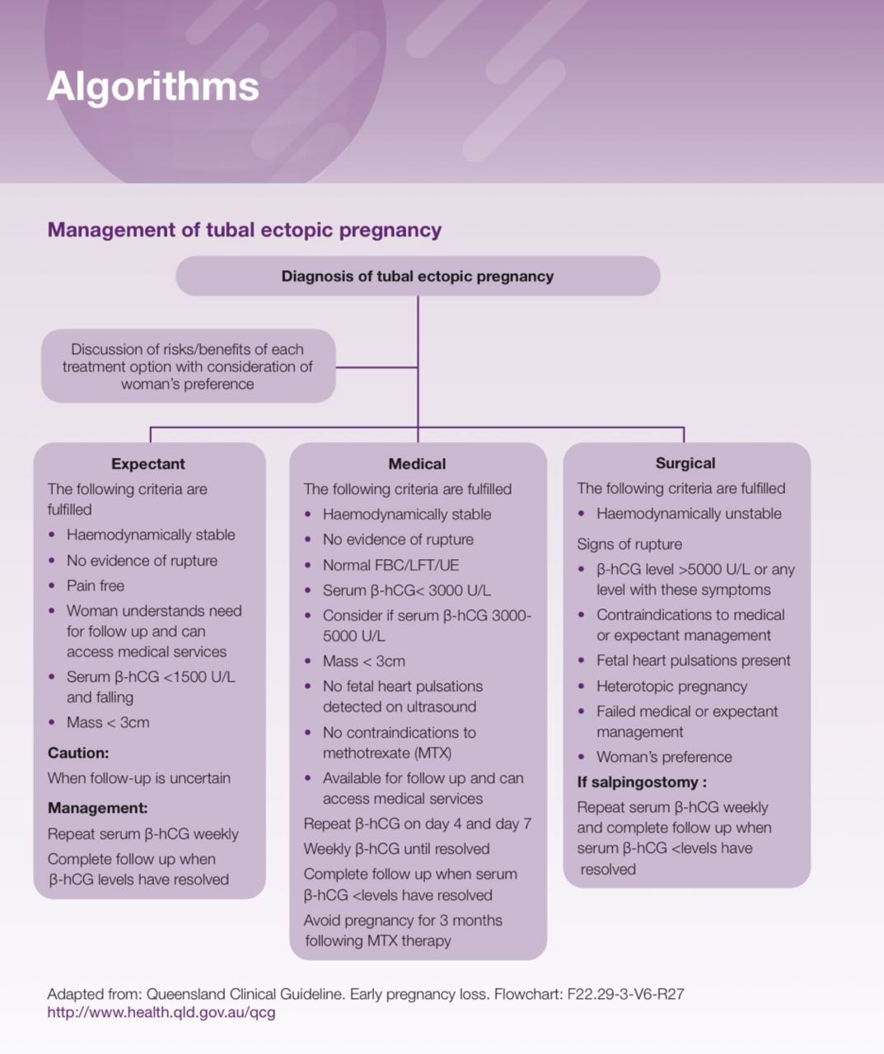

Slide 59
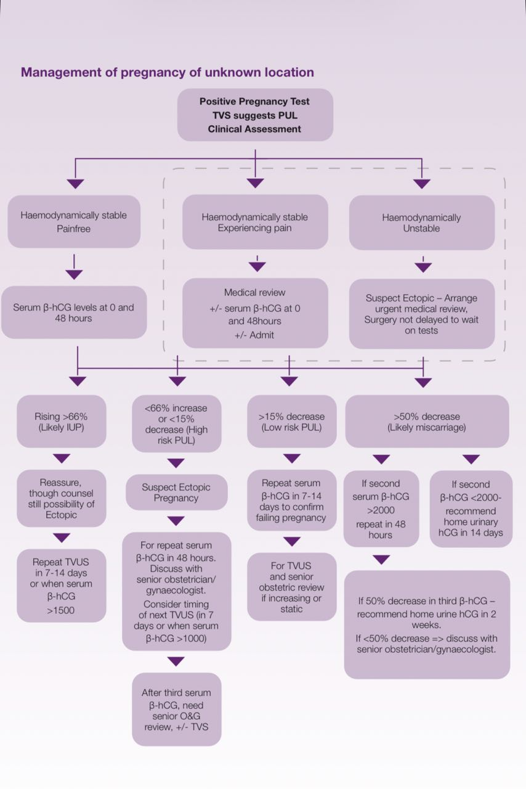

Slide 60
Background
The rate of ectopic pregnancy is 11 per 1,000 pregnancies, with a maternal mortality of 0.2 per 1,000 estimated ectopic pregnancies.1 Ectopic pregnancy ruptures are the leading cause of maternal mortality within the first trimester of pregnancy with a rate of 9%-14% and an incidence of 5%-10% of all pregnancy-related deaths.3 EP remains a cause of maternal death in pregnancy with those who are vulnerable and young women being disproportionately represented.4 The fatality rate has decreased over recent years due to earlier diagnosis and treatment.

Slide 61
Investigation of Ectopic Pregnancy
1/ The National Standards for Bereavement Care following pregnancy loss and perinatal death provide a framework for the provision of bereavement care following ectopic pregnancy. Best Practice
2/Women should be offered bereavement support at diagnosis and should be offered follow-up bereavement care after ectopic pregnancy. Best Practice

Slide 62
contineuation
3/ .Women should be given written information at the time of diagnosis of an ectopic pregnancy regarding their diagnosis and management. They should be counselled regarding signs of clinical deterioration when they should present for review and given information about emergency contacts. Best Practice
4/ A urinary beta-human chorionic gonadotrophin (β-hCG) test should be performed in all women of reproductive age presenting to a maternity or adult general hospital/unit with abdominal pain, vaginal bleeding, gastrointestinal symptoms, dizziness, or collapse. Grade 1B
5/ A thorough gynaecological, obstetric, medical, and surgical history should be taken to assess for risk factors for ectopic pregnancy in women who present with the above symptoms; however, half of women with an ectopic pregnancy will have no known risk factors. Best Practice

Slide 63
Contineuations
6/ A physical examination, including measurement of vital signs, should be performed to assess haemodynamic stability in women presenting with the above symptoms. Best Practice
7/ There should be prompt escalation of care if there are any red flag symptoms on triage assessment or abnormal vital signs in the presence of a positive urinary HCG. This should include referral to an Obstetrics/Gynaecology doctor, IV access and use of an assessment room. Best Practice

Slide 64
Diagnosis of Ectopic Pregnancy
8/ Transvaginal ultrasound (TVUS) is the first line imaging modality for diagnosing an ectopic pregnancy. Grade 1B
9/ An ultrasound scan should only be performed by a suitably qualified member of staff. Best Practice
10/ A TVUS by an experienced sonographer is the gold standard for determining the location of a pregnancy. Grade 1C.

Slide 65
contineuation
11/ An adnexal mass moving separate to the ovary (and/or with a gestational sac containing a fetal pole or yolk sac) with an empty uterus is highly suggestive of a tubal ectopic pregnancy. Grade 2A
12/ . A serum β-hCG should be performed at diagnosis of a tubal ectopic pregnancy to guide management options. Grade 1C

Slide 66
continuation
13/If pregnancy location cannot be determined on a TVUS, serial serum β-hCG measurements should be used in conjunction with a woman’s history and symptoms to guide management. Grade 1C
14/ Serum β-hCG cut offs used to guide management decisions can be assay dependent – hospitals/ units should discuss this with the relevant laboratory to determine if there is a positive or negative bias in their β-hCG assay. Best Practice

Slide 67
Tubal Ectopic Pregnancy Management
15/ All hospitals/units should have a local policy on PUL investigation and management, and this should include whether progesterone levels are included in management algorithms. Best PracticeIn
16/ PUL management, a senior clinician should be consulted after/at the third serum β-hCG test and should be involved in ongoing decision-making. Best Practice
17/ Expectant management should be reserved for haemodynamically stable women with β-hCG levels below 1500 U/L which are falling, with no pain, a tubal/adnexal mass <3cm on tvs and willing to complete follow up.
.

Slide 68
continuations
18/ Medical management is appropriate in women with serum β-hCG <5000u|L,no contraindication to methotrexate ,no evidence of fetal cardiac activity and no significant pain or hemoperitoneum
19/ medical management is most successful in women with a serum β-hCG of 3,000 U/L and less. Grade 1B
20/ All hospitals/units need to have local protocols for assessment, monitoring, and follow-up of women who choose expectant or medical management for ectopic pregnancy. Best Practice

Slide 69
continuation
21/ Surgical management is appropriate when there is evidence of rupture, significant pain, β-hCG levels >5000 U/L, fetal cardiac activity, an adnexal mass >3cm on TVUS, where the ectopic pregnancy is not suitable for medical management or where there has been unsuccessful medical management, and in some scenarios of preference or where the woman is not available for follow up. Grade 1A

Slide 70
Interstitial Ectopic Pregnancy
22/ TVUS is the first line imaging modality for diagnosing an interstitial ectopic pregnancy. Grade 1C
23/ A serum β-hCG should be performed at diagnosis of an interstitial ectopic pregnancy to guide management. Best Practice
24/ The optimal method of treatment for interstitial ectopic pregnancy has not been determined and needs further research. Cases should be managed on an individual patient basis and a Consultant Obstetrician/Gynaecologist should be involved in decision making and management. Best Practice

Slide 71
contiuo
25. Expectant management of interstitial ectopic pregnancy should be used with caution due to the high mortality associated with rupture of an interstitial ectopic pregnancy but can be considered when β-hCG levels are falling and the pregnancy is non-viable. Grade 1C
26. Intramuscular or local methotrexate treatment may be considered in asymptomatic women who fit the criteria for medical management, with follow up serum β-hCG levels. Grade 1C
27. Surgical management may be considered for interstitial ectopic pregnancy and is required when there is evidence of rupture, with follow up β-hCG levels. Best Practice

Slide 72
Cervical Ectopic Pregnancy
28/ A cervical ectopic pregnancy is diagnosed using TVUS; the absence of a sliding sign, a gestational sac below the level of the internal os and blood flow on Doppler all raise suspicion for a cervical ectopic pregnancy. (Grade 1B)
29/ A cervical ectopic pregnancy can be managed medically with methotrexate, surgically or with uterine artery embolisation; a Consultant Obstetrician/Gynaecologist should be involved in decision making and management. Grade 1C

Slide 73
Caesarean Scar Pregnancy
30/ High resolution TVUS is the primary imaging modality for diagnosis of a caesarean scar ectopic pregnancy. Grade 1C
31/ Caesarean scar pregnancy should be discussed within a multidisciplinary team to determine the best management option. Women should be informed of risk: benefits of treatment options to make an informed decision. Best Practice
32/ A woman who declines treatment for a caesarean scar pregnancy should be counselled regarding associated morbidity and the pregnancy managed as per the ‘Diagnosis and Management of Placenta Accreta Spectrum’ National Clinical Guideline 2023. Best Practice

Slide 74
Ovarian Ectopic Pregnancy
33/ An ovarian ectopic pregnancy is diagnosed on TVUS as a mass on the ovary with a negative sliding sign and separate to a corpus luteum. Grade 1C
34/ Surgical management is the treatment of choice for an ovarian ectopic pregnancy. Grade 1C
35/ A Consultant Obstetrician/Gynaecologist should be involved in decision making and management of ovarian ectopic pregnancy. Best Practic

Slide 75
Rudimentary Horn Ectopic Pregnancy
36/ Ultrasound criteria can be used to diagnose a rudimentary horn ectopic pregnancy; visualisation of a single interstitial portion of fallopian tube in the main unicornuate uterine body, gestational sac/products of conception mobile and separate from the unicornuate cavity and completely surrounded by myometrium, and a vascular pedicle adjoining the gestational sac to the unicornuate uterus. Grade 1C
37/Treatment for a rudimentary horn ectopic pregnancy is excision of the rudimentary horn via laparoscopy or laparotomy. Grade 1C

Slide 76
Follow Up Care
38/All non-sensitised women who are RhD negative should receive Anti-D immunoglobulin if having surgical management for any type of ectopic pregnancy. Grade 2C
39/ Women should be given a follow up hospital appointment 6-9 weeks following surgical treatment for any ectopic pregnancy and future pregnancy implications discussed. Best Practice
40/ Routine follow up for all women with ectopic pregnancy should be considered regardless of the mode of treatment, to ensure clinical resolution in expectant/medical management, to facilitate a clinical discussion as well as advise on future pregnancy planning. Best PracticE

Slide 77
continuation
41/ General Practitioners should be informed of a woman’s treatment for an ectopic pregnancy and of implications for future pregnancy. Best Practice
42/An early pregnancy ultrasound scan at 6 weeks’ gestation should be performed in any subsequent pregnancy due to the increased risk of ectopic pregnancy recurrence. Best Practice

Slide 78


Slide 79
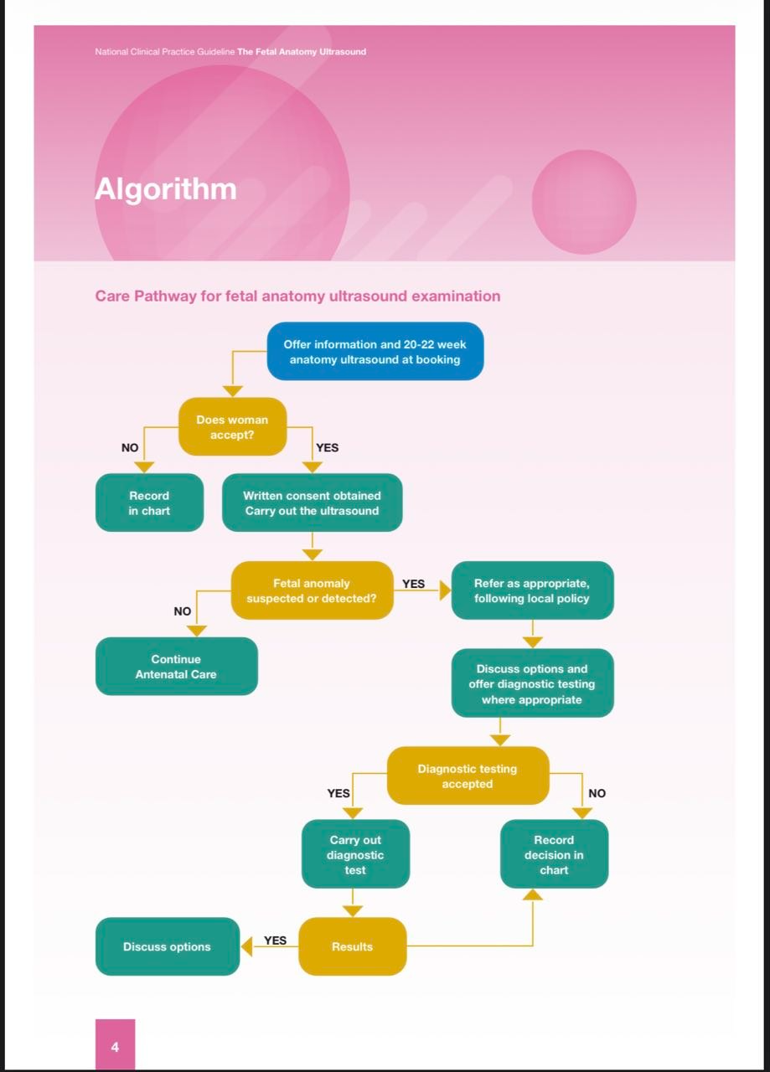
Key recommendations

Slide 80
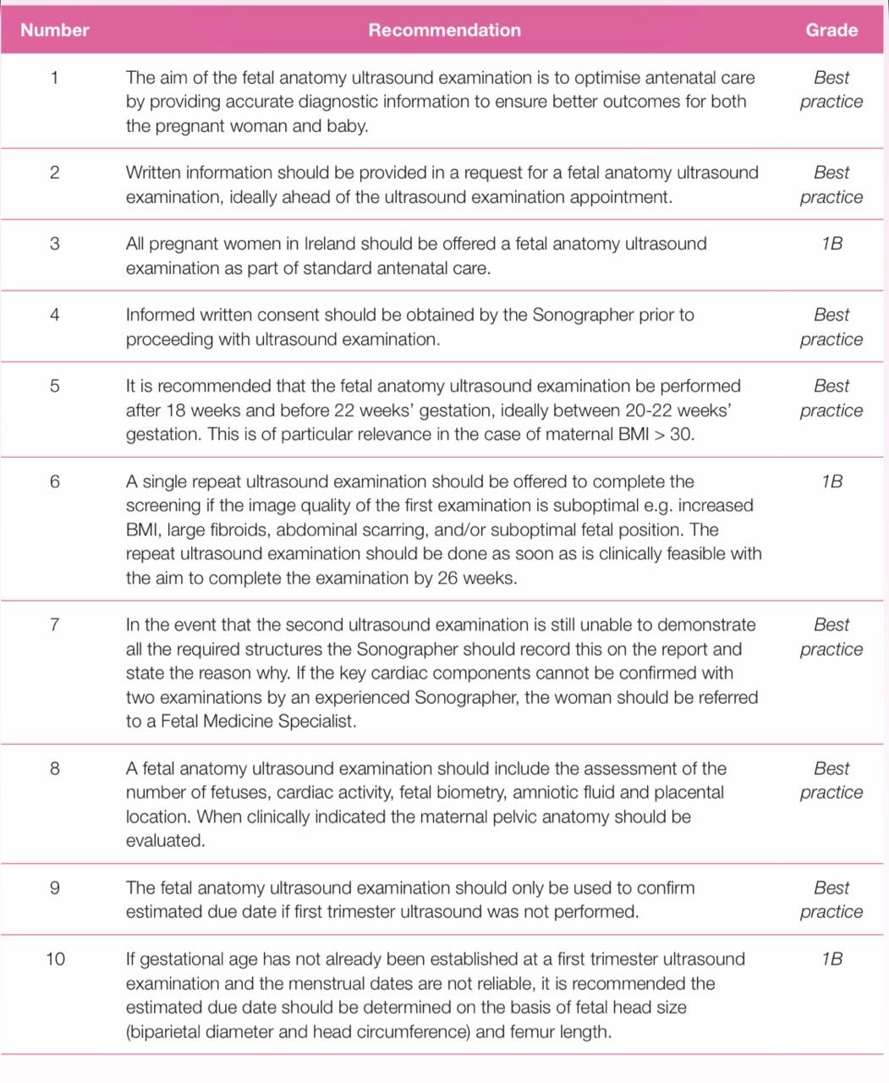

Key recommendations

Slide 81
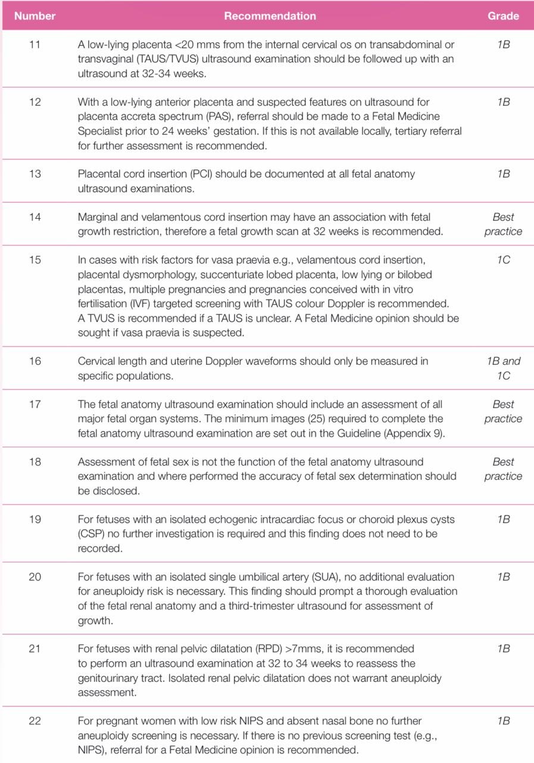

Slide 82
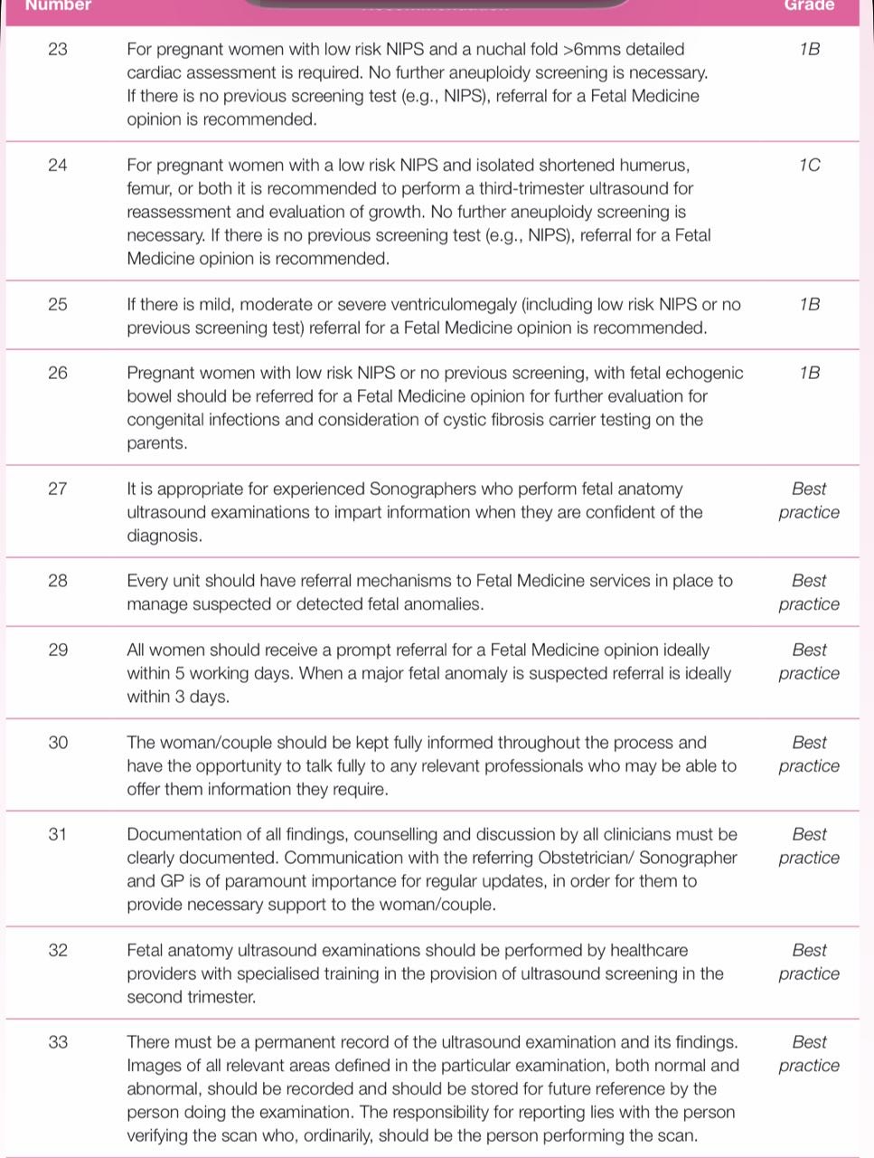

Slide 83
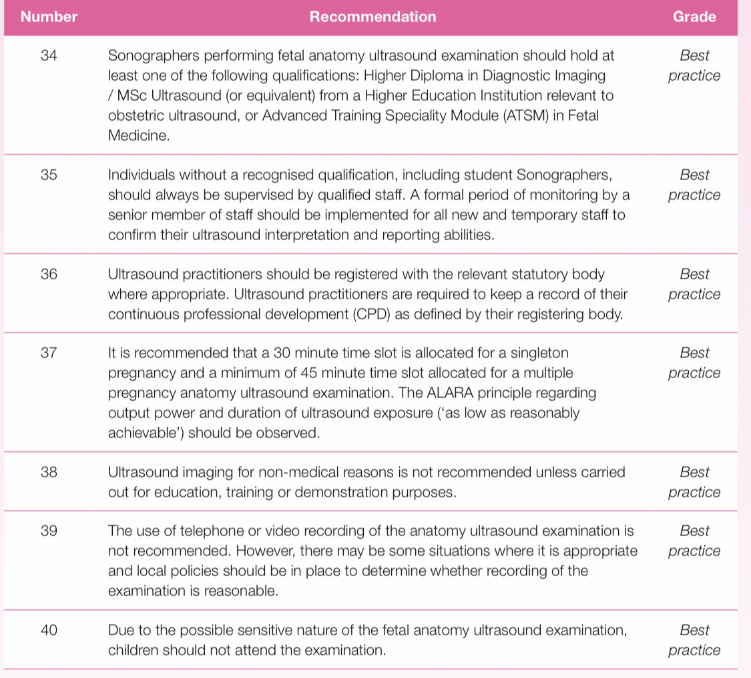

Slide 84
Background
The fetal anatomy ultrasound examination is an investigation offered to pregnant women during the second trimester of pregnancy.

Slide 85
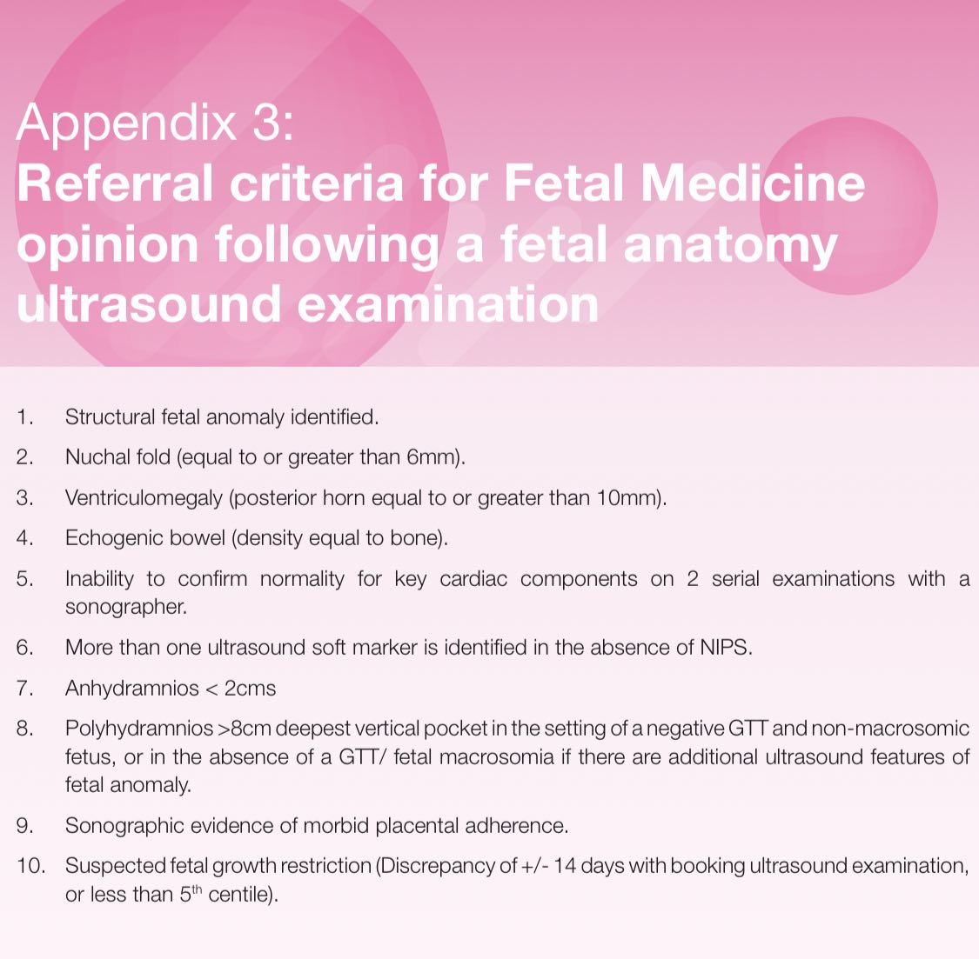

Slide 86
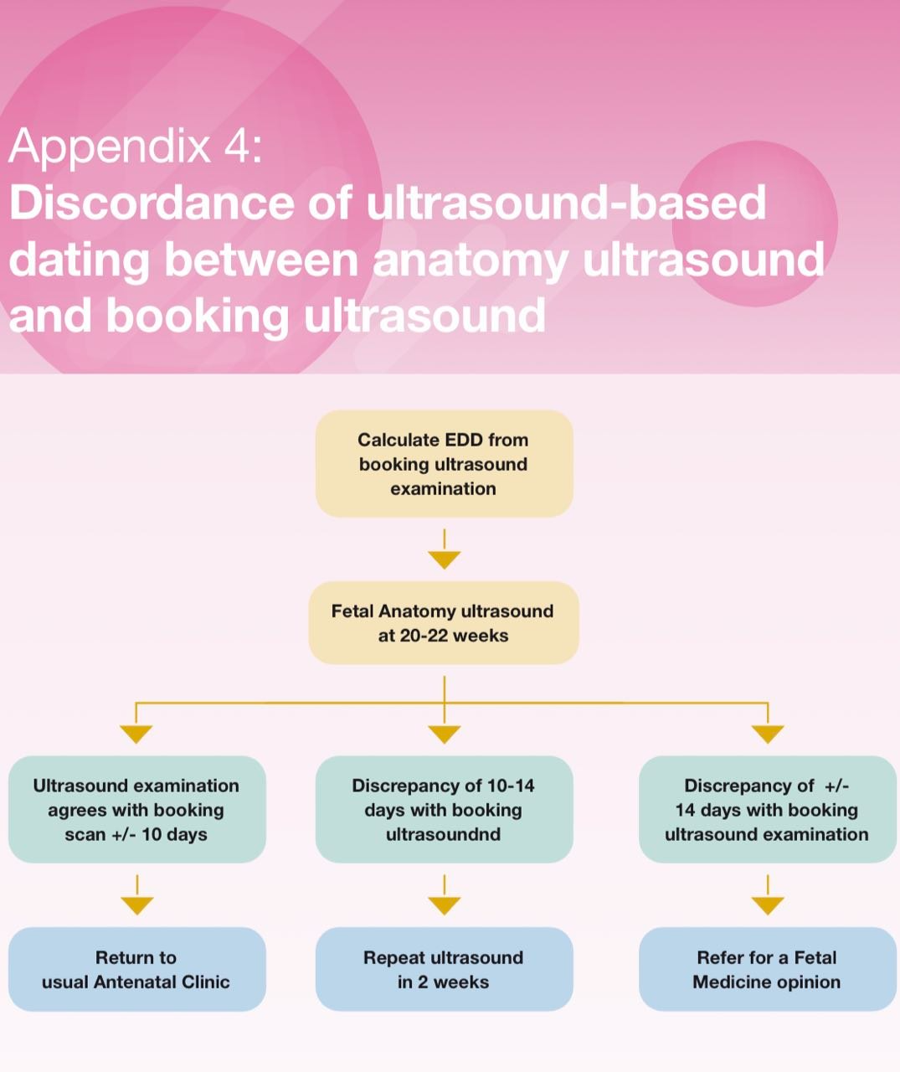

Slide 87
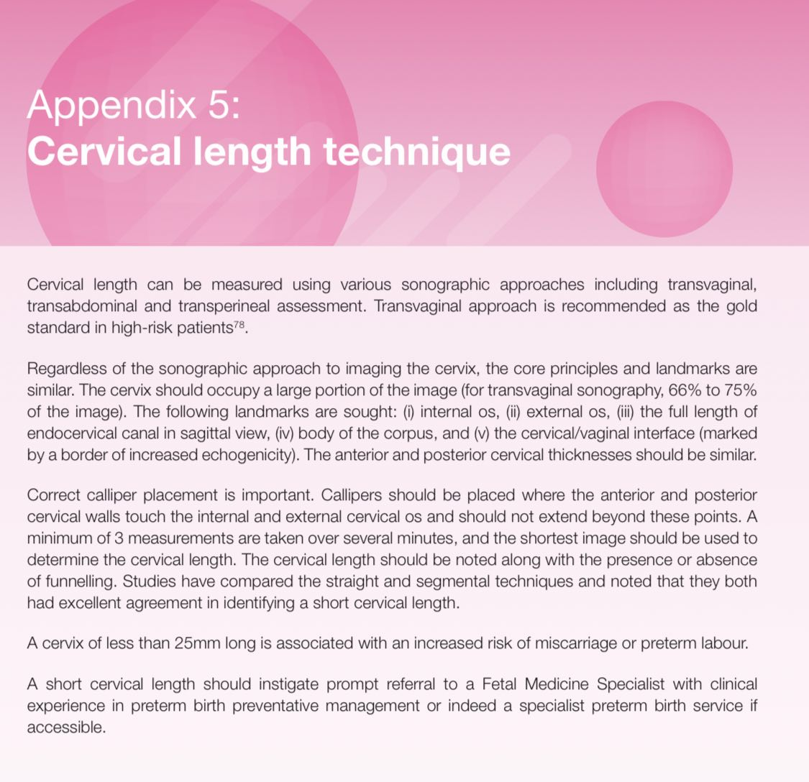

Slide 88


Slide 89
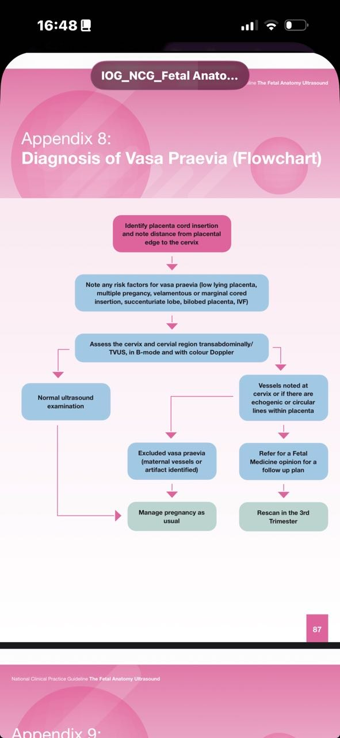

Slide 90
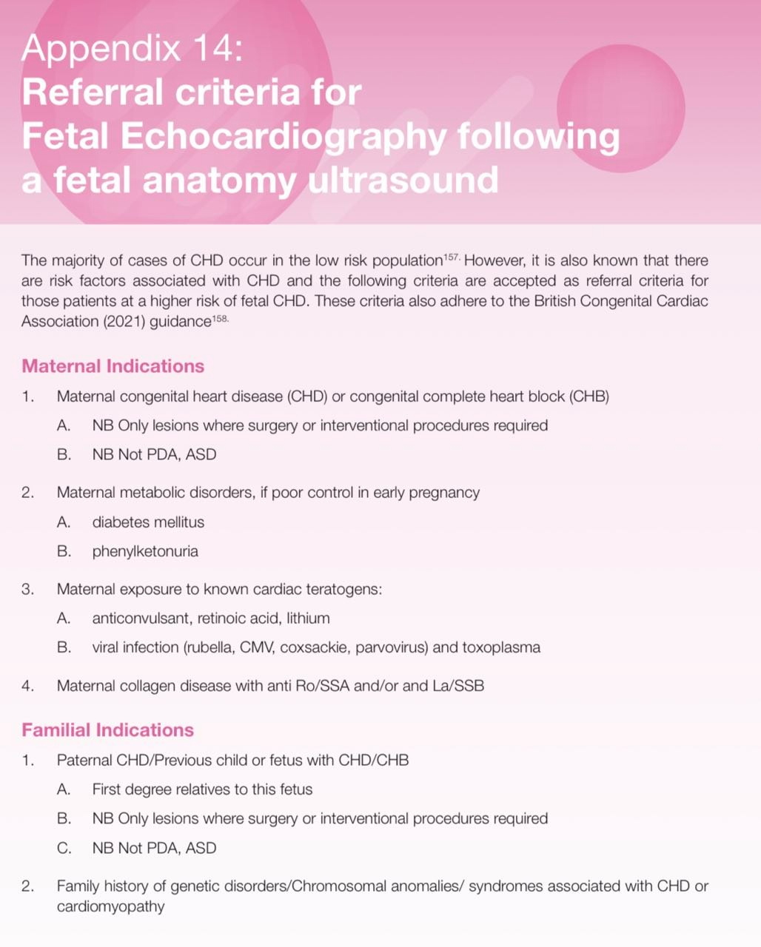

Slide 91
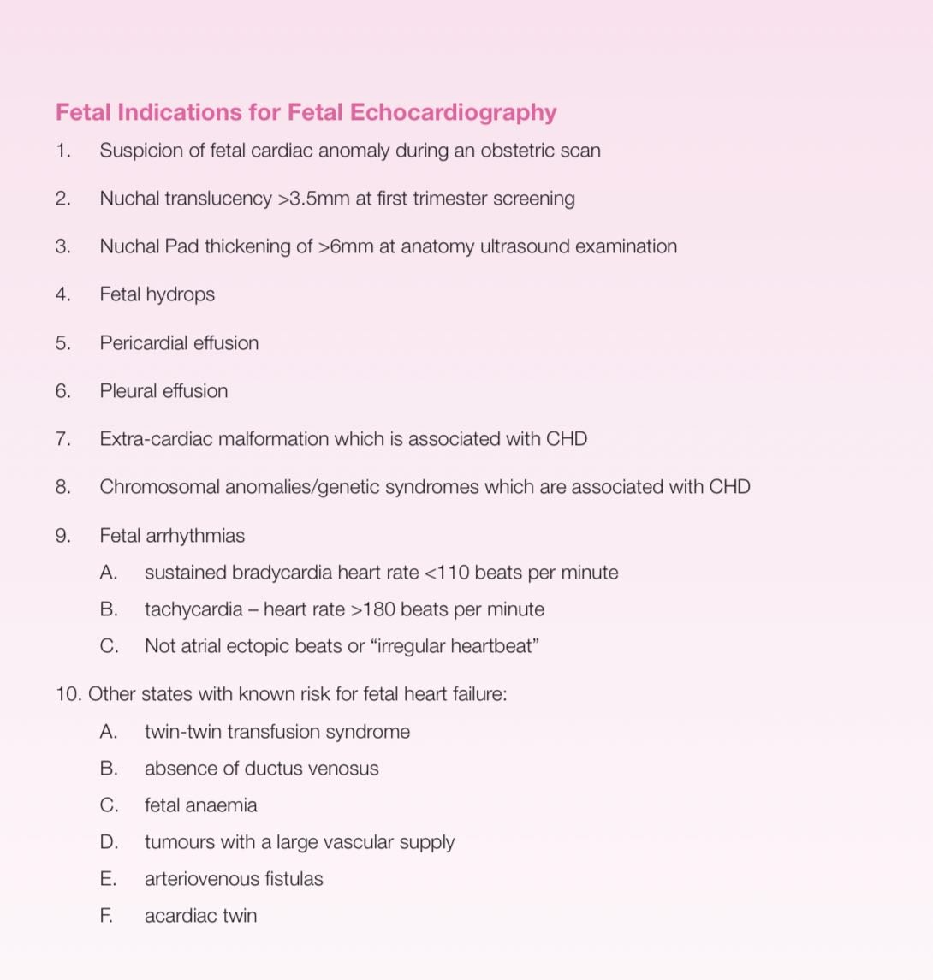

Slide 92
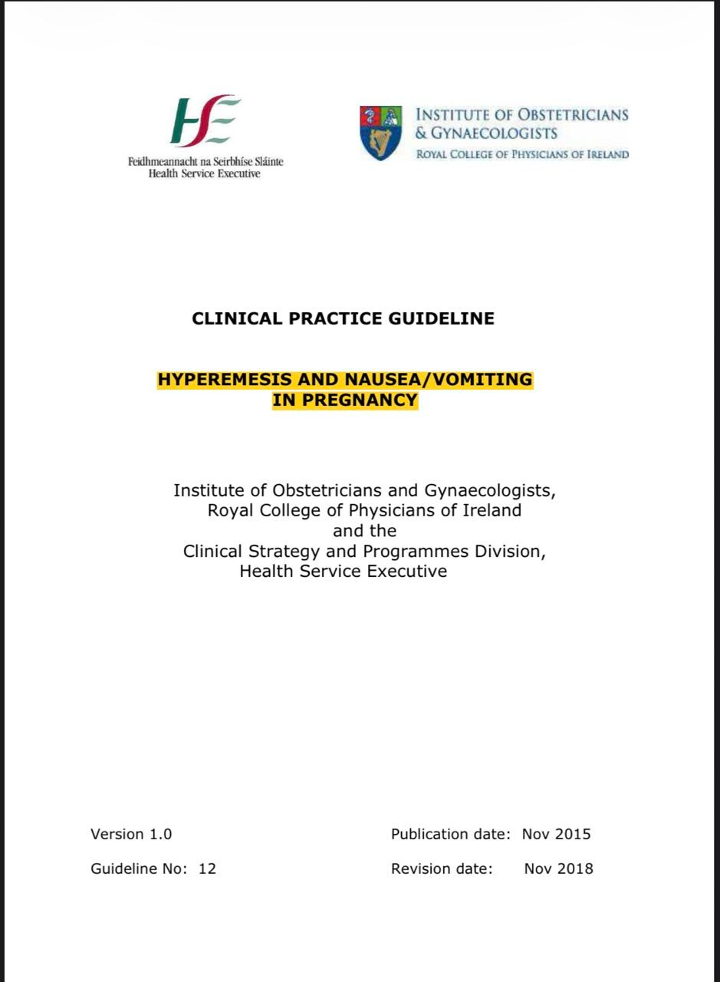
HYPEREMESIS AND NAUSEA/VOMITING IN PREGNANCY

Slide 93
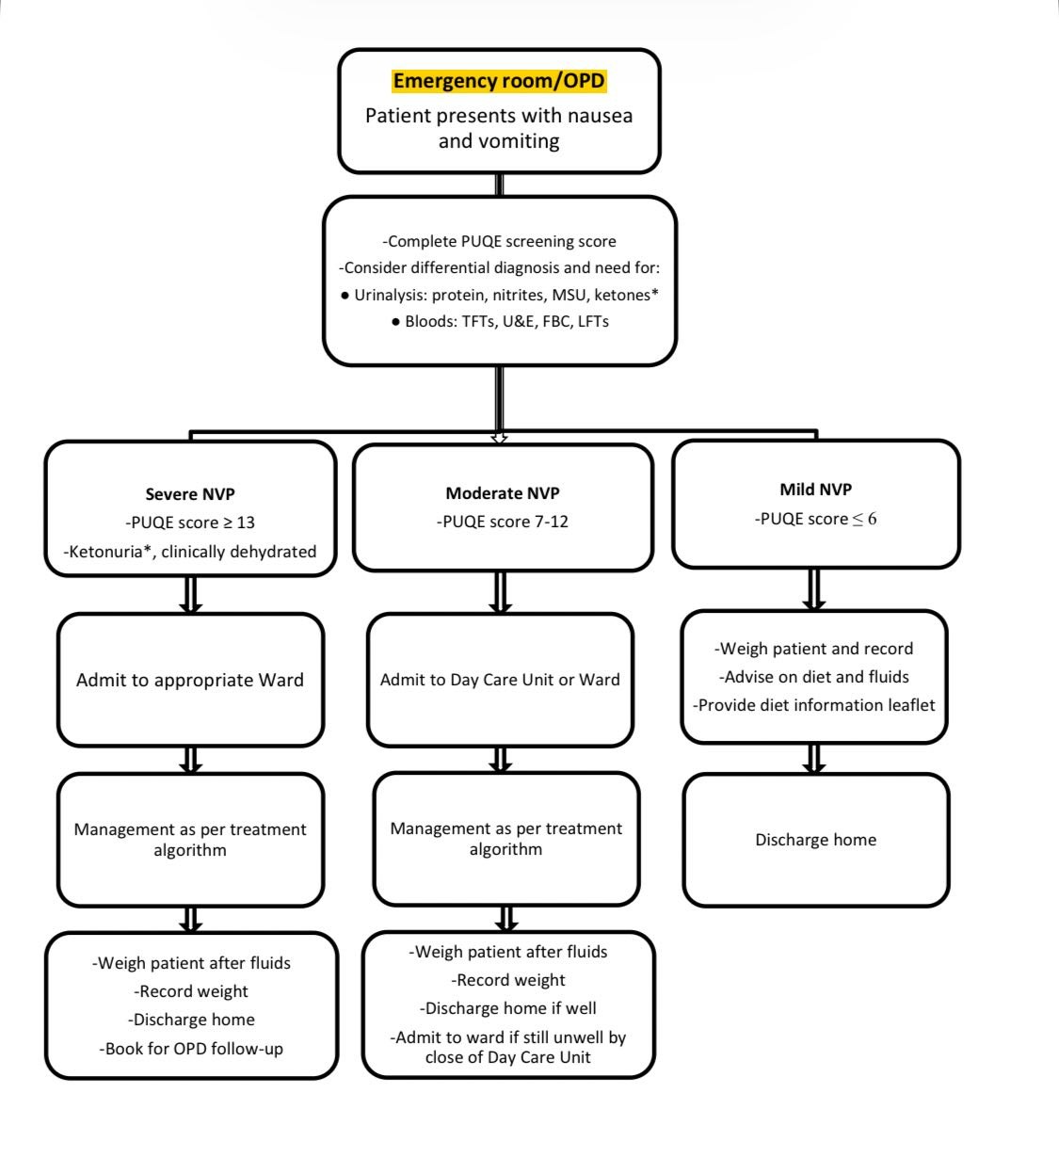

Slide 94
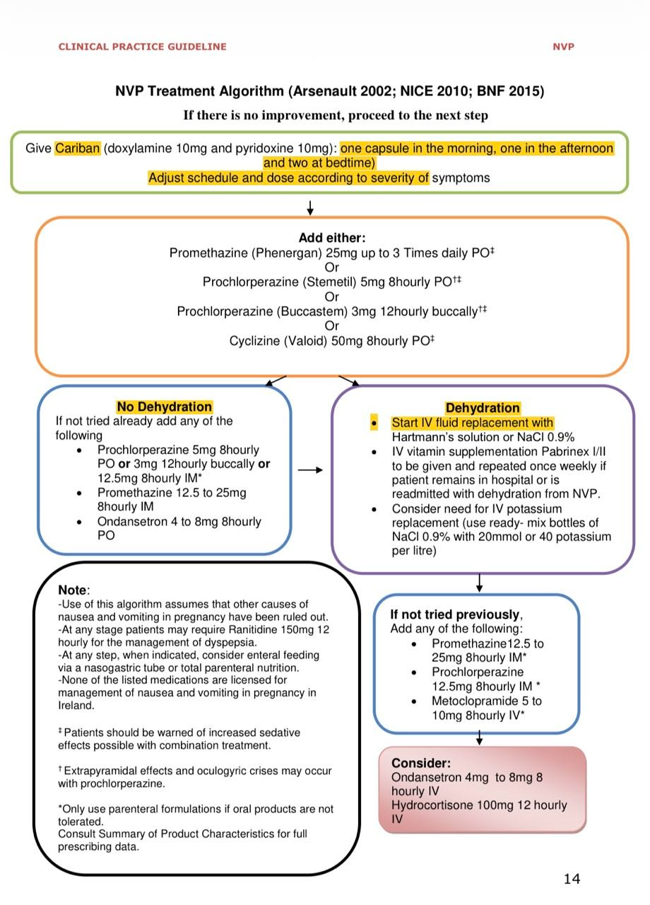

Slide 95
Key recommendation
Hyperemesis gravidarum, a severe form of nausea and persistent vomiting in pregnancy, must be diagnosed and treated appropriately to reduce associated morbidities and mortality.
Diagnosis of hyperemesis gravidarum is by exclusion. Women who experience nausea and vomiting for the first time after 10 weeks’ gestation are more likely to have an alternative diagnosis to nausea/vomiting in pregnancy. Be aware of potential alternative diagnoses.
There should be a low threshold for admission for women with diabetes, hyper/ hypothyroidism, epilepsy or other pre-existing conditions that may be adversely affected by nausea and vomiting. Women with diabetes should be monitored carefully as dehydration increases the risk of diabetic ketoacidosis

Slide 96
contineu
The severity of the condition should be assessed using the Modified 24 hour PUQE (Pregnancy Unique Quantification of Emesis and Nausea) score.
A clear and concise plan of care should be documented. Using the Modified 24-hour PUQE score and the NVP assessment algorithm, the management plan for individual patients will be outlined.
Treatment includes the correction of hypovolemia, electrolyte imbalances and ketosis and the provision of vitamin supplementation, anti-emetic medication and thromboprophylaxis.

Slide 97
Contineuo key recommendation
Consultation with a Dietitian is recommended. There is no evidence to support the effectiveness of dietary restrictions to relieve symptoms and patients are advised to avoid personal triggers of nausea.
Psychological support should also be offered to affected women with emphasis placed on the self-limiting nature of the condition.

Slide 98
Be Aware of Potential Differential Diagnoses or Pre-disposing Conditions
Urinary tract infection
• Multiple pregnancy
• Gastrointestinal (for example, infection including Helicobacter pylori, reflux oesophagitis, gastritis, cholecystitis, peptic ulceration, hepatitis, appendicitis, pancreatitis, complications after bariatric surgery)
• Neurological (for example, migraine, raised Intracranial pressure, central nervous system diseases)
• Molar pregnancy
• Ear, nose, and throat disease (for example, labyrinthitis, Ménière’s disease, vestibular dysfunction)
• Drugs and supplements (such as opioids and iron- some prenatal multivitamin preparations contain iron which may exacerbate NVP)
• Metabolic and endocrine disorders (such as hypercalcaemia, Addison’s disease, uremia, and thyrotoxicosis)
• Persistent vomiting in diabetic women which may suggest autonomic neuropathy
• Psychological disorders (such as eating disorders)

Slide 99
Maternal Complications
Dehydration o increases the risk of diabetic ketoacidosis in those with type 1 diabetes o increases the risk of thromboembolism along with immobilisation
• Electrolyte disturbances as seen in any patient with persistent vomiting – hypochloraemic alkalosis, hypokalaemia and hyponatraemia
• Protein-calorie malnutrition
• Vitamin/mineral deficiencies and accompanying problems – e.g. thiamine deficiency can cause Wernicke’s encephalopathy, a serious neurological disorder associated with acute mental confusion, short term memory loss, ataxia, ocular abnormalities such as nystagmus and peripheral neuropathy. Wernicke’s encephalopathy can lead to irreversible neurological impairment .

Slide 100
continueuo
• Folate deficiency, leading to iron deficiency
• Thyroid dysfunction – e.g. “pseudo-thyrotoxicosis” – suppressed TSH with high free thyroxine resulting from thyroid stimulation by HCG

Slide 101
contineuo
• Renal dysfunction – (reversible) elevated urea and creatinine
• Hepatic dysfunction accompanying hyperemesis – elevated ALT, AST, low albumin, elevated bilirubin, due to malnutrition and catabolic changes
• Ulcerative oesophagitis
• Psychological morbidity e.g. post-traumatic stress disorder
• Mallory –Weiss tears

Slide 102
Fetal Complications
Fetal loss as a result of maternal Wernicke’s encephalopathy (Selitsky 2006) 6 CLINICAL PRACTICE GUIDELINE NVP
• Intrauterine growth restriction (IUGR) or small for gestational age infants associated with prolonged hyperemesis /multiple admissions and loss of >5% body weight
• Undernutrition in early pregnancy during fetal programming increases risk of chronic illness in adult life of the offspring

Slide 103
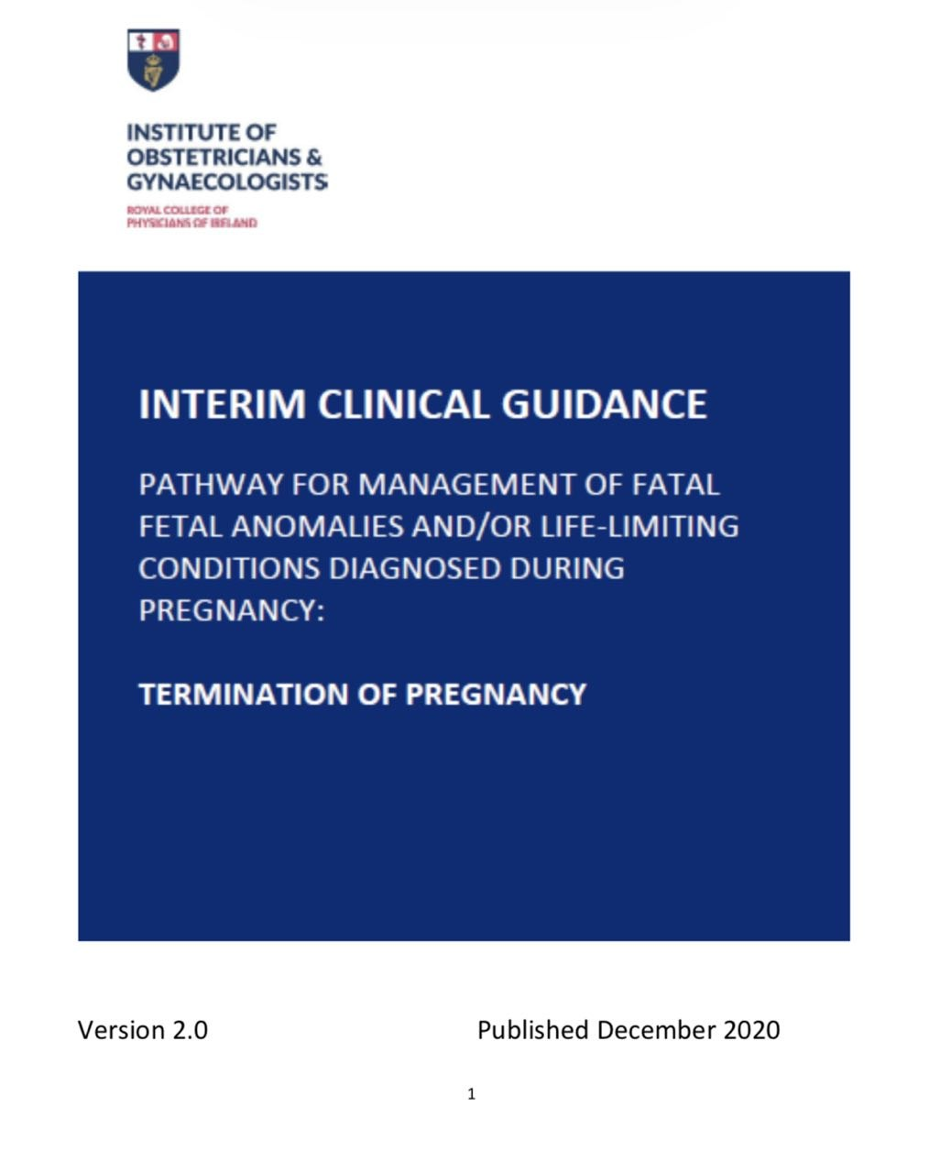

Slide 104
BACKGROUND
**Around 2-3% of pregnancies are complicated by congenital anomalies, of which around 15% are life-limiting.
**Advances in antenatal diagnosis of fetal anomalies, obstetric and neonatal care have increased the need for decision-making about end-of-life care for the fetus and neonate. These decisions also include the option of termination of pregnancy. This presents both Parents and Clinicians with new and difficult challenges.
**A perinatal palliative care approach is appropriate for Parents who continue their pregnancy after antenatal diagnosis of fatal fetal anomalies (FFA) / life- limiting conditions (LLC) as well as for those who opt for termination of pregnancy.

Slide 105
aims
The purpose of developing a pathway of care is:
• To enable clinical staff to deliver consistent, high quality ongoing care for families electing to continue or terminate pregnancy with a fetus with a life-limiting condition/fatal fetal anomaly or potential life limiting condition
• To ensure uniform standards of care wherever families are cared for in Ireland.

Slide 106
Continuation of aim
This pathway deals with:
Termination of pregnancy where there are prenatally diagnosed fatal fetal anomalies
or life- limiting conditions in singleton or multiple pregnancies.
This pathway does not refer to:
• Unplanned imminent birth of a preterm pre-viable fetus.
• Newborn with a postnatally diagnosed life-limiting condition

Slide 107
STATUTORY GROUNDS FOR TERMINATION OF PREGNANCY

Slide 108
Key recommendations
• All women must have equal access to standardised ultrasound services, to accurately date the pregnancy, to assess the fetus for ultrasound diagnosable anomalies as part of a planned prenatal fetal diagnostic service, and for other indications if deemed necessary during the antenatal period.
The widely accepted minimal schedule for antenatal ultrasound comprises of two examinations; a dating ultrasound in the late first trimester, followed by a fetal anomaly scan, usually performed between 20-22 weeks’ gestation.
• The fetal anomaly scan is best performed between 20+0 to 22+6 weeks gestation as this time point allows the best visualisation of fetal anatomical structures. This ultrasound requires a high skill level and needs to be performed by an individual with specialised training for the practice of diagnostic ultrasonography in pregnant women.

Slide 109
Continuations of recommendations
• Fetal anomaly ultrasound should follow a strict format and should meet the minimum requirements set by the major international obstetric ultrasound professional bodies.
• Prompt referral to a fetal medicine specialist ideally within 24 to 72 hours is the standard of care where a major fetal anomaly is suspected, followed by provision of written information resources and support.
• Where termination of pregnancy is being considered, a fetal medicine specialist should be involved in the antenatal diagnosis, counselling, and planning the subsequent care of the pregnancy.

Slide 110
continuo
• Input from Neonatology/Paediatric specialists may be necessary to ascertain and/or agree on prognosis, and other specialist colleagues (e.g. surgery, cardiology, neurology, radiology and genetics) should be consulted as necessary. Such consultation should particularly occur in cases of rare or combined complex anomalies and may assist in the counselling of parents/families.
• All fetal medicine units should have timely access to clinical genetics specialists who may advise further on the type of testing necessary depending on the ultrasound presentation/family history and previous history.

Slide 111
• All fetal medicine units should have timely access to fetal MRi Paediatric Radiology specialists when clinically appropriate for confirmation of diagnosis or when additional information is warranted.
• A perinatal/paediatric Cardiologist using fetal specialist echocardiography should assess cardiac anomalies or cases where specific anomalies are associated with cardiac anomalies.
• Cases should be discussed by the fetal medicine team and the multi-disciplinary team (MDT) at the tertiary site; this will include discussion on diagnosis and prognosis, and to consider the option of termination of pregnancy being discussed with the Parents.

Slide 112
continuo
• Complex cardiac cases should additionally be discussed in a specialised cardiology cardiothoracic surgical multidisciplinary team meeting.
• The option of continuing the pregnancy with planned perinatal palliative care for the baby or terminating the pregnancy (in accordance with the Health (Regulation of Termination of Pregnancy) Act, 2018) should be discussed with the Parents; these discussions are usually held with the fetal medicine team and may include healthcare professionals from the multi disciplinary team (MDT).
• Women should have access to accurate and objective information and, if required, counselling and support. There should be local arrangements in place for providing value-neutral information to women about termination of pregnancy.

Slide 113
• Information around termination of pregnancy should be provided in simple, clear and concise English with avoidance of medical terminology.
• If either the Parents or the healthcare professionals are still uncertain about the diagnosis or prognosis, a second opinion, either internal or external, should be sought. The case should be discussed at an MDT meeting in the external tertiary centre. This should be facilitated in a timely fashion.
• Fetal medicine multidisciplinary team (MDT) discussions should form a component of the assessment of fetal anomalies, their prognosis and outcomes.
• Where termination of pregnancy is being considered, a fetal medicine specialist involved with the diagnosis and care should be one of the signatories on the certification documents.

Slide 114
Continuo key recommendations
• The decision regarding diagnosis and prognosis in cases of fatal fetal anomalies/life-limiting conditions is a clinical decision for which legal responsibility under the Health (Regulation of Termination of Pregnancy) Act, 2018 lies with the two certifying medical practitioners.
• As with Parents who continue pregnancies after antenatal diagnosis of fatal fetal anomalies/life-limiting conditions a perinatal palliative care approach may be appropriate for those who opt for termination of pregnancy
• An explicit care plan should be developed in conjunction with the Parents, especially for termination of pregnancy at later gestations.

Slide 115
• Maternal health and wellbeing during pregnancy, birth and the postnatal period remain components of maternity care, including when there is a planned termination of pregnancy for fatal fetal anomalies /life-limiting conditions.
• Fetal medicine assessment should be available alongside antenatal care, for as long as the pregnancy continues, in either the local maternity unit/hospital or in the tertiary centre. However, care should be provided in a place away from busy maternity clinics and areas of routine clinical activity.
• Bereavement support should be provided all along the care pathway and continue through the baby’s death and beyond. Parents who opt for termination of pregnancy need to be supported and given access to resources to help them through their grief.

Slide 116
• Appropriate consent should be obtained prior to termination of pregnancy, which clearly outlines the risks, benefits, side effects and complications of treatments or procedures.
• Women should be informed that termination of pregnancy is generally a safe procedure for which complications and mortality are rare at all gestations.
• Feticide can be performed before medical termination takes place after 21 weeks and 6 days of gestation to ensure that there is no risk of a live birth. Parents must receive sympathetic and supportive counselling before and particularly after the feticide procedure.
• Feticide should only be performed in tertiary referral centres where there are fetal medicine specialists with the appropriate level of training.

Slide 117
• Plans around induction, labour and delivery need to be clearly documented and communicated to the hospital staff who will be involved in the woman’s care. It should be agreed who will be present at the delivery.
• The Parents should be counselled prior to birth about scenarios where the baby may be born alive (most relevant at later gestations and where feticide has not been performed). The care plan should therefore allow for a scenario where perinatal palliative care is provided.
• It is important that women receive normal postnatal care and emotional support from the midwives looking after her in delivery suite and on postnatal wards. Ideally, one midwife should be allocated to care for the Parents and the fetus/baby. Parents should be allocated a room on their own after delivery. Consideration is to be given to using the hospital bereavement symbol, if the Parents wish.

Slide 118
• Clinical assessment, laboratory investigations and a full post-mortem examination should be considered to confirm the antenatally diagnosed fetal anomaly, the chance of recurrence and possible means of avoiding further pregnancy complications.
• The Parents should be given verbal or written information about cremation and burial options for fetal remains, with a clear explanation of what each entails, and given the opportunity to discuss them. Personal, religious or cultural needs relating to this should be met wherever possible.
• All women (and partners) should be offered a review appointment (or support visit as appropriate) in the weeks following termination of pregnancy and delivery, to assess the woman’s physical and emotional wellbeing.

Slide 119
continuo
• The Parents must also have a formal follow-up postnatal appointment with the fetal medicine team and/or their local Obstetrician, to assess wellbeing and review results of any post- mortem investigations .
• Appropriate training and support should be available for staff to enable confidence to care for the pregnant woman during delivery, the fetus/baby at birth and to deliver the supportive care plan.
• Medical practitioners with a conscientious objection to carrying out or participating in carrying out a termination of pregnancy, are obliged to make the necessary arrangements for the transfer of care of the pregnant woman, to enable her to avail of a termination of pregnancy. In an emergency, the pregnant woman’s care must be made a priority and the necessary treatment must be provided, irrespective of any conscientious objection the medical practitioner may have.

Slide 120
continuo
• Issues and challenges for staff arising from caring for women who have termination of pregnancy for FFA/LLC should form part of team discussions and should be addressed in hospital reviews of bereavement care.
• In all cases of termination of pregnancy, a form of certification must be completed as specified by the Health (Regulation of Termination of Pregnancy) Act 2018. This is the responsibility of two medical practitioners and includes the Obstetrician who carries out the termination of pregnancy.
• The review committee for matters relating to Section 11 certification (condition likely to lead to death of fetus) should be constituted by fetal medicine specialists, as well as specialists in Neonatology/ Paediatrics.
• Termination of pregnancy service providers must conduct regular audit of the care they provide. The recommendations within this guideline can serve as criteria for audit.

Slide 121
Important definitions
Stillbirth
Babies born dead after the 24th week of pregnancy are defined in law as a Stillbirth and must be registered as such, regardless of whether a termination of pregnancy has been performed.
Neonatal Death
Babies born with signs of life who die in the neonatal period must be registered. The responsible Obstetrician as appropriate completes the Death Notification form (part 1).

Slide 122
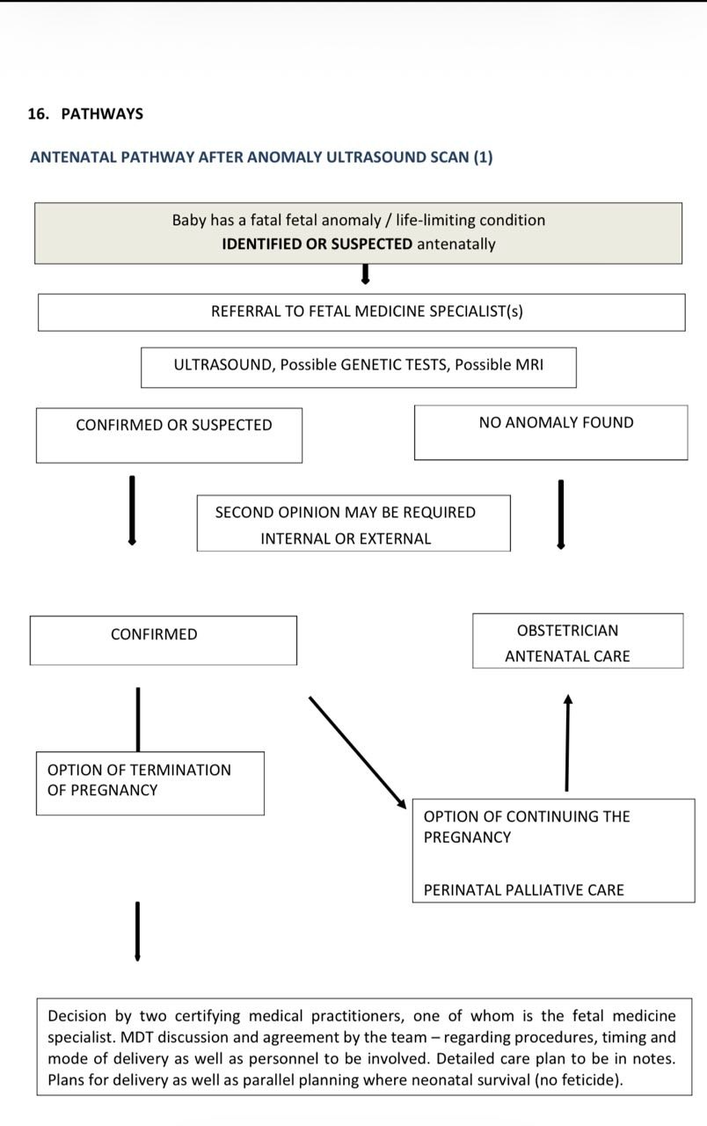

Slide 123
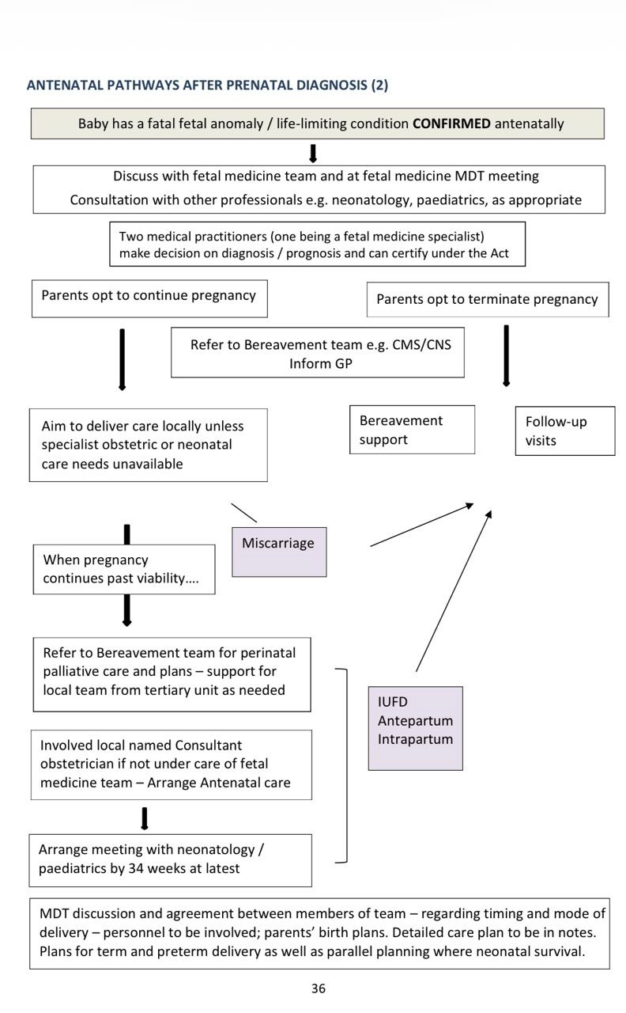

Slide 124
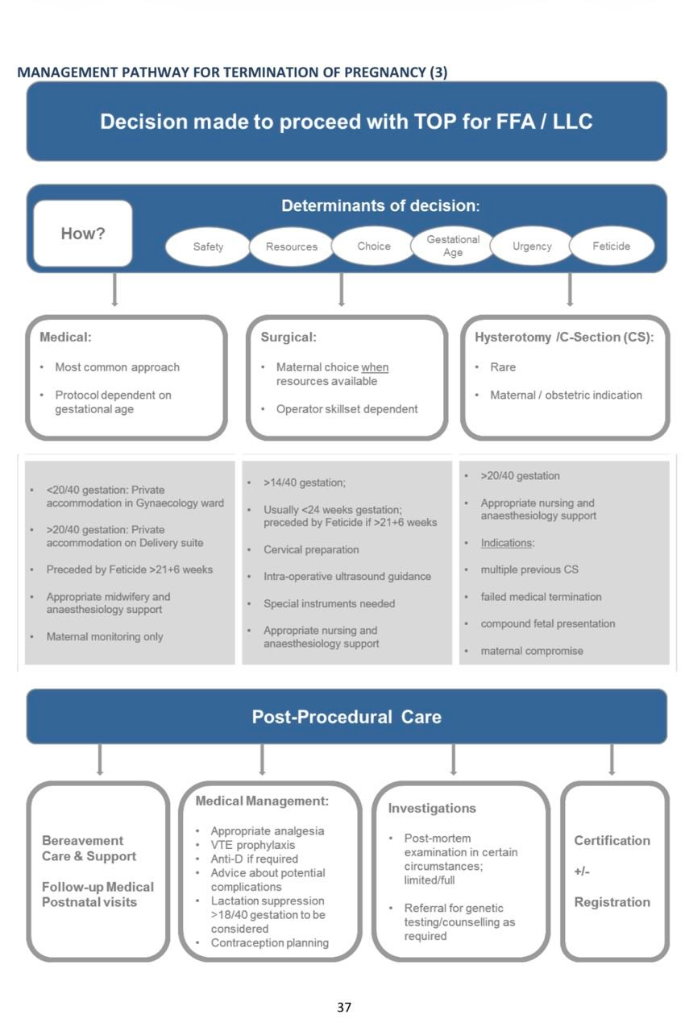

Slide 126
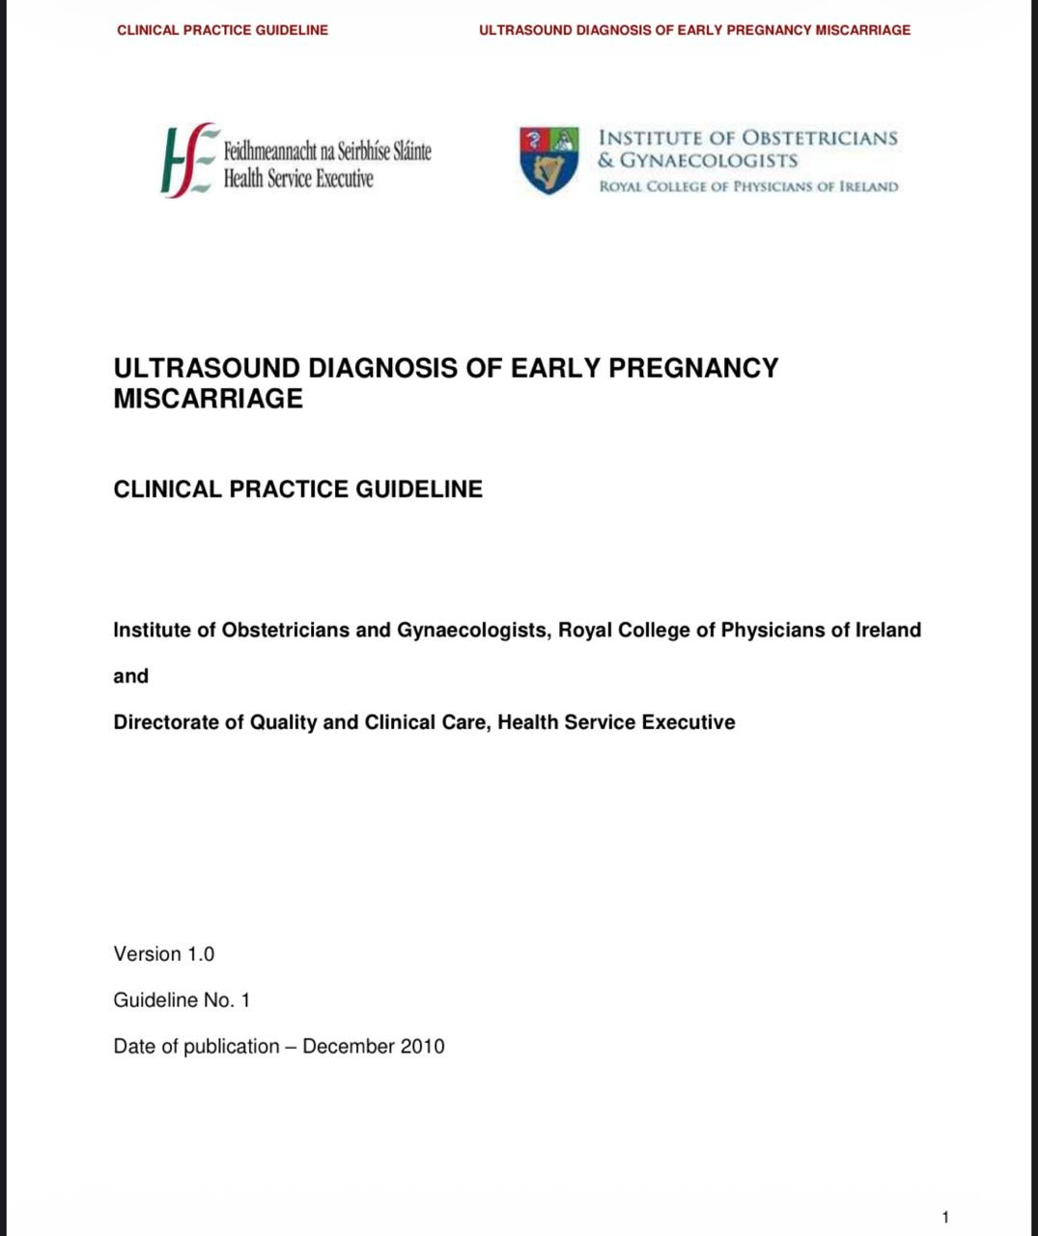

Slide 127
Purpose and Scope
The purpose of this guideline is to assist all healthcare professionals in the management of first trimester spontaneous miscarriage.
Background and Introduction
Spontaneous miscarriage is the commonest complication of pregnancy. It occurs in up to 20% of clinical pregnancies equating to approximately 15,000 miscarriages per annum in Ireland.

Slide 128
Terminology
”.
The recommended medical term for pregnancy loss less than 24 weeks should be “miscarriage.

Slide 129
Ultrasound and Embryo Development
:
The first ultrasound evidence of pregnancy is the gestational sac within the thickened decidua. This sac which represents the chorionic cavity is a small anechoic fluid collection surrounded by an echogenic ring that represents trophoblasts and decidual reaction. It is possible to identify the sac with transvaginal ultrasound by 4 weeks and 2 days when the mean diameter is 2-3 mm.

Slide 130
continuo
The yolk sac is the first structure often seen within the gestational sac and it confirms an intrauterine pregnancy.
yolk sac is first seen by transvaginal ultrasound when the mean gestational sac diameter is ≥5 mm.
The amnion is a thin, rounded membrane surrounding the embryo and is completely enveloped by the thick echogenic chorion.
. The yolk sac is situated between the amnion and the chorion.
At 5–7 weeks gestation both the embryo and gestational sac should grow at approximately 1 mm per day
From 5 ½ - 6 ½ weeks gestation a fetal heart rate of less than 100 beats per minute is normal. During the following 3 weeks there is a rapid increase up to 180 beats per minute.

Slide 131
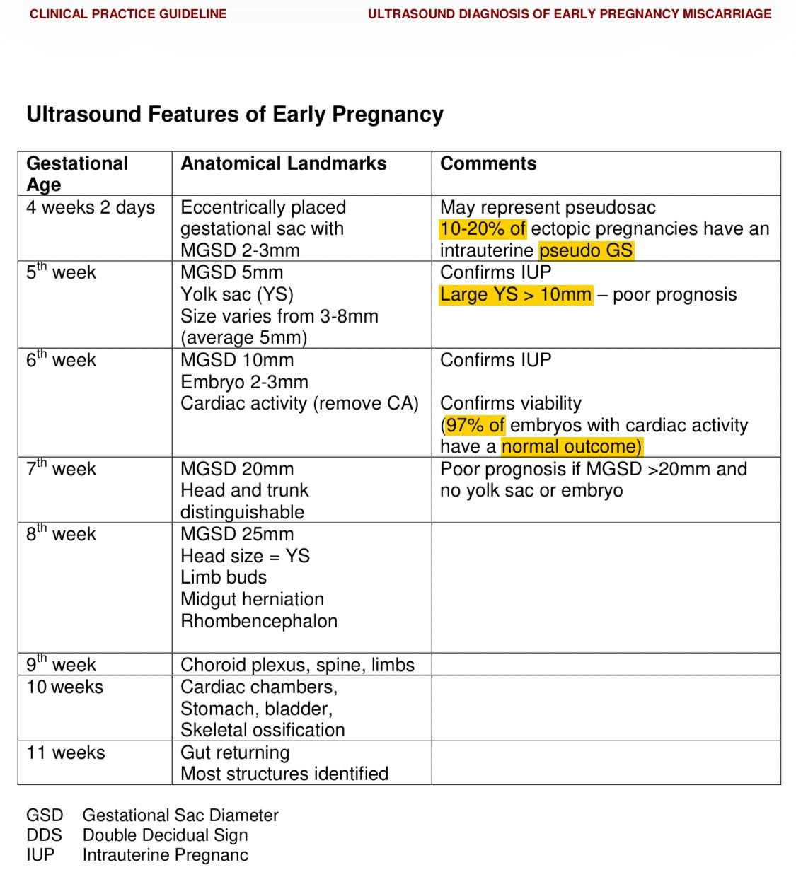

Slide 132
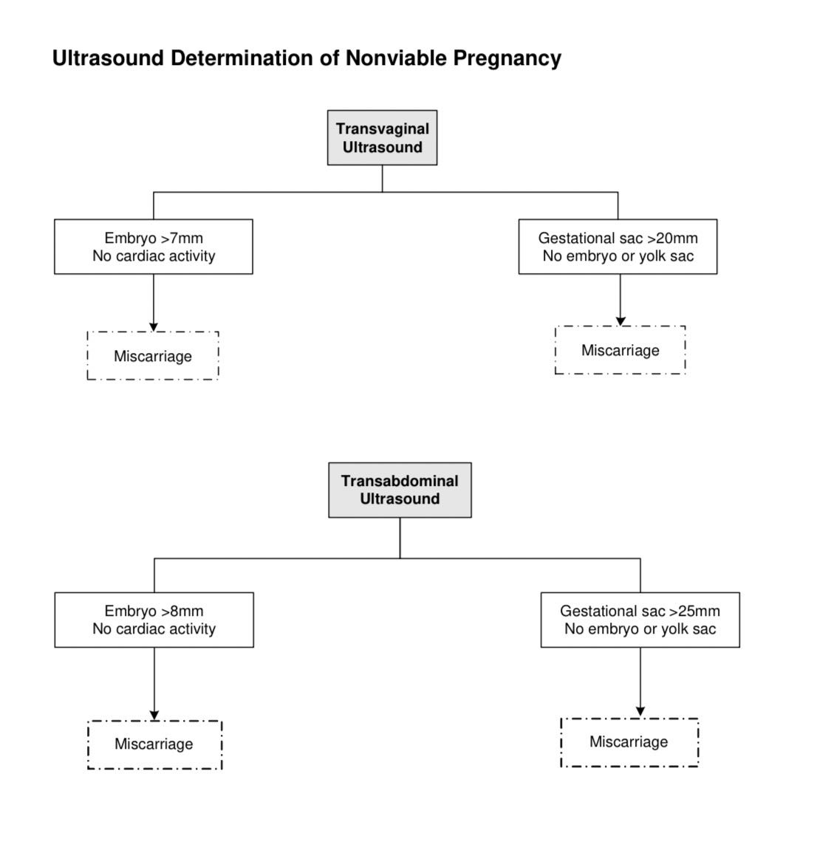

Slide 133
Ultrasound determination of pregnancy loss
When you can not confirm miscarriage yet>>>>>
On tve :if the mean gestational sca diameter <20mm and there is no yolk sac or embryo
Or
If the crl <8 mm and no fetal heart seen after observing for 30 sec
Then you can not dx miscarriage yet>>>>>you mus repeat the scan in 7-10 days .

Slide 134
When you can dx miscarriage (fetal demise)>>>>>>>
On tvs:
There is no fetal heart in an embryo with crl >7 mm,
Or
The msd >20 mm and there is no yolk sac or embryo
If only tas is available >>>the cut-offs are bigger because tas is less accurate
You can dx miscarriage if :
Crl >8mm with no fetal heart ,or
Msd >25 mm no yolk sac or embryo

Slide 135
continuo
The CRL does not include the yolk sac. If the mean gestational sac is smaller than expected, the possibility of incorrect dates should always be considered, especially when there is no pain or vaginal bleeding. In these circumstances, a repeat transvaginal scan should be arranged after 7-10 days.
It is not essential for a second sonographer to confirm fetal demise, , provided that the first sonographer is appropriately qualified and has adhered to the guidelines. It may be distressing for the woman to undergo another unnecessary transvaginal assessment.

Slide 136
Common Pitfalls with Ultrasound in Early Pregnancy
Exercise extreme caution with regard to last menstrual period (LMP) on history taking. 50% of women are uncertain of their dates, or have an irregular cycle, or have just stopped the oral contraceptive pill (OCP), or are lactating or did not have a normal last period .
Visualise all of the uterus. >>>Failure to visualise all of the uterus will result in missing gestational sacs in multiple pregnancies. Pseudosacs. Exercise caution in labelling intrauterine sac–like structures as gestational sacs unless they have contents i.e. yolk sac or fetus. Pseudosacs will follow the uterine cavity and are more ellipitical, while gestational sacs are fundal and eccentrically place

Slide 137
continuo
Neglecting to scan the adnexae >>>result in missing hererotopic pregnancies and ovarian masses
Fibroid Uterus>>>>. The fundus of a fibroid uterus may not be included in the scan field at TVS. Both TVS and abdominal scans are needed in these women to avoid missing gestational sacs.
Avoid labelling subchorionic bleeds as additional gestational sacs. Do not tell a woman that she has a twin pregnancy with one empty sac unless you are very experienced in ultrasound.

Slide 138
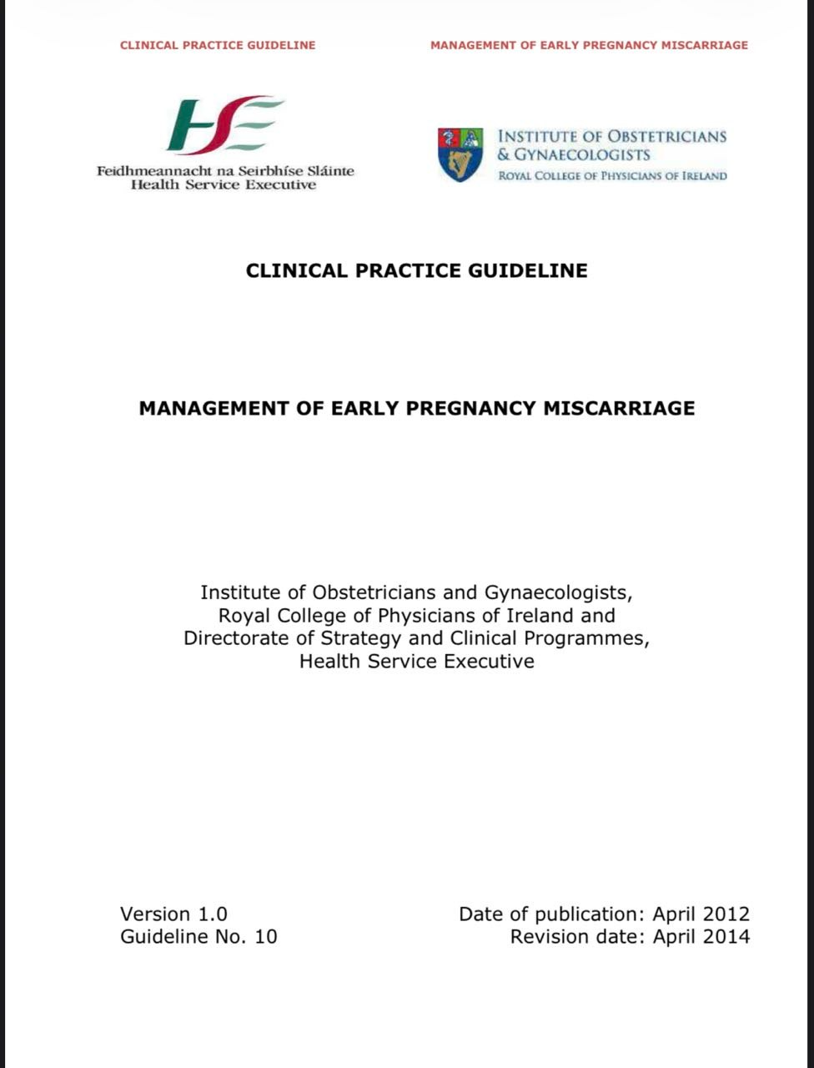

Slide 139
Key Recommendations
1. It is important that all relevant staff in the maternity services are familiar with the chronological ultrasound features of early pregnancy to accurately diagnose an early pregnancy loss.
2. This guideline should be read in conjunction with Clinical Practice Guideline: Ultrasound Diagnosis of Early Pregnancy Miscarriage (January 2011).
3. Women are sensitive about references to pregnancy loss. As their loss is not out of choice, use of language like “abortion” can be sometimes offensive at a vulnerable time. Hence, discussion or documentation of management of early pregnancy loss should be worded appropriately

Slide 140
4. At all times women should be supported in making informed choices about their care and management. Adequate explanations supplemented with written information should be given.
5. Surgical management of miscarriage should be offered to women who make a specific request, women who change their mind during the course of conservative or medical management, women who have heavy bleeding and/or severe pain, when gestational trophoblastic disease is suspected or if infected intrauterine tissue is present.
6. Conservative management of miscarriage is an effective and acceptable method to offer women. Women should be counselled that complete resolution may take several weeks and that overall efficacy rates may be lower than medical or surgical interventions.

Slide 141
7. Outpatient medical management should be reserved to women with a mean gestational sac diameter < 50mm as increased vaginal bleeding may be encountered. Misoprostol is given sublingually in two 600µg doses three hours apart.
8. All professionals should be aware of the psychological sequelae associated with pregnancy loss and should provide support, follow-up and access to formal counselling when necessary. Furthermore, a system must be in place for informing all relevant primary care professionals

Slide 142
Purpose and Scope
The purpose of this guideline is to improve the management of women with early pregnancy loss, defined as a loss within the first 12 completed weeks of pregnancy. It mainly reviews management of spontaneous miscarriage but is also relevant to women affected by ectopic pregnancy and gestational trophoblastic disease. However, specific recommendations for both these conditions are not covered in this guideline.

Slide 143
Background and Introduction
Spontaneous miscarriage is the commonest complication of pregnancy. It occurs in up to 20%
Historically, the majority of women who miscarried underwent „routine‟ surgical uterine evacuation; that is, evacuation of retained products of conception (ERPC).

Slide 144
Service Provision
• The EPAU service should be comprehensive and ideally sited in a dedicated area with appropriate staffing. There should be direct access for GPs and selected patient groups.

Slide 145
Terminology
• Viable intrauterine pregnancy:
Is when there is a normally sited gestational sac with a fetal pole and clearly identified cardiac activity. Demonstration of fetal heart activity is generally associated with a successful pregnancy rate of 85-97%.
Pregnancy of uncertain viability
Is when there is a normally sited gestational sac and the mean gestational sac diameter (MGSD) ≤ 20 mm and no fetal pole is seen or when there is a normally sited gestational sac with a fetal pole ≤ 7 mm present and no fetal heart pulsation is seen on a TVS .need uss in 7 days.
.

Slide 156
Information table
 | Column Name | Column Name | Column Name | Column Name
Row Name | Content | Content | Content | Content
Row Name | Content | Content | Content | Content
Row Name | Content | Content | Content | Content
Row Name | Content | Content | Content | Content
Row Name | Content | Content | Content | Content
Row Name | Content | Content | Content | Content

