Slide 1
Fetal infections module
By dr eiman elnasri
MRCPI PART 2 WRITTEN EXAM
SEPTEMBER

Slide 2
Frequently asking infections
Chicken pox
Herpes
Zika
Listeria
cytomegalovirus
Toxoplasma
Parvovirus B19
Rubella
Meseles

Slide 3
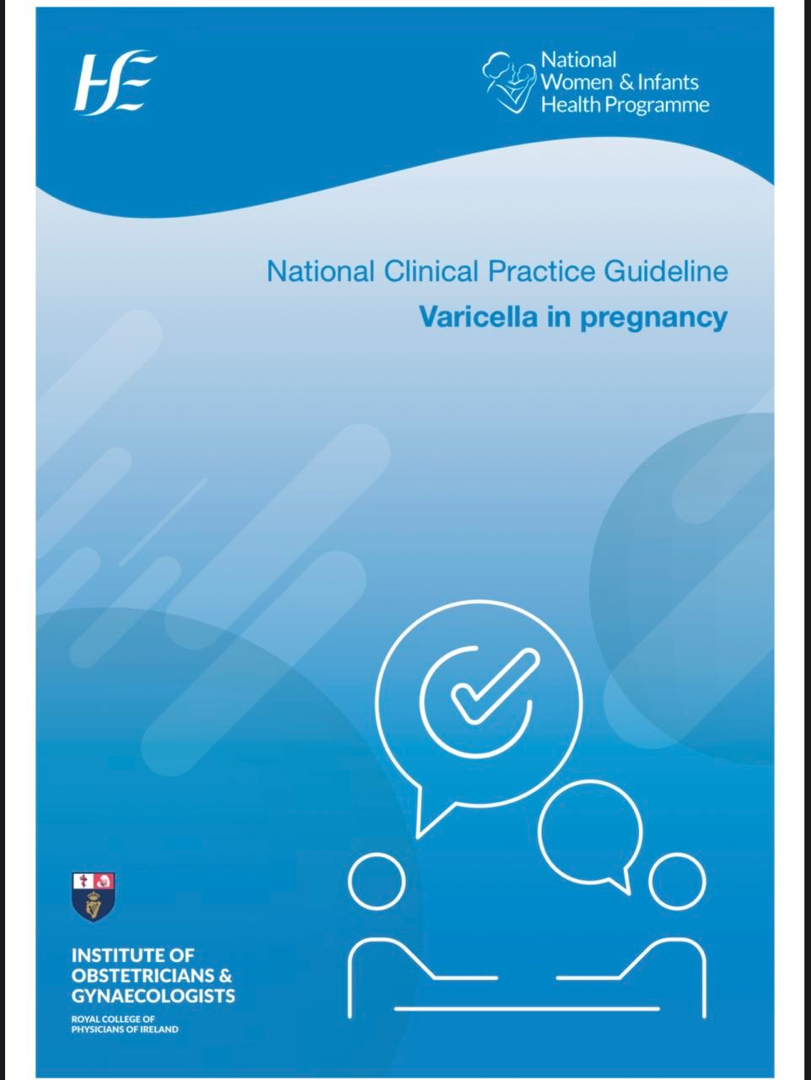

Slide 4
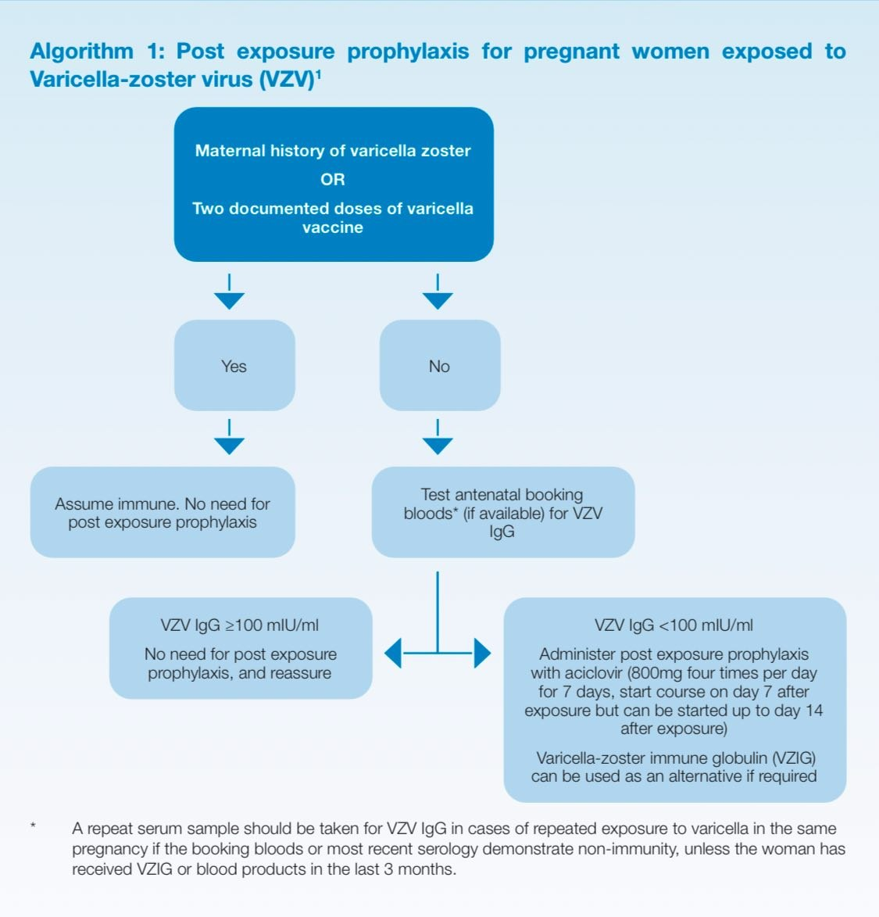

Slide 5
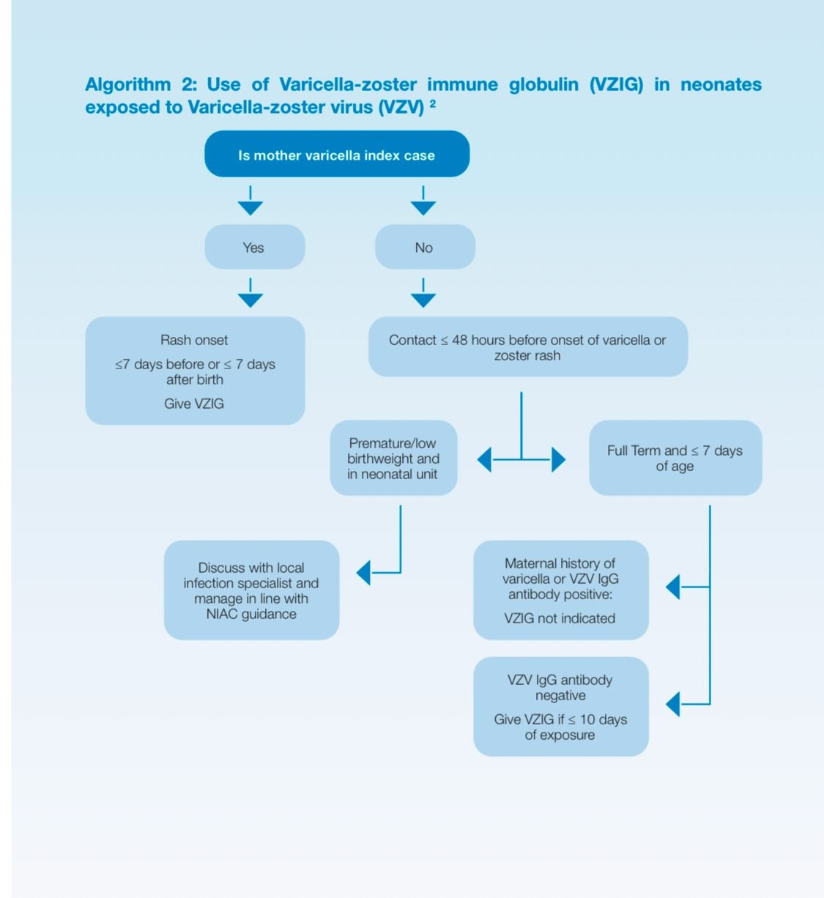

Slide 6
ANTENATAL CARE AND VARICELLA PREVENTION
1.We suggest that women planning to conceive and/or engaging with fertility services, should have their varicella status assessed as part of pre-conception counselling either by history or laboratory testing.
2.We strongly recommend that women should have their immunity to varicella discussed and documented at their booking visit. Their immunity can be confirmed by either reliable history of varicella, two varicella vaccines or by a laboratory test (varicella IgG) following exposure in line with National Immunisation Advisory Committee (NIAC) guidance. Laboratories may choose to only send varicella IgG if a woman is exposed, rather than on all women with an uncertain varicella history. Best practice

Slide 7
CONTINEU
3.We recommend that if there is any uncertainty around the history of varicella or shingles infection, that immunity should be confirmed by laboratory testing, at either booking or if exposure occurs.
4.We strongly recommend that women who are non-immune to varicella should be offered varicella vaccine in the postnatal period in line with NIAC guidance.
5.We strongly recommend that varicella vaccination should not be given during pregnancy in line with NIAC guidance.

Slide 8
CONTINEUO
6.We suggest that women with underlying medical conditions, or who are on immunosuppressive drug treatments which would put them at higher risk of severe varicella infection, should have this documented at the time of booking also.
7.We strongly recommend that pregnant women, who have no known immunity to varicella, should avoid children who are ill with varicella where possible.

Slide 9
Post-exposure prophylaxis for the non-immune pregnant woman exposed to varicella
8. If a pregnant woman contacts a healthcare provider following a potential varicella exposure, we strongly recommend that an assessment is done of her immunity and the nature of the exposure.
9.We strongly recommend that if the history of immunity is uncertain, that a varicella IgG test is performed either after exposure or at the time of booking.

Slide 10
CONTINEUO
10.If non-immune, or if immunity tests are pending, we recommend that the woman should be isolated with contact and respiratory precautions, if attending a healthcare facility during her potentially infectious period. This is from day 8-21 post-exposure if they receive aciclovir or no prophylaxis and from day 8-28 post exposure if they receive Varicella-zoster immune globulin VZIG.

Slide 11
CONTINEUO
10.If the varicella exposure is deemed significant, and the woman is non-immune, we strongly recommend that post exposure prophylaxis should be given in line with NIAC guidance. This should be oral aciclovir as first line option, with VZIG as an alternative.
11.We recommend that any pregnant woman exposed to varicella, should be encouraged to contact their healthcare provider if a rash or fever develops in the next 3-4 weeks.

Slide 12
CONTINEUO
13.We suggest that if a woman has additional medical conditions or is on immunosuppressive medications, then this should be taken into account when deciding on post exposure prophylaxis. A woman with prior history of varicella or shingles, may require post exposure prophylaxis if she is on significant immunosuppression. If unsure, consult NIAC guidance (Chapter 3) and liaise with the medical specialty team

Slide 13
CONTINEUO
Management of a pregnant woman or recently post-partum (<6WEEKS POST BIRTH) woman with suspected or confirmed acute primary varicella infection

Slide 14
14.We strongly recommend that all suspected or confirmed cases of varicella are isolated in a single room with ensuite facilities under airborne precautions if they require admission to hospital.
15. We strongly recommend that staff caring for the woman should be immune to varicella (natural immunity or vaccination or confirmed by laboratory testing as part of an occupational health assessment) to prevent hospital outbreaks, in line with NIAC guidanc

Slide 15
CONTINEUO
16. We strongly recommend that women with disseminated varicella should avoid contact with other vulnerable people (i.e. immunocompromised due to biologics, chemotherapy or other varicella non-immune pregnant women) until all the lesions are completely crusted. In case of shingles outbreak the lesions should be kept covered where possible.
17. We recommend that if a pregnant woman presents with acute varicella, aciclovir should be given as soon as possible, and ideally within the first 24 hours of the rash appearing. The benefit of aciclovir after 24 hours of the rash should be judged on a case-by-case basis.

Slide 16
CONTINEUO
18.We strongly recommend that IV aciclovir (10mg/kg every 8 hours) is given to pregnant women at all gestations if they have severe varicella with organ dysfunction (i.e. hepatitis, pneumonitis, encephalitis). Renal function should be monitored carefully, especially if receiving other nephrotoxic drugs, as aciclovir dosage adjustment may be required.
19. We strongly recommend that there is no role for VZIG once the rash has started to develop.
20. We suggest that, in addition to the management of acute varicella, pregnant women should be managed in line with the national sepsis guidelines, and be monitored for possible secondary bacterial infection especially with Group A Streptococcus. Best practic

Slide 17
CONTINEUO
21. Women with sepsis (i.e. organ dysfunction and suspected infection) should have their care escalated through established pathways to HDU or ICU level, and be managed in line with national sepsis pathways.
22. We suggest that any pregnant woman with symptoms or signs of meningoencephalitis be discussed with the local adult general medical service.

Slide 18
CONTINEUO
23. We recommend that women are advised to monitor for rash or symptoms for 8-21 days post exposure if given aciclovir or no prophylaxis, and 8-28 days if given VZIG.
24. The care and follow up of women with acute primary varicella should be individualised, with senior Obstetricians involved in the care.
25. We suggest that routine referral to a Fetal Medicine Specialist is not required for women without symptoms of varicella post exposure, unless there are particular concerns about fetal growth or anomalies. Best practic

Slide 19
Management of the pregnant woman whose fetus is exposed to varicella in utero
26. We recommend that women who develop primary varicella infection in pregnancy should be referred to a Fetal Medicine Specialist from 16-20 weeks gestation, and at least 5 weeks after the infection. Consultation with a Neonatologist is recommended if fetal anomalies are diagnosed on antenatal ultrasound
27. We suggest that women who develop primary varicella infection during pregnancy should be counselled about the risks versus benefits of amniocentesis to detect varicella DNA by polymerase chain reaction (PCR). Amniocentesis should not be performed before the skin lesions have completely healed, and at least five weeks after infection to minimise risk of a false negative result.

Slide 20
continue
28. If the mother develops primary varicella infection in the last four weeks before giving birth, she should be counselled that there is an increased risk of the baby developing severe disseminated varicella which would warrant antiviral treatment as soon as possible.
29. We suggest that clinicians should consider avoiding elective birth as clinically appropriate, until the infectious period has passed

Slide 21
continue
30. We recommend that care is taken around placement of epidural/spinal anaesthesia in line to avoid vesicles, and this should be done in consultation with senior anaesthetists. The suitability for epidural or spinal anaesthesia will depend on the presence or absence of skin lesions at the site of insertion, suspicion of viraemia and when treatment was commenced.
31. Mode of delivery should be considered on an individualised basis. Where there is evidence of fetal compromise or maternal respiratory failure delivery by emergency caesarean section is recommended.

Slide 22
continue
32. We strongly recommend that all babies born to mothers with acute primary varicella infection during pregnancy or birth, should be referred to the neonatology team at the time of birth. Best p

Slide 23
Management of the neonate exposed to varicella in utero, at time of birth or within first week of life
33. Babies whose mothers develop varicella in pregnancy at any gestation up to 7 days before birth:
a. We suggest that all babies with in utero exposure to maternal varicella more than 7 days before birth, should have a neonatal assessment at birth and pre-discharge, and their mother be encouraged to attend the routine developmental checks to ensure that they achieve their developmental milestones.

Slide 24
continue
b. The risk of severe varicella infection following exposure of preterm infants, i.e. <28 weeks or <1kg birth wt, should be discussed with senior Neonatologists.
34. Babies whose mothers develop varicella either within 7 days before birth or 7 days after birth:
a. We strongly recommend the use of post-exposure VZIG prophylaxis in line with NIAC guidance.

Slide 25
continue
35. When the index case is not the mother, then NIAC guidelines should be followed when considering prophylaxis for the neonate.
36. If a varicella exposed baby develops any rash or febrile illness in the neonatal period, we suggest that caregivers should contact the local GP or return to the local paediatric unit rather than the local maternity unit. They should be isolated in a single room to minimise risk of spread pending further investigation.

Slide 26
Management of the neonate with suspected or confirmed varicella in the first month of life
38. We strongly recommend that empirical IV aciclovir should be started in an unwell neonate with a disseminated vesicular rash, pending confirmation of the aetiology (i.e. HSV, VZV or enterovirus).
If varicella is confirmed, we strongly recommend that IV aciclovir should be continued in preterm infants irrespective of maternal immunity, those with respiratory compromise or those with severe end organ damage(encephalitis,
Hepatitis)

Slide 27
Varicella and breastfeeding
41. We recommend that women with varicella should be supported and encouraged to breastfeed if they wish.
42. Vesicles on the breast should be covered to minimise risk of transmission.
43. We recommend that clinicians advise mothers that aciclovir is not contra-indicated in breastfeeding. Aciclovir is present in breast milk after systemic administration but is not expected to cause any adverse effects in breastfed infants

Slide 28
Reactivation of varicella zoster in pregnancy (i.e. localised shingles
44. We suggest that Fetal Medicine assessment is not required, in the case of secondary infection/ herpes zoster infection, as shingles is not associated with fetal varicella syndrome.
45. We suggest that the placement of women with shingles, if admitted to hospital, is discussed with local infection control teams. In the cases of disseminated shingles, vesicles in an exposed site (e.g. ophthalmic shingles) or infection in an immunocompromised woman, infection control precautions are the same as acute primary varicella infection – isolation in a single room with ensuite facilities, under airborne precautions

Slide 29
continue
46. We suggest that oral aciclovir can be considered in certain women with shingles, but this should be done on a case-by-case basis. Aciclovir may be warranted particularly if the rash has spread to multiple dermatomes, involves non-truncal areas (i.e. near the eye) or the woman is immunocompromised

Slide 30
Important tips you have to know !!!
Baby delivered to mother with shingles >>>>no IG required

Slide 31
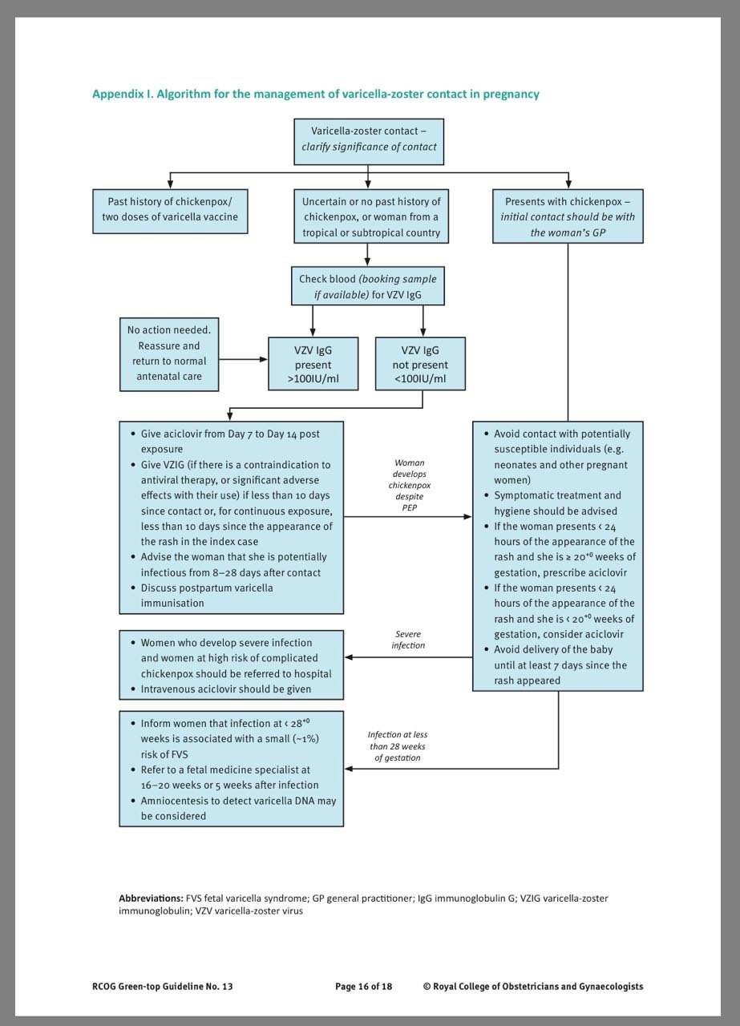
GTG

Slide 32
HSV 1&2
Key update :
1.Ulcer panel PCRfor all genital ulcers in pregnancy.
PCR testing from ulcers should routinely include type specific HSV ,VSV ,AND AND TREPONEMA P.
2.Suppressive therapy starts earlier:
32 weeks for all and 22wks if high risk of preterm birth
3.Valaciclovir now accepted alternative to acyclovir

Slide 33
TRANSMISSIONS AND TYPES
Initial episode:
First episode with either HSV-1 or HSV-2
Dependent on whether the individual has had prior
exposure to the other type, this is further subdivided
into:
o Primary infection: first infection with either HSV-1 or
HSV-2 in an individual with no pre-existing antibodies to
either type.
o Non-primary infection: first infection with either HSV-1
or HSV-2 in an individual with pre-existing antibodies to
the other type.

Slide 34
Transmission AND TYPES
An initial episode may not be recognized as such as only
approximately one third of patients present with symptoms
following acquisition. Therefore, what appears to be an
initial episode may be a recurrent episode.
· Recurrent episode: recurrence of clinical symptoms due
to reactivation of pre-existent HSV-1 or HSV-2 infection
after a period of latency.
.

Slide 35
TRANSMISSION RISK
“Risk… very high at 41% for those who acquired primary herpes simplex in the third trimester.
• Non‑primary first episode → 25% risk
• Recurrent lesions at delivery → 0–3% risk
“Risk is low (0–3% for vaginal delivery).

Slide 36
Mx of first episode HSV IN PREGNANCY
• Do not delay treatment while awaiting PCR.
STANDER DOSE :
• Aciclovir 400 mg TDS × 5 days OR Valaciclovir 500 mg BD × 5 days.
• Full STI screen required.
• MDT involvement mandatory (GUM + obstetrics + neonatology

Slide 37
CONTINEU Mx
Suppressive therapy after first episode
• Start at 32 weeks (or continue treatment dose if acquired in 3rd trimester).
• Start at 22 weeks if high risk of preterm birth

Slide 38
Mx of recurrent HSV episode
1.before 28 weeks start symptomatic ttt lidocaine gel 2% OR 5%OINTMENT WITH analgesia like paracetamol.
Then start ACICLOVIR 400 MG 3 TIMES ADAY the suppressive dose from 32 weeks until delivery

Slide 39
Mode of Delivery
Primary or non‑primary first episode
• If within 6 weeks of delivery → Caesarean section recommended.
• Benefit decreases after ROM >4 hours, but still recommended.

Slide 40
contineuo
Recurrent HSV
• Vaginal delivery appropriate (risk 0–3%).
• Caesarean NOT recommended solely for recurrent lesions

Slide 41
Preterm pre labour ROM
Primary HSV + PPROM
• Neonate = highest risk.
• MDT decision: immediate delivery vs expectant management.
• If expectant → IV aciclovir 5 mg/kg q8h until delivery.
Recurrent HSV + PPROM
• Start aciclovir 400 mg TDS or valaciclovir 500 mg BD until delivery.
• Expectant management acceptable before 34 weeks

Slide 42
Neonatal Mx –risk categories
Highest Risk
• Primary maternal infection at delivery
• Vaginal birth with active first episode
• Maternal postpartum primary HSV within 4 weeks
• Any positive neonatal HSV PCR
→ Immediate IV aciclovir 20 mg/kg q8h
→ Full workup: blood PCR, CSF PCR, LFTs, coagulation, surface swabs.

Slide 43
continue
High risk
• Maternal first episode within previous 6 weeks but baby asymptomatic
→ Investigations at 24 hours; treat if positive.
Low Risk
• Recurrent lesions at delivery
→ Swabs at 24 hours; no routine aciclovir unless positive.

Slide 44
continue
Lowest Risk
• Recurrent HSV >6 weeks ago, no lesions at delivery
→ No investigations needed.

Slide 45
Breast feeding
• Safe unless active herpetic breast lesions.
• If lesions present → do not feed from affected breast; discard expressed milk from that side.
• Aciclovir/valaciclovir safe in breastfeeding.

Slide 46
Discordant Couples (Partner HSV+, pregnant person HSV–)
Avoid sexual contact (oral/vaginal/anal) in third trimester + 2 weeks before.
• Partner may take suppressive antivirals to reduce shedding.
• Serology may help but has limitations.

Slide 47
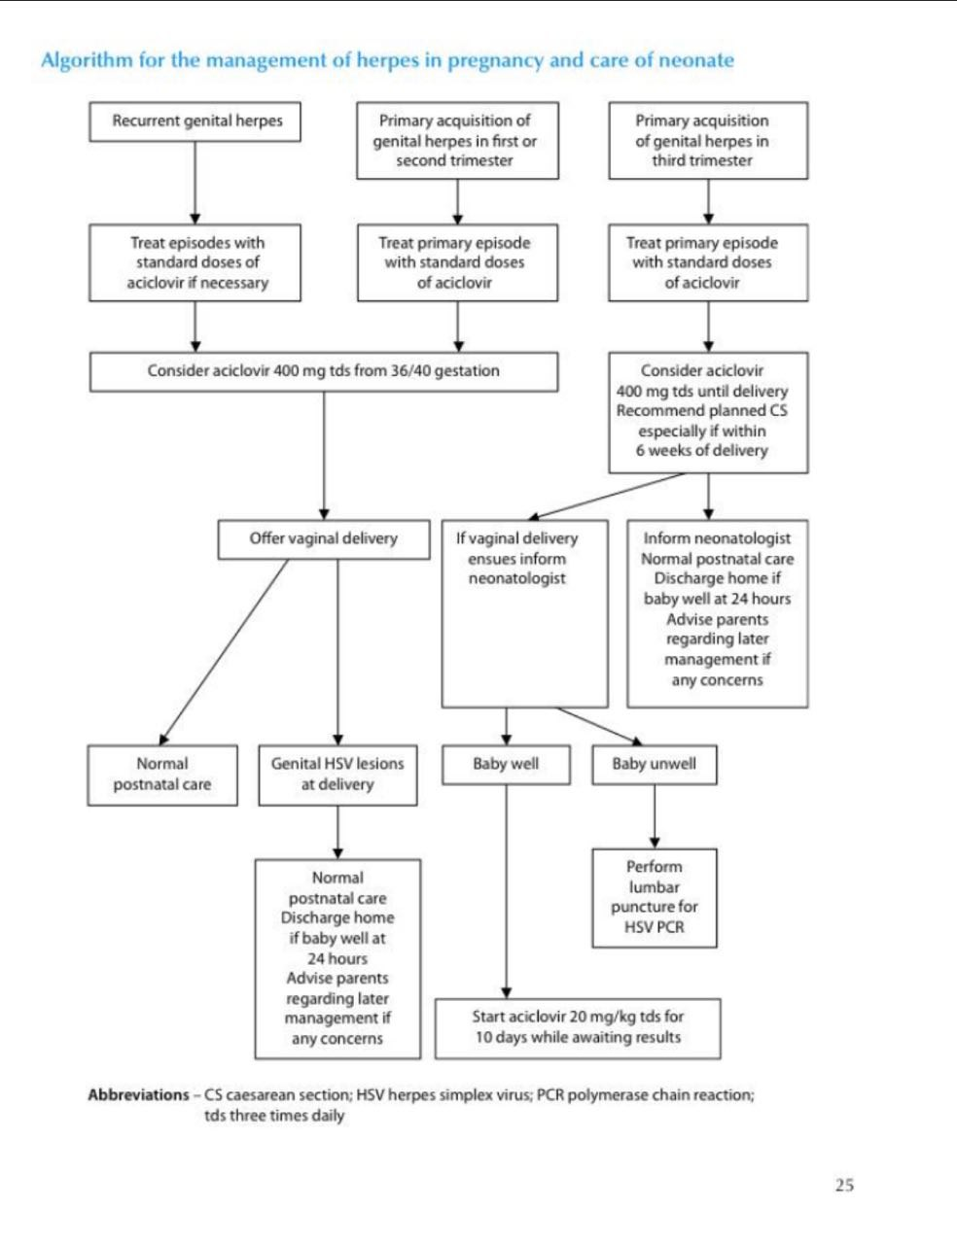

Slide 48
Serology –
• Third trimester first episode → helps distinguish primary vs recurrent.
• If antibodies match PCR type → recurrent, not primary → vaginal delivery allowed.
• Interpretation complex → discuss with virology

Slide 49
Antivirals – Safety
• Aciclovir & valaciclovir not associated with birth defects.
• Transient neonatal neutropenia reported but not clinically significant.

Slide 50
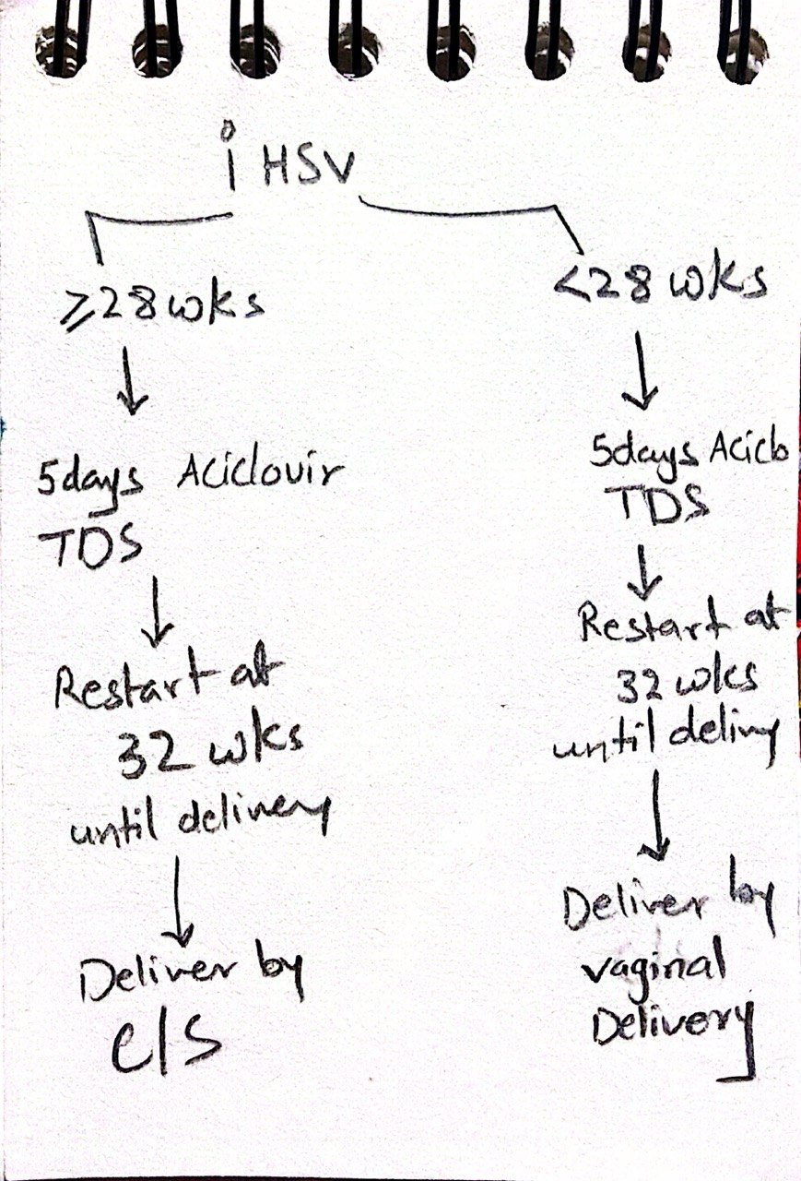

Slide 51
Zika virus
Zika virus disease is mainly transmitted by Aedes mosquitoes.
It is not a contagious disease and does not spread from person to person.
Since 2014, there has been an increase in the numbers of ZIKV infections in South and Central America, the Caribbean and the Pacific.

Slide 52
continue
Symptoms and signs:
Most people with Zika virus infection are asymptomatic.
Symptoms may include two or more of the following:
fever, rash, conjunctivitis, myalgia, arthralgia/arthritis, headache, retro‑orbital pain, pruritus.

Slide 53
Diagnosis:
Zika virus can be detected by PCR testing of blood during the symptomatic period and with relevant travel history.
Maternal implications:
Serious complications are rare; however, an increase in Guillain‑Barré syndrome and other neurological or autoimmune syndromes has been reported.

Slide 54
continue
Fetal implications:
Zika virus crosses the placental barrier and has been detected in fetal blood and tissues.
There is a probable association with congenital microcephaly, but a causal relationship has not yet been proven. In October 2015, Brazil reported an unusual increase in babies born with microcephaly, thought to be associated with the ZIKV outbreak.

Slide 55
continue
Effect on breastfeeding:
There is no evidence that Zika virus can be transmitted through breast milke
If Zika virus antibodies are not detected in a serum sample collected 4 or more weeks after the last possible travel‑associated or sexual exposure, recent infection can be excluded.
If fetal microcephaly or brain abnormality (e.g., intracranial calcification) is diagnosed, consider amniocentesis for RT‑PCR testing

Slide 56
continue
If a couple is considering pregnancy, consistent use of effective contraception is advised to prevent pregnancy and barrier methods (e.g. condom use) are advised during vaginal, anal and oral sex to reduce the risk of conception and the developing fetus being exposed to Zika virus.
These measures should be followed while travelling and for:

Slide 57
continue
three months after return from an area with risk for Zika virus transmission, or last possible Zika virus exposure, if both partners travelled.
three months after return from an area with risk for Zika virus transmission, or last possible Zika virus exposure, if just the male partner travelled.
two months after return from an area with risk for Zika virus transmission, or last possible Zika virus exposure, if only the female partner travelled.
If a woman considering pregnancy develops symptoms compatible with Zika infection on her return to the UK, it is recommended that she avoids becoming pregnant for 2 months following recovery

Slide 58
DX
The diagnosis of Zika virus infection should be considered in individuals who
experience symptoms suggestive of acute Zika virus infection within 2 weeks of
leaving an area with risk for Zika virus transmission OR within 2 weeks of sexual
contact with a male sexual partner who has recently travelled within the previous
three months to an area with high or moderate risk of Zika virus transmission.

Slide 59
treatment
NO SPECIFIC antiviral ttt available

Slide 60
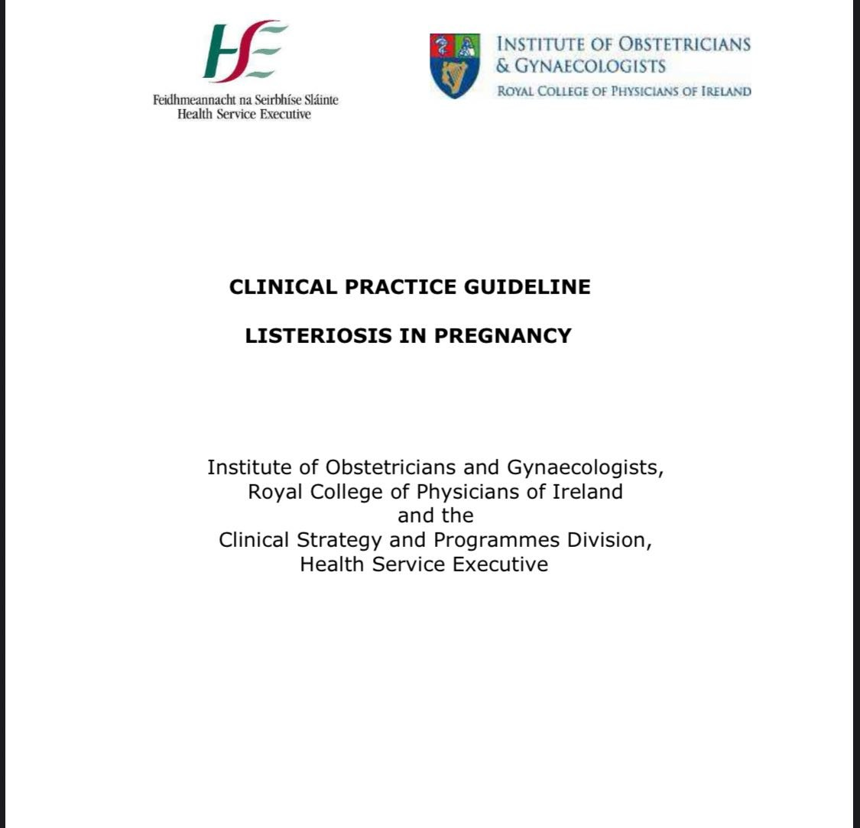
LISTERIA irish GL

Slide 61
KEY RECOMMENDATION
1. Listeriosis is mainly a foodborne infection. Pregnant women should avoid
eating food with a high risk of contamination with Listeria. This
information may be incorporated into formal antenatal education. Special
attention should be paid towards food handling, preparation and storage.
2. Pregnant women who are exposed to, or who develop symptoms of
Listeriosis should be assessed to determine if maternal and fetal
investigations are required.
3. No testing, including blood and stool cultures, or treatment is indicated for
an asymptomatic pregnant woman who reports consumption of a product

Slide 62
continue
that was recalled or implicated during an outbreak of listeria
contamination. An asymptomatic patient should be instructed to return if
she develops symptoms of Listeriosis within two months of eating therecalled or implicated product. There is no reason to alter or begin fetal
surveillance in asymptomatic women with known or presumptive exposure
to Listeria

Slide 63
continue
4 .There are no data to guide the management of an exposed, afebrile
pregnant woman with mild symptoms that do not strongly suggest
Listeriosis. Such a woman can be managed expectantly, alternatively,
such a woman could be tested with blood culture for Listeria, but if such a
course is elected, specific instruction should be given to the microbiology
laboratory and treatment only commenced if blood cultures yield Listeria.
A baseline fetal assessment may be performed and only continued if
cultures or symptoms dictate so

Slide 64
continue
5. If suspicion for Listeral infection is high, blood cultures should be
considered in any pregnant woman presenting with fever, especially if
accompanied by flu like or gastro intestinal symptoms. After obtaining
cultures, care providers should consider starting treatment. Initiating a
program of fetal surveillance seems prudent for women in whom
Listeriosis is diagnosed or strongly suspected because of exposure and
fever with or without other symptoms, although studies and data do not
exist to point to one best plan for such testing.

Slide 65
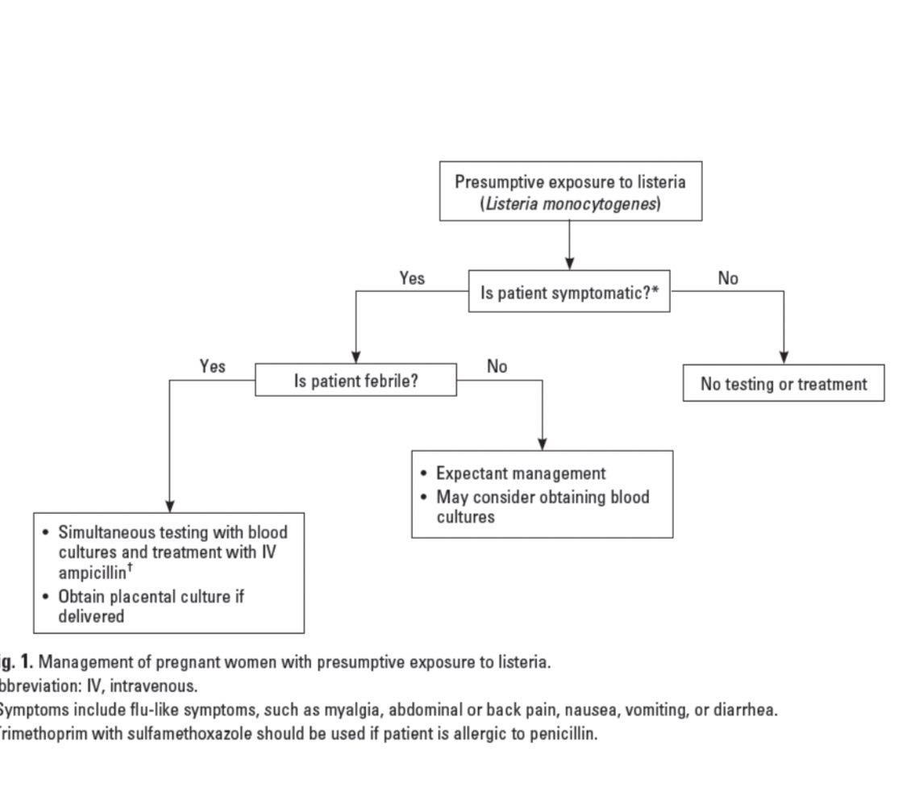

Slide 66
CMV
Epidemiology & Significance
“Congenital cytomegalovirus (cCMV) is the commonest infectious cause of neurodevelopmental impairment.
• Only 10–15% symptomatic at birth, but 8–18% of asymptomatic later develop SNHL.
• Half of infected newborns result from non‑primary maternal infection.

Slide 67
Maternal Infection & Serology
• Primary infection highest risk for severe fetal disease, especially first trimester.
• IgG– / IgM– → non‑immune; repeat in 4 weeks if exposed.
• IgG+ / IgM– → past infection; immune.
• IgM+ / IgG+ with low avidity (<30%) → infection within last 3 months.
• High avidity (>60%) → infection >3 months ago .

Slide 68
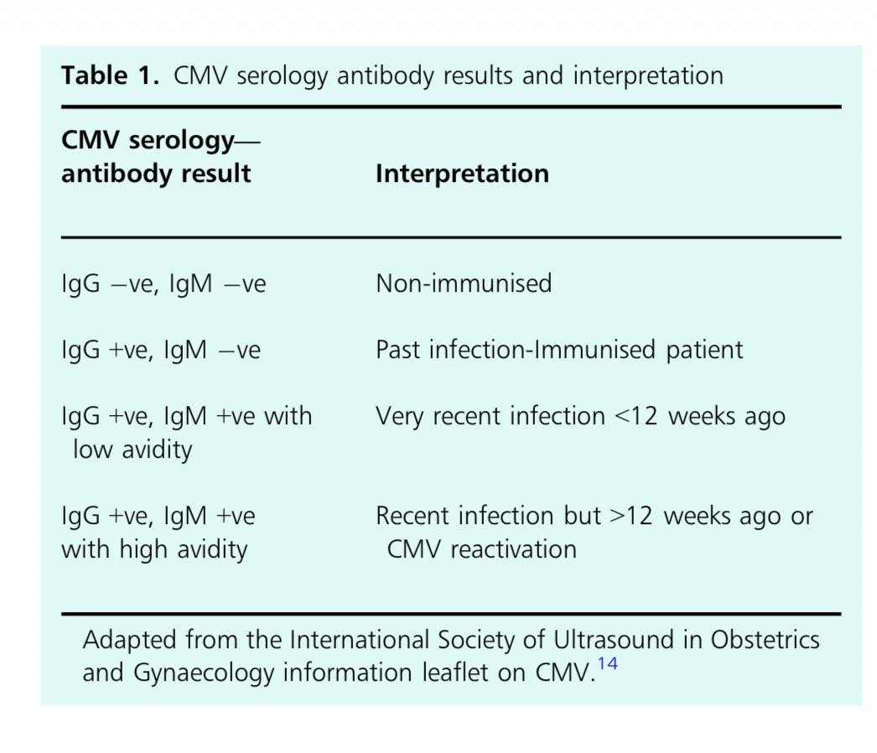

Slide 69
Vertical Transmission
• Transmission risk increases with gestation:
25–45% (1st trimester), 45% (2nd), 47–78% (3rd).
• But earlier infection = more severe fetal disease.

Slide 70
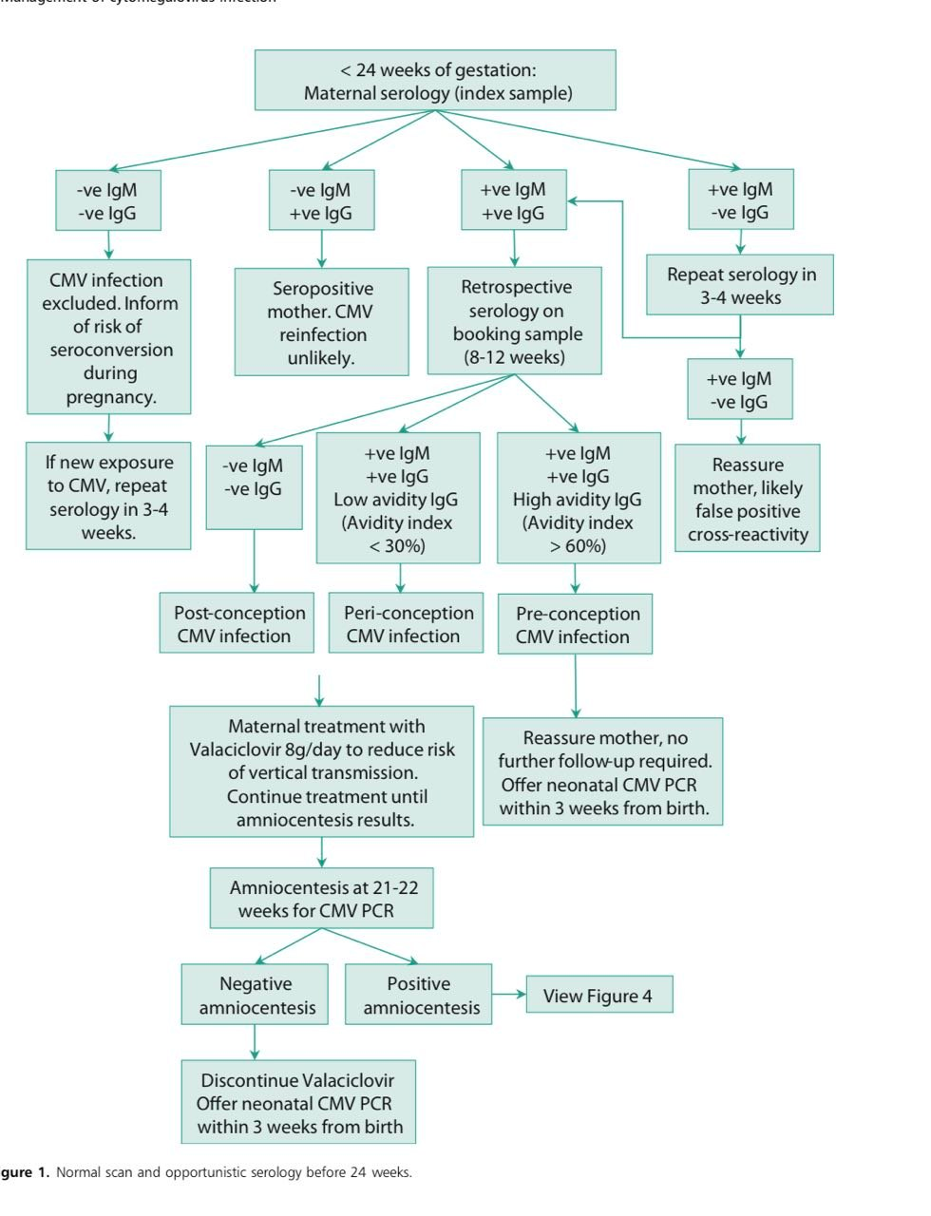

Slide 71
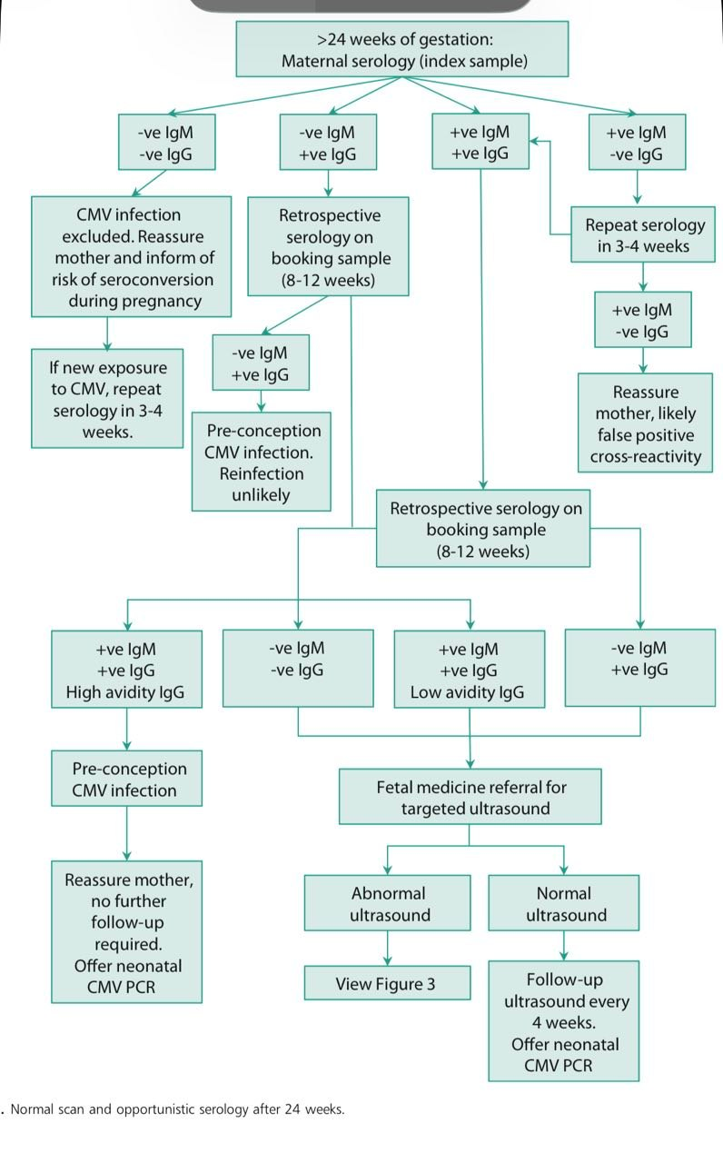

Slide 72
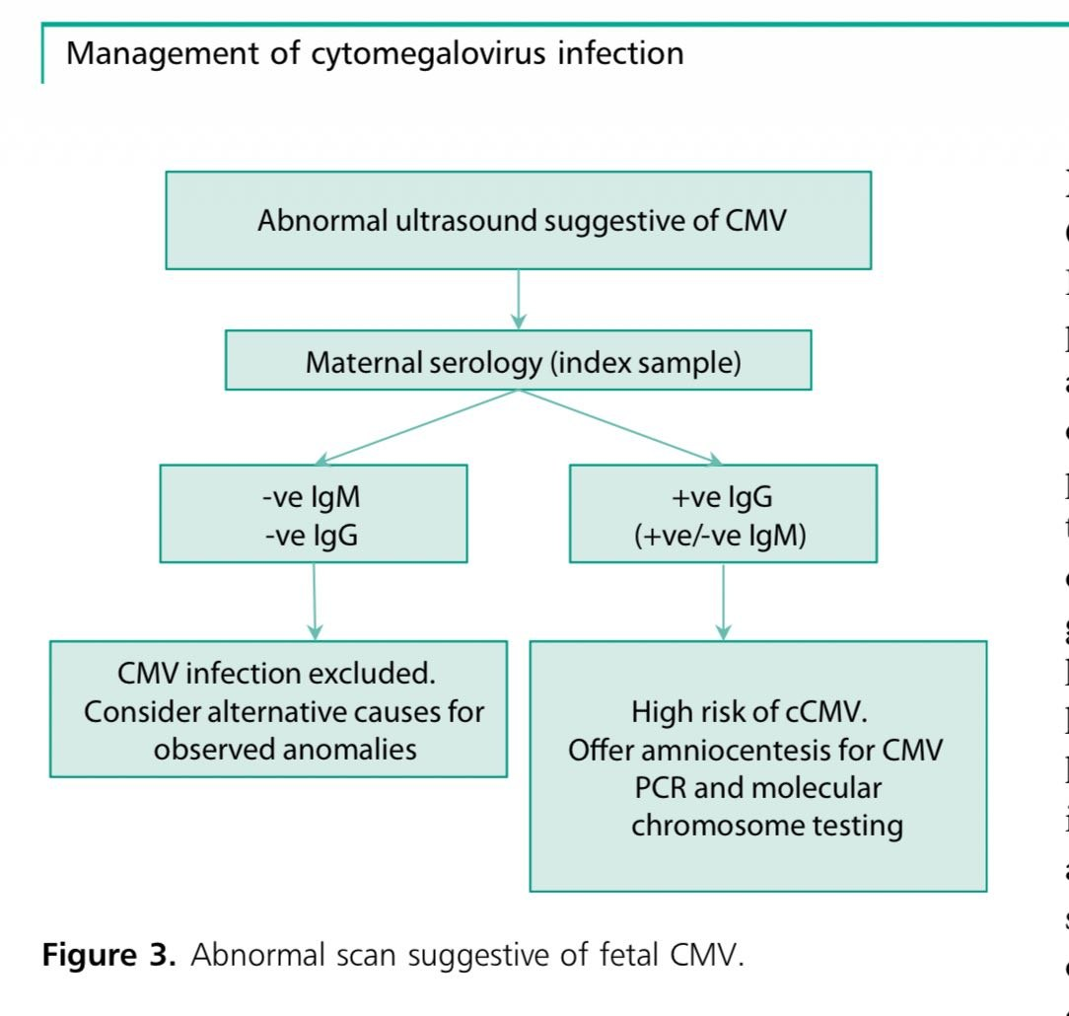

Slide 73
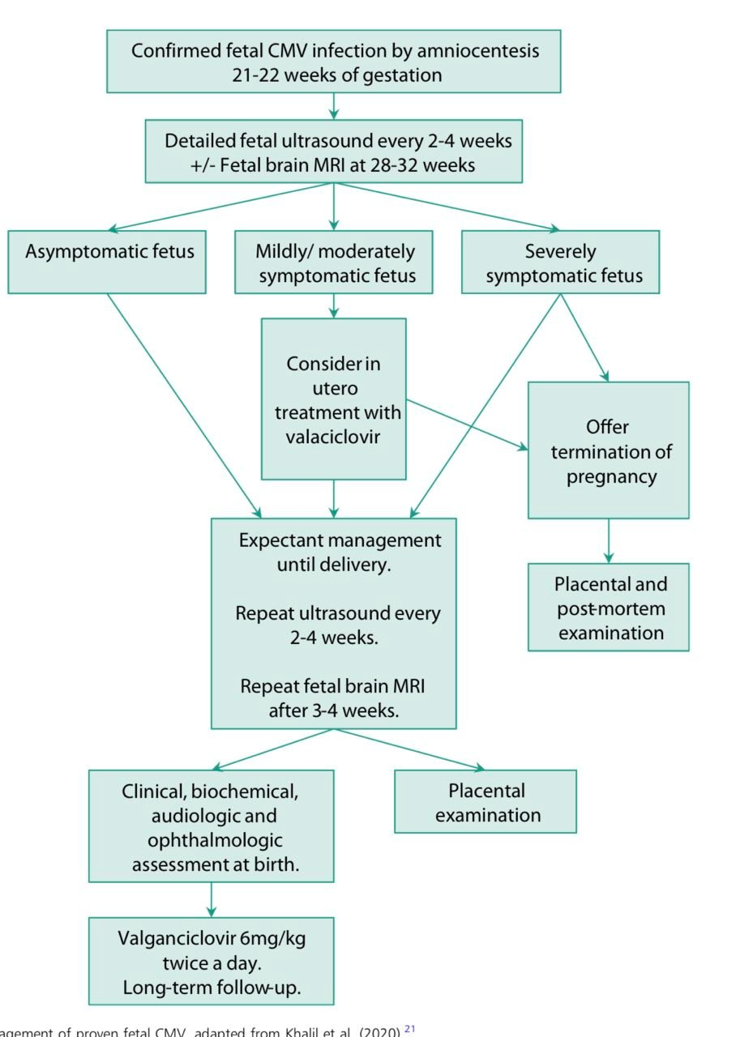

Slide 74
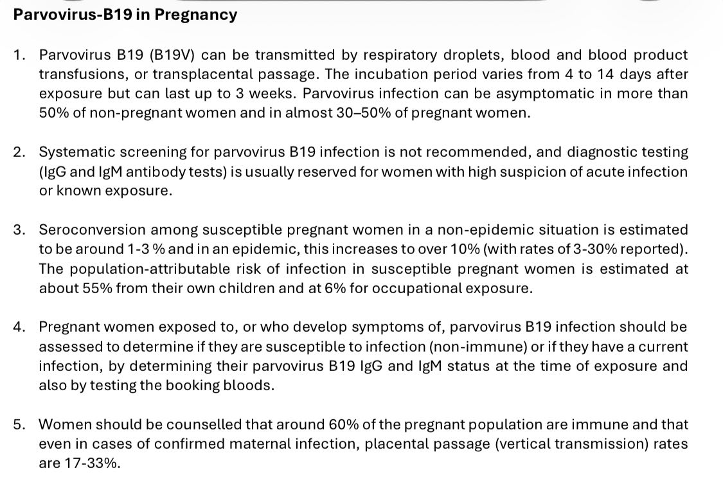
Irish GL Parvovirus-B19 in pregnancy

Slide 75
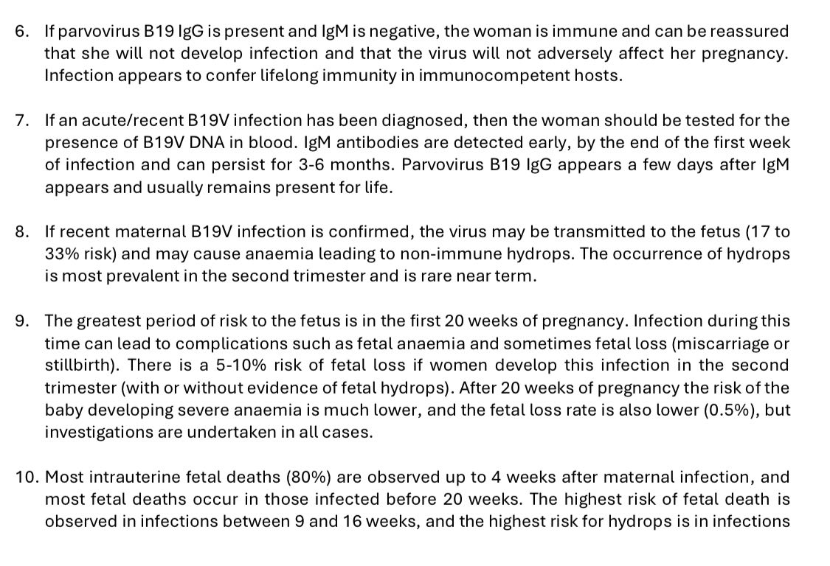
Continue recommendation

Slide 76
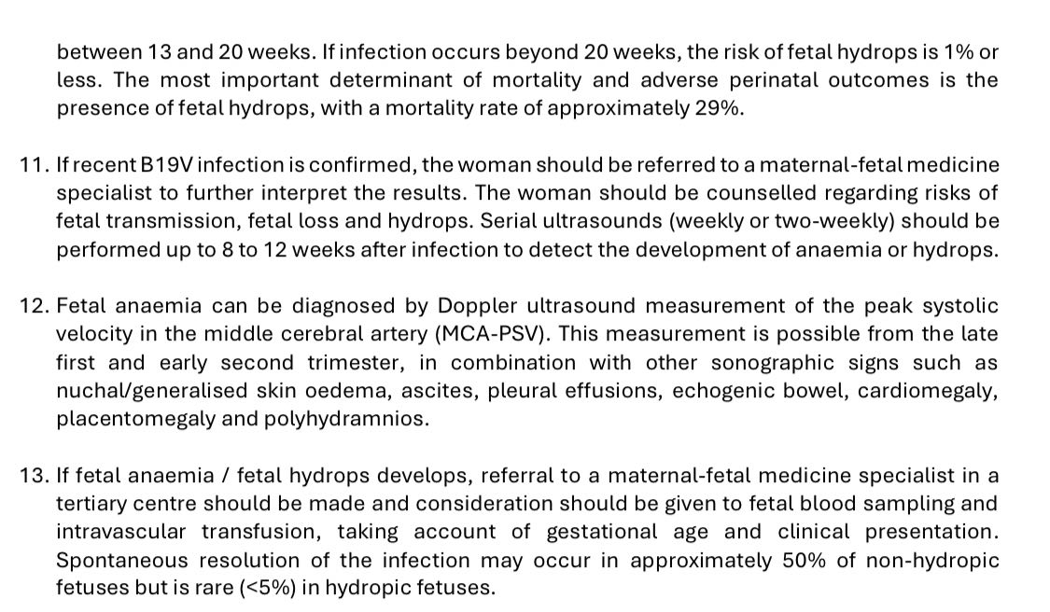
Contineuo

Slide 77
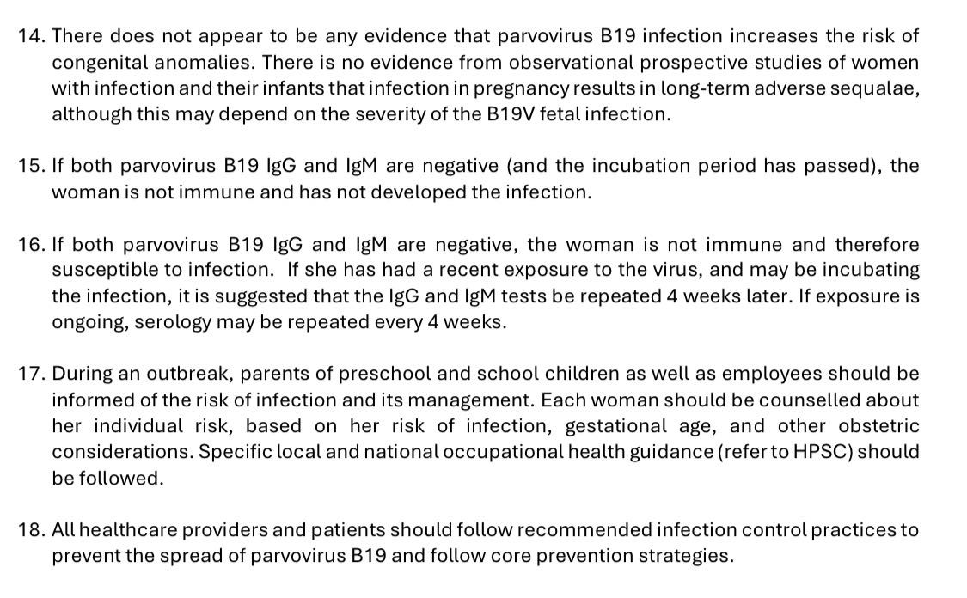

Slide 78
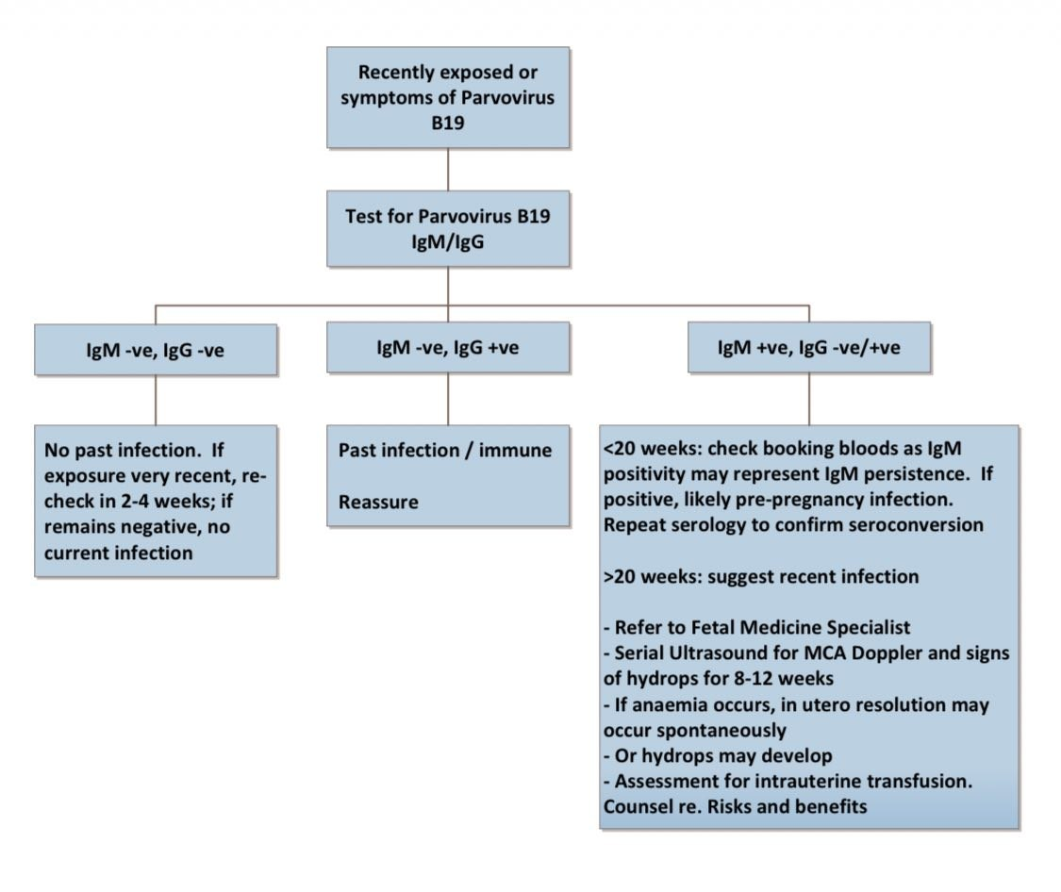
CONTINEUO

Slide 79
measles
the incubation period is typically around 10–12 days
the transmission mostly airborne by droplet spread or direct contact with nasal or throat secretions of infected persons.
Fever typically (generally >39°C) around the rash onset, and will gradually decrease after that.
The maculopapular rash generally starts on the face and behind the ears.
The number of lesions/spots generally increase in the first 2–3 days, and their distribution expands further to the face, trunk, and can sometimes be generalised.
Lesions can become confluent, particularly on the face and the trunk.
Barky cough.

Slide 80
The rash is red, blotchy, maculopapular (that is non‑vesicular), not itchy, and generally lasts for 3–7 days, fading gradually.
Koplik spots may appear around the time of the rash, sometimes one day before, and last for 2–3 days after the rash appears.
These are small spots with white or bluish‑white lesions, of about 2–3 mm in diameter, on an erythematous base on the buccal mucosa.
The most frequent complications include viral pneumonitis and otitis media, as well as diarrhoea.

Slide 81
Laboratory confirmed case of measles: a suspected case with evidence of laboratory confirmation of acute measles infection (that is measles IgM in blood or oral fluid (OF) in the absence of recent vaccination).
Treatment symptomatic treatmen

Slide 82
Measles in pregnancy
If a patient is not immune to measles and becomes infected during pregnancy, there is a risk of miscarriage, stillbirth, premature delivery, and low birth weight.
All infants should be considered susceptible before receiving their first dose of MMR.
Urgent IgG testing of contacts: when susceptibility cannot be assessed from history, management may be based on measles IgG testing.
Doctors caring for vulnerable groups should perform IgG testing as part of routine care so patients understand their risk and can be managed appropriately after exposure.

Slide 83
contineuo
If there is contact with an infected person and the woman is not immune, human normal immunoglobulin (HNIG) can be used.
HNIG is recommended for neonates born to mothers who develop a measles rash from 6 days before to 6 days after delivery.
For neonates and infants exposed to measles, HNIG is recommended up to and including 8 months of age.

Slide 84
Rubella
RNA virus
Acquired by respiratory droplet exposure
Symptoms:
fever, rash appears behind the ear at the start then spreads over the body, arthralgia, post‑auricular and sub‑occipital lymphadenopathy (only 50–75% of infected patients are symptomatic)
Incubation period 2–3 weeks

Slide 85
CONTINEUO
Vaccination:
results in long‑term (not lifelong) immunity in 95% of those vaccinated
Diagnosis:
clinical diagnosis unreliable. Need to demonstrate seroconversion in susceptible women (presence of rubella IgM in sample taken 3 weeks after contact).

Slide 86
Congenital rubella syndrome typically affects:
1. Eyes – cataract, retinopathy, glaucoma, micro‑ophthalmia
2. Heart – PDA, pulmonary valvular/artery stenosis, coarctation of aorta, VSD, ASD
3. Ear – bilateral progressive hearing loss; also IUGR and oligohydramnios

Slide 87
Universal vaccination
Universal screening in pregnancy – this is no longer offered in England.
Screening and vaccination of all women planning pregnancy
No evidence that vaccine is teratogenic; therefore TOP is not indicated if a pregnant woman is vaccinated
If fetal infection is suspected, fetal blood sampling and PCR may be used to confirm fetal infection
Offer TOP if infection occurs in the first trimester

Slide 88
Congenital rubella syndrome
Between 16–20 weeks: low chance of deafness
Between 11–16 weeks: 10–20% risk of CRS
Before 8–10 weeks: 90% risk of CRS and high likelihood of multiple defects
There are no effective treatments to prevent CRS
If rubella infection is diagnosed in pregnancy and gestation is >20 weeks:
• The woman can be reassured that there have been no reported cases of CRS after this gestational age
• If non‑immune, rubella immunization should not be given in pregnancy but may be given postpartum

Slide 89
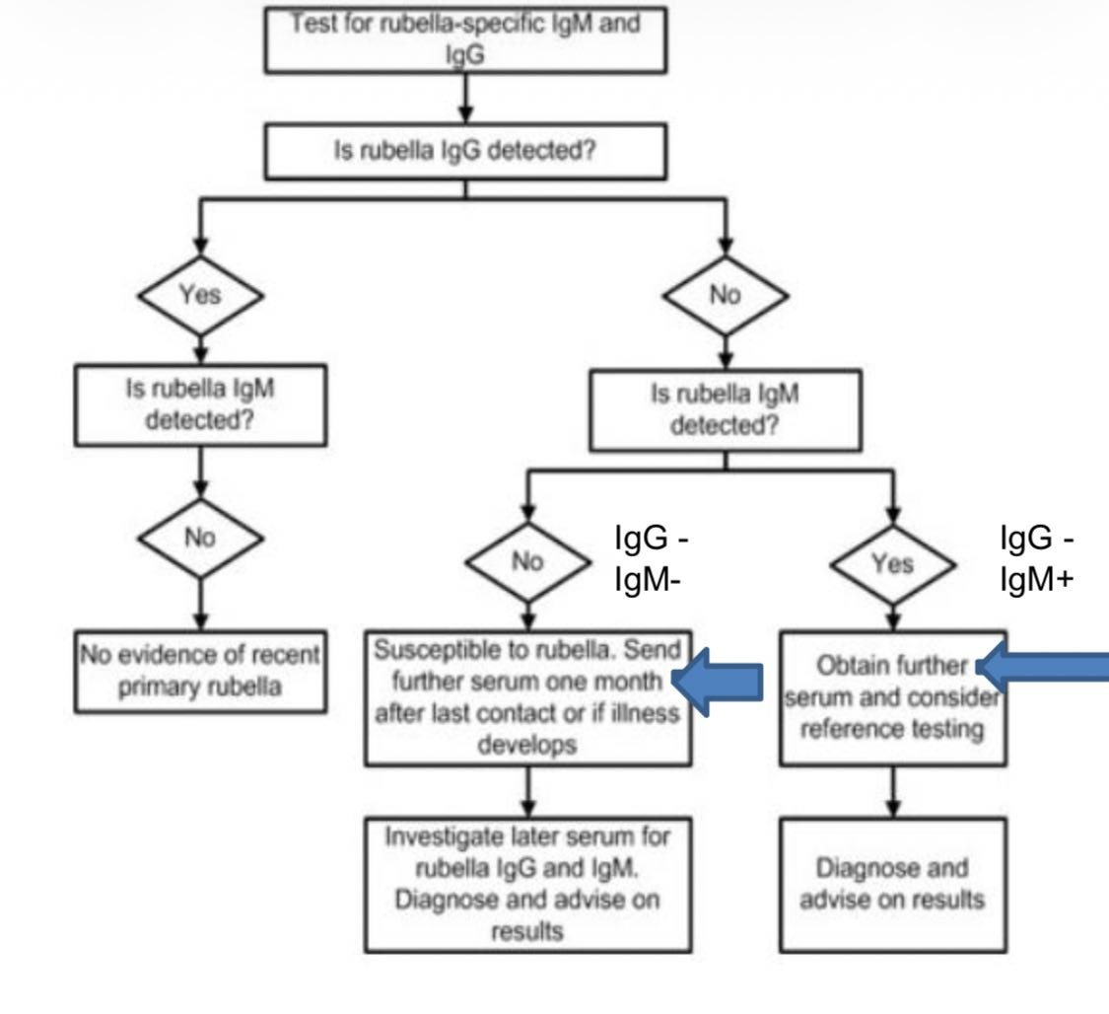

Slide 90
Toxoplasmosis
Transmission by oro-fecal route .
MTCT:
FIRST TRI:10%>>>>2ND TRI:25%>>>>THIRD TRI:85%
MOST FETUSE ASYMPTOMATIC

Slide 91
CONTINEUO
RISK TO CONGENITAL SEQUENCESE :
IS 85% IN FIRST TRI.
TOXOPLASMOSIS TRIAD :
1/INTRACEREBRAL CALCIFICATION
2/HYDROCEPHALUOSE
3/CHORIO-RETINITIS

Slide 92
MX
SPIRAMYCIN TO PREVENT CONGENITAL UNFECTION**
SULPHADIAZINE AND PYRIMETHAMINE IF CONGENITAL INFECTION CONFIRMED

Slide 93
THANK YOU
ANY QUESTIONS?????

